Slide 1
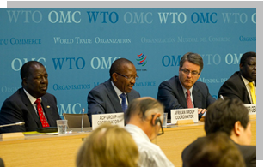









WTO Trade Facilitation Agreement Facility (TFAF)
TF- related information easily available
Provide technical assistance on TFA
Find donor support
Grant program
Launched 2014 by DG & African, ACP and LDC Groups
TFAF Donors:
Notes:
The WTO has a Trade Facilitation Agreement Facility to help developing and LDC WTO Members find the support they need to implement the new Trade Facilitation Agreement.
The Facility provides technical assistance, helps Members connect with donors, and aims to enhance donor cooperation and coordination.
It will also launch a grant program this autumn to assist with implementation.
The Facility has two websites – one is a one stop shop for all information relating to trade facilitation. The other is a database with statistics on the implementation status of all WTO Members

Slide 2
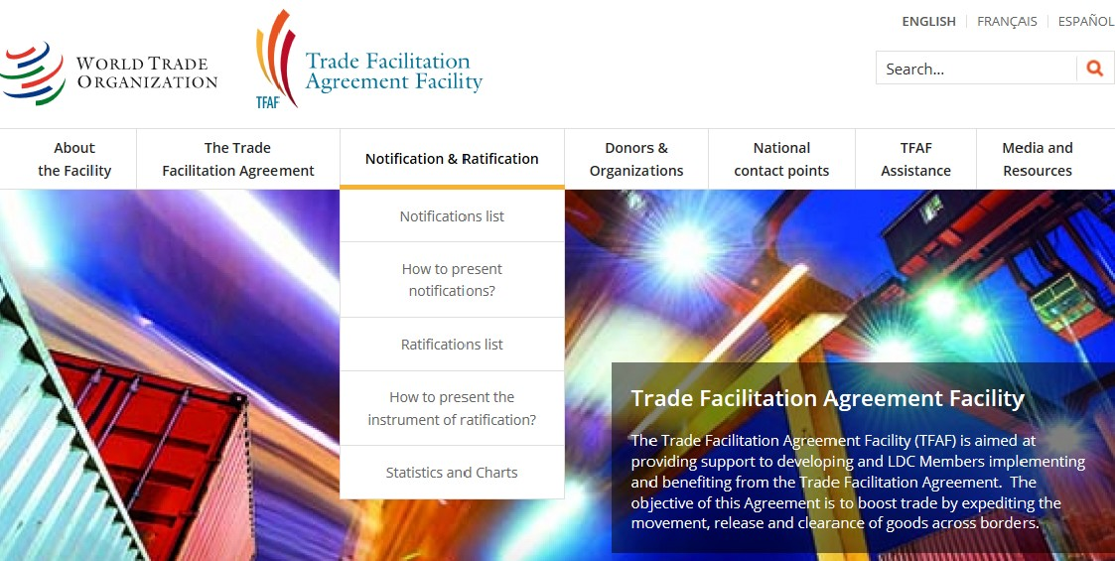
- info on the TFA
- info on notifications and ratifications
-donor information
- contact points of NTFCs
- standards, guidelines, case studies
TF news and events
info on WTO technical assistance
info on TFAF Grant program
- and more . . .
www.TFAFacility.org
Notes:
This slide will give you an idea of some of the information that is available on the Facility website. (the photo on the main page is currently different)
Of course it has information on the Agreement as well as implementation guidelines, standards and case studies.
It has contact information for national trade facilitation committees in most developing countries as well as information on technical assistance that has been provided.
The Facility can conduct direct matchmaking. But it also makes information available on donor programs so you can contact donors directly.

Slide 3
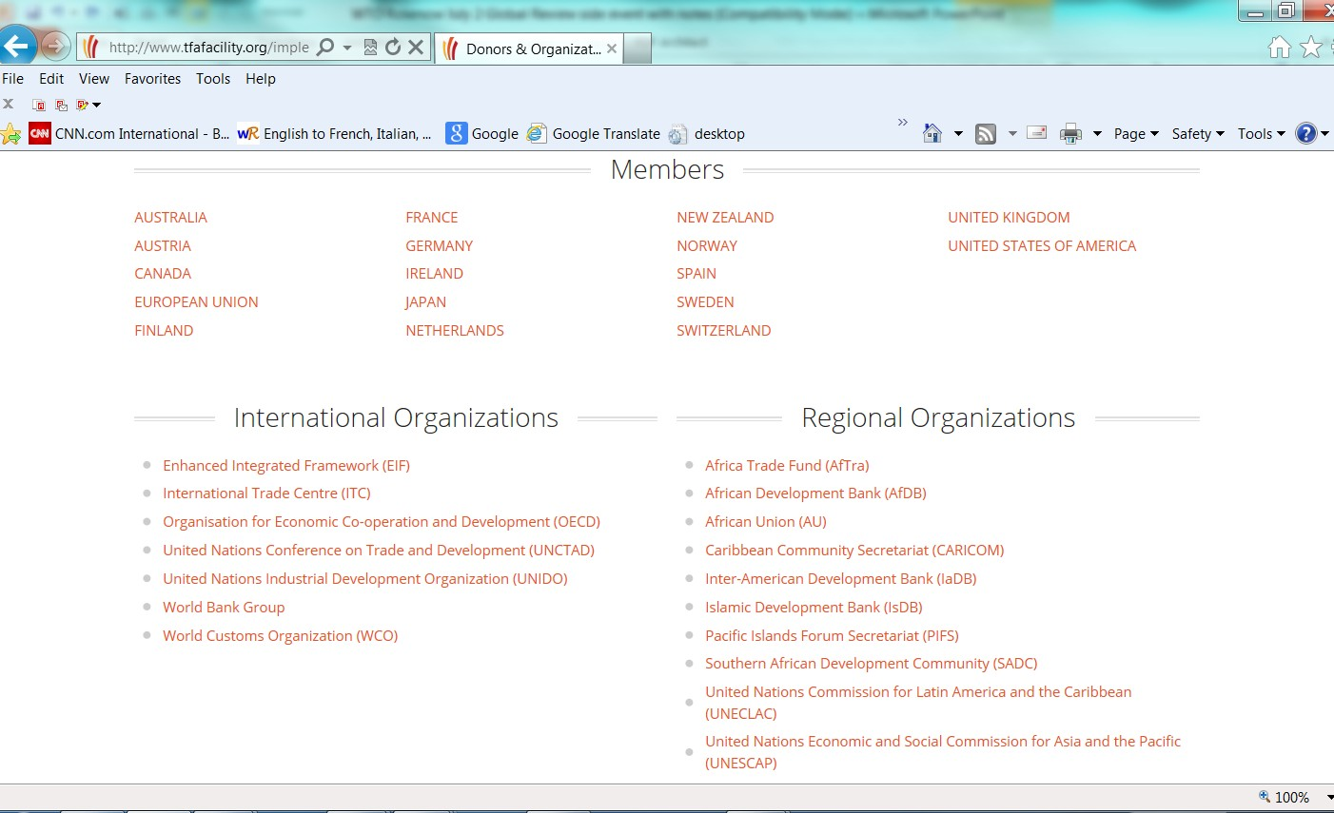

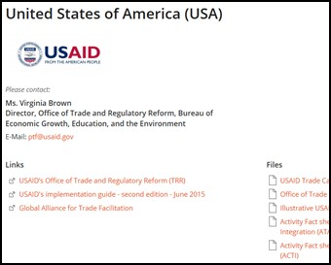
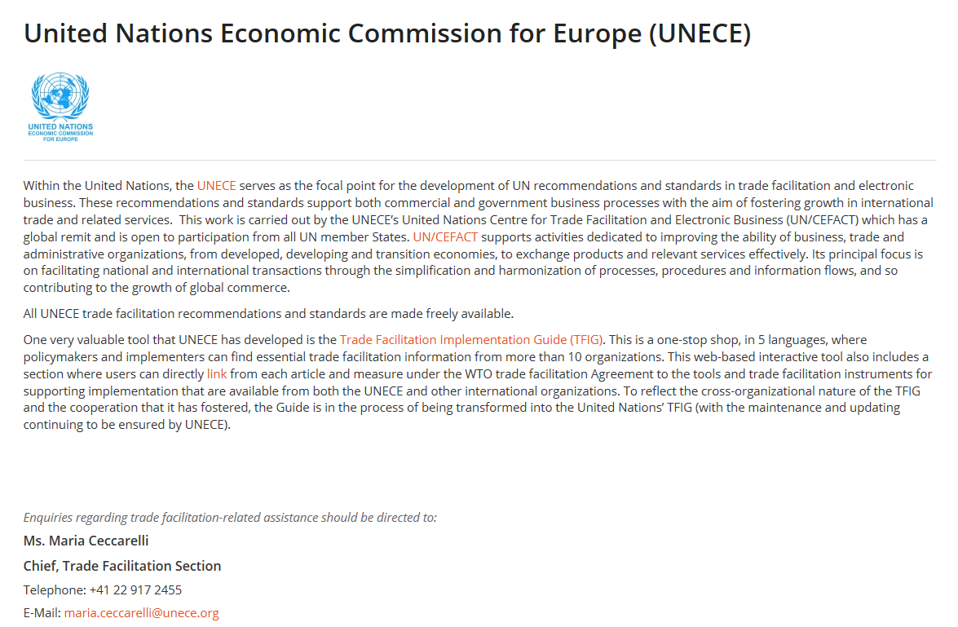
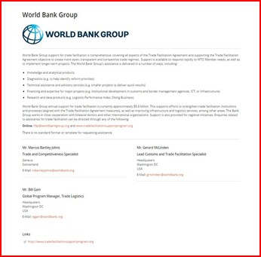
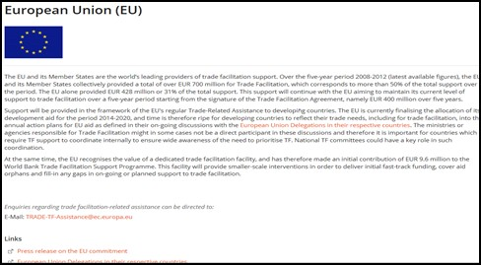
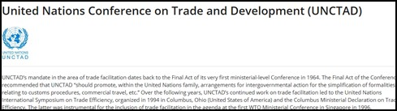
Donors and Organizations
Notes:
This slide shows the donor page as well as some cut-outs showing the type of information you can find on the assistance programs of donor members, international and regional organizations.

Slide 4

National workshops
Upon request, in the following areas:
needs assessment updates;
outstanding category A, B and C notifications;
support national trade facilitation committees;
workshops for Parliamentarians in countries that have not ratified;
general TF workshops (TFAF or ITTC).
Send email from Geneva mission to
TFAF@wto.org
Notes:
Upon request from Members the Facility provides technical assistance to help Members with the notifications required to take advantage of delayed implementation of the Agreement- the so called ABC notifications, implementation dates and technical assistance and capacity building support needs.
The Facility can also provide overviews of the TFA--- and address Parliamentarians in countries that have not yet ratified.
It can also work in collaboration with our partner organizations to assist the national committees that need help to get started.

Slide 5


Grants
  If can’t find assistance needed, the Facility will try to find donor
  Project preparation (max $30,000)
  Project implementation (max $200,000)
  After national ratification and submission of Category C notification
Notes:
This autumn the Facility will launch a grant program that will offer project preparation and project implementation grants.
These grants are intended to fill the gaps for members that cannot find the support they need from donors.
Full information on this program will be made available on the Facility website.

Slide 6
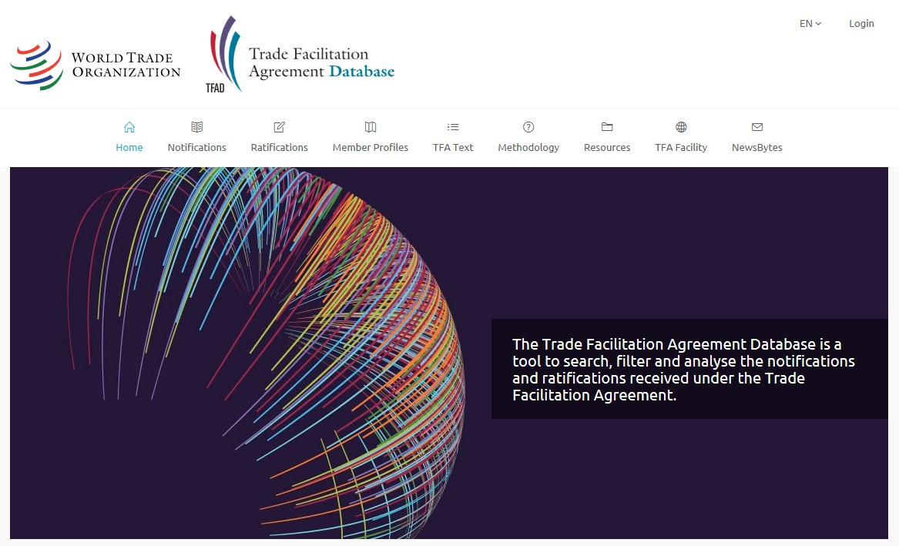
TFA Database
www.tfadatabase.org
Notes:
Another website that you will find very useful is the TFA Database. Here you can find statistics on all the trade facilitation notifications.
You can run different searches using different criteria. For example you can search notifications by country, by region, or by the TFA provision.
And you can export all the information to Excel
You can find the full information on ratification and notifications of every WTO Member.

Slide 7
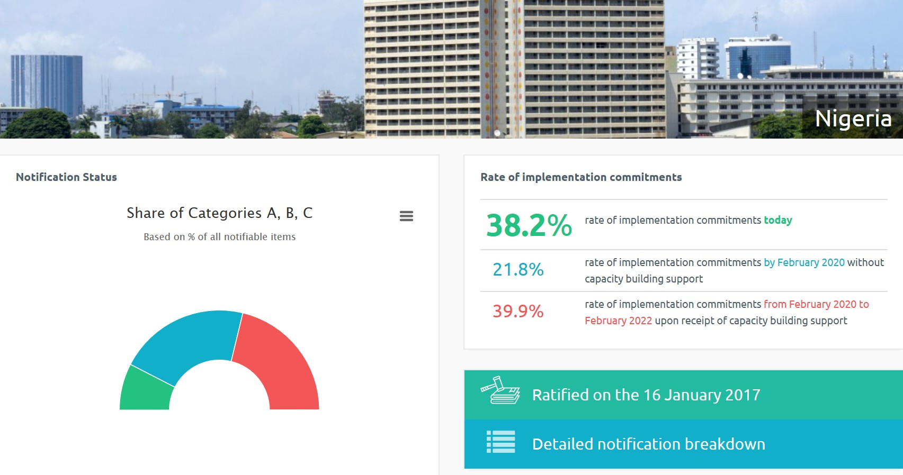
TF Database: Member Profile
Notes:
This slide shows you just part of the member profile on Nigeria. You can immediately see that Nigeria ratified the TFA in January 2017- and you can also see the breakdown of their category ABC notifications.
If you were to click on “detailed notification breakdown” you would find how Nigeria classified each provision of the TFA.
And more charts and information are available if you scroll down the page.

Slide 8

Thank you!
WTO Trade Facilitation Agreement Facility
www.TFAFacility.org
www.tfadatabase.org
TFAF@wto.org
Notes:
This is a quick introduction to the WTO TFA Facility.
If you want more information on the Facility – of course you can visit the website- and you can also ask your Geneva delegate to stop by the WTO to meet with the Facility team.

