Slide 1

Electronic Transit Permit Distribution
Obtaining Permits
Allocating Permits According to Legislation
E-Distribution
Notes:
With bilateral agreements Transit Permits are allocated accordingly as very well known;
Aim of ePermit System is to facilitate the sector’s one of the main challenges of the industry.

Slide 2

ePERMIT System
Customs
Customs
Host Country System
MoT U.NET
GEBOS
HAULIERS
Notes:
Host Country’s System allocates certain amount-series of ePermits to Home Country’s U.net System – U.net and U.net transmits the epermit data to GEBOS (Distribution Channel).
Then; Haulier’s data which the epermit is handed also trasmitted back to the Home Country’s U.Net System and here back to the Host Country’s System
Finally with a simple QR Code with a strong IT infrastructure the proposed ePermit promisses great facilitation to Hauliers as well as relevant Government Authorities.

Slide 3

ePERMIT System
Customs
Customs
GEBOS
PreDeclaration
HAULIERS
Notes:
Afterwards;
At the begining of the transport operation Haulier sends a pre-declaration to the ePermit System containing the itinary, goods, date and other necessary data
As explained in the previous slide, system supplies the QR Code confirming the ePermit; which is already allcated to the Home Country’s system

Slide 4

Global opportunity for secure border crossing and facilitation
PPP
Notes:
eTIR Pilot Project is an important step through Digitalisation of the TIR System

Slide 5
eTIR Pilot Project 1st Phase - Single Loading/Unloading limited COs
1 Customs Office in Each Country
1 Holder From Each Country
Single Load/Unload Customs Administrations
eTIR Pilot Project 2nd Phase - Multiple Loading/Unloading more COs involved
* 14 Customs Office in Turkey -9 Customs Offices in Iran
* Multiple Holders From Each Country
* Multiple Loading/Unloading COs from each country
* Data Amendment
Notes:
As you can see in the slide, first phase of the eTIR Pilot Project successfully completed by transports through single customs points from Turkey and Iran and single load/unload by the Holders. In the first step it was proven that eTIR is technically and practically possible in order to facilitate the TIR transports
When we stepped to the second phase; we have been practicing eTIR transports in a more realistic and rational practice. It is worth to note that the pilot Project second phase is finalized, but the transports continue due to the request of the Project partners, considering the facilitated application.

Slide 6
eGuarantees issued/activated
Between 24.11.2015 - 03.08.2017
TOTAL
180
TURKEY
146
Notes:
The figures of eTIR Carnets used during the pilot Project can be seen (approx 180 as of 06/08/2018)

Slide 7
Feedbacks
Carrier
Easy Order- User Friendly
Cost Saving (Time, Stationary, Workforce)
Less Redtape& Bureaucracy
Efficient Tracebility
Association
Less redtape and bureucracy
Efficient traceability and decreasing the risks
Decreased costs for stock Management
Less work load among HQ and Local Chambers
Customs
Efficient risk analysis and monitoring
Secure environment
Automatic pre-declaration
Time saving – no re-entering data
No Paper Handling Costs
Possibility of Monitoring all steps of the transport
Online Payment Mechanism – Added value
Notes:
Feedbacks from all partners are observed highly positive, by means of saving time& workforce, efficient risk analysis, etc

Slide 8
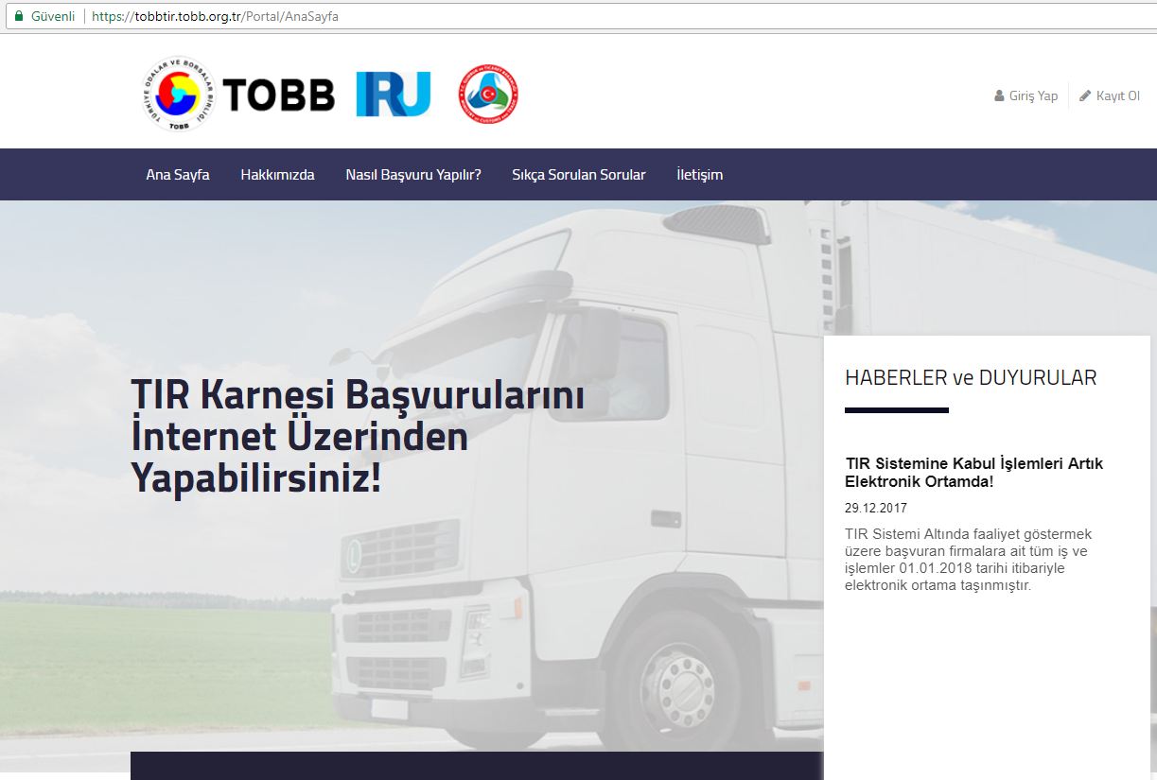
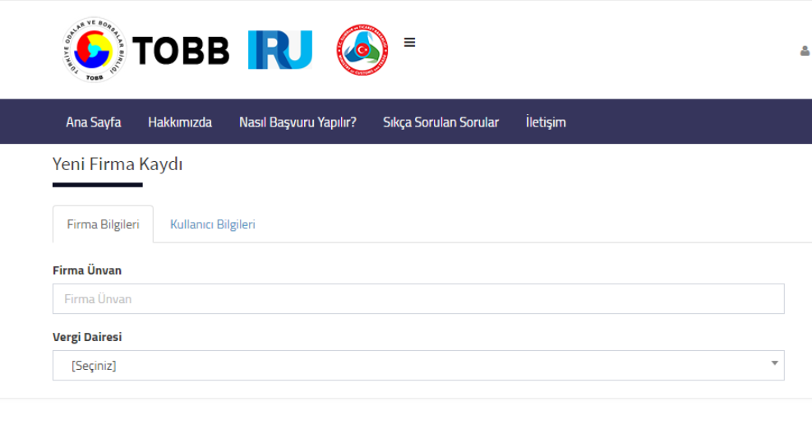
TOBB’s Added Value to the System
E-ADMISSION
Online Application to the TIR System

Slide 9
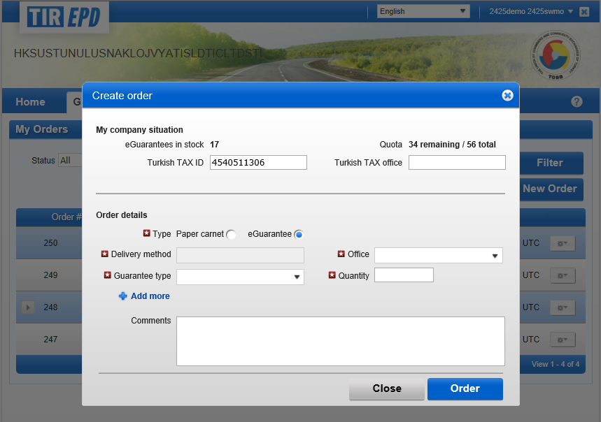
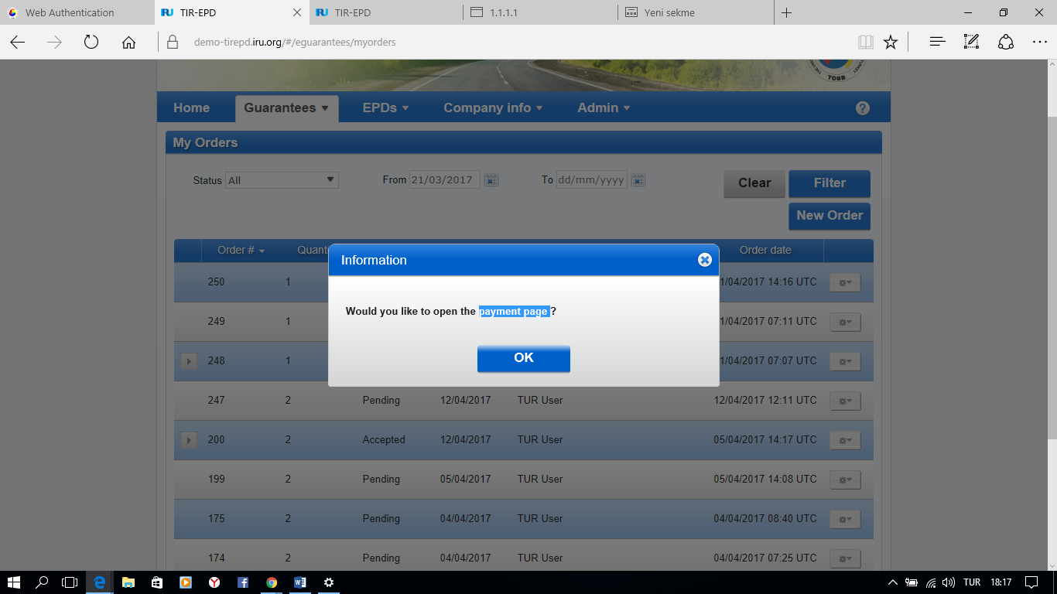
TOBB’s Added Value to the System:
E-Order / e-Payment
Notes:
While we have been working on this Project; our vision is also enhenced as we also developed a n online paymetn system which is connected to the IRU AskTIRWeb application. So that our Holders are able to order and issue eTIR ( and normal) Carnets electronically. (Paper carnets would also need to be collected physically)

Slide 10
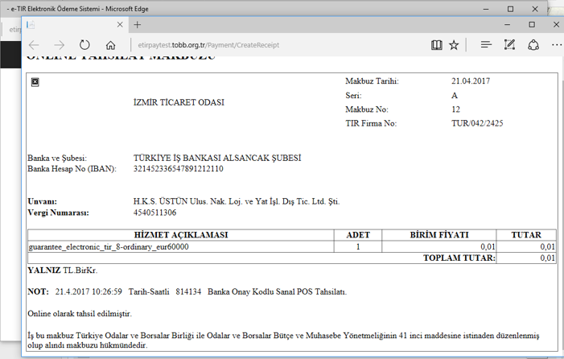
Notes:
You can see the screen shots of the payment system and a sample receipt

Slide 11
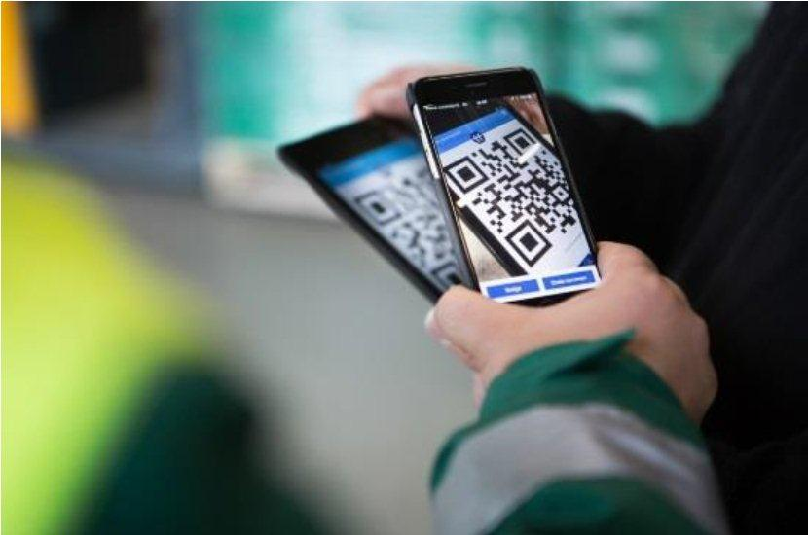
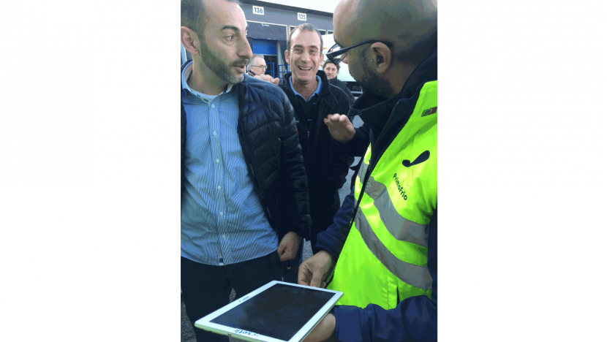
In addition…. E-CMR – ICTechnologies
  17 Countries ratified (including Turkey)
  Pilot Transports started
  Rapidly disseminating
  e-CMR Protocole adopted on 22 August 2017
Notes:
E-CMR is another Project that we are also following. This is also an important step to facilitate transports in less paperwork and in more electronical way.

Slide 12
THANK YOU
Union of Chambers and Commodity Exchanges of Turkey (TOBB)
Can ÖZKAYMAK
Expert
TIR and ATA Carnets Division
Phone : + 90 312 218 22 46
Fax : + 90 312 218 22 44
e-mail : can.ozkaymak@tobb.org.tr

