Slide 1
ESPRIT Easily diStributed Personal RapId Transit
John Birtwistle – Head of Policy, FirstGroup UK Bus
IRU Mobility as a Service Workshop 3 May 2017

Slide 2
WP1,WP7, WP8 Partners
(UK)
Public Transport Operator
8,6 Billion € Turnover
120 000 employees, UE & World
Market leader UK & US
(UK)
Transport Research Center
Leader WP8
(FR)
Public Transport Operator
Subsidiary of SNCF (70%)
5,6 Billion € Turnover
60 000 employees, UE & World
(ES)
City of L’Hospitalet de Llobregat
Barcelona urban area
Second city of Catalonia (248 150 inhabitants)
Highest population density in Spain
(UK)
Transport planning and infrastructure design services
Clients : Fairview New Homes, Arrow Estates, IKEA etc…
Leader WP1
(FR)
First French cooperative network of carsharing operators gathering 36 big cities including Lyon & Grenoble

Slide 3
WP1,WP7, WP8 Partners
LES PARTENAIRES : MODELISATION (WP7)
(DE)
Consulting Company
Specialised in mobility and transportation.
Expertise in setting carsharing services, business model
(IT)
Research Centre (7 departments , 8000 employees)
Modelling of traffic and operation
(FR)
Institute for Energetic Transition
Created by Movéo’TEC (Cluster gathering Renault/PSA/Valéo)
(UK)
Modelling of transports
Covering UK, UE & World
Leader WP7
(FR)
SME specialised in collaborative research project support
Project management
and dissemination

Slide 4
WP2to 6 Partners
(FR)
Coordinator
Leader WP3 (Kinematics and Dynamics Control)
Leader WP4 (Energy Control System)
(DE)
World Leader in Railway Couplings
5,7 Billion € Turnover
4500 employees
Leader WP2 & WP6
(UK)
SME, Design & Manufacturing of composite components for the auto industry
In charge of the Undercarriage
(FR)
SME, Electric Vehicle Manufacturer
Turnover 1,5M€, Fr, SP, PO
(IT)
SME, Design and Manufacturing of Battery Packs
Light Quadricycles supplier
(LUX)
Certifying Body
1,6 Billion € Turnover
1700 employees
(FR)
SME, Design Office
Leader WP5

Slide 5
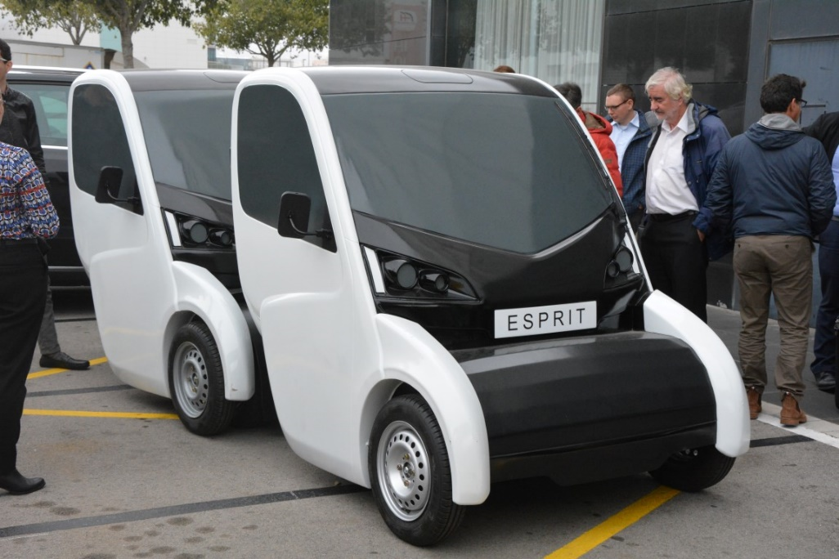
ELECTRA – demonstration project OPERATION
Bidding for additional funding for “live” demonstrations in various EU cities – submitted February 2017
Trial sites Glasgow (Hillington Park), Lisbon, Toulouse – 2 year live demonstration

