Slide 1
Joint Workshop Mobility-as-a-Service Implementing New Mobility Schemes: Impact on Business, Operations & Regulation May 3, 2017, Brussels Andreas Hoedl

Slide 2
Our service/our company: Taxi Dispatcher Fleet of Cars: About 2000 cars Availability: 24/7/365 a year Region: Vienna & Linz Fast: More than 90% of our customers gain a taxi within 5 min, via Callcenter & App

Slide 3
Offered services in MaaS Field
Taxi
Public transport
Carsharing
Bikesharing
Parking Facilities
Docking Stations
Wayfinder App &
WienMobil App

Slide 4
Wayfinder App &
WienMobil App
Targets of cooperation in MaaS Field:
Optimization of the fleet workload
Reduction of administrative costs
Implementation of individual mobility strategy
To minimize CO2 emission

Slide 5
Advantages/innovation for costumer:
Creating transparency
Increasing efficiency
Reducing barriers
Examples:
Possibility of personalization
One-stop-ticketing
Ticketing via mobile phone possible
Price estimation
Price evaluation regarding different service providers
Information/routing
Wayfinder App &
WienMobil App

Slide 6
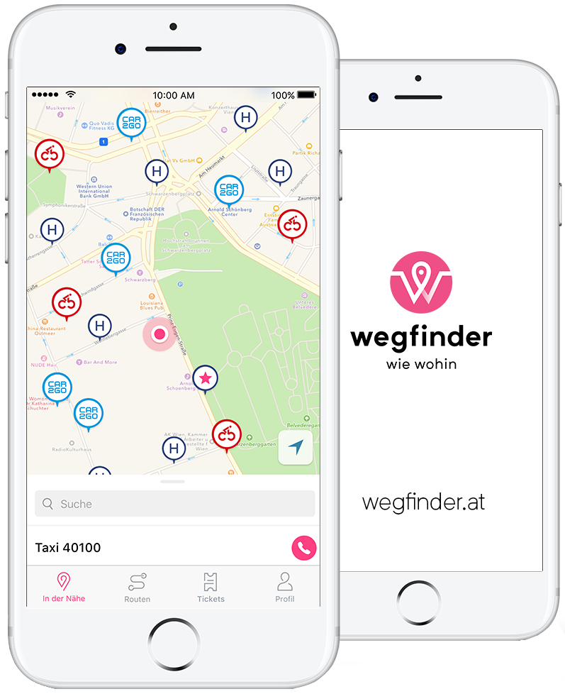
Partner:
Taxi 40100
Taxi 31300
Car2Go
DriveNow
Public Transport (e.g. Wiener Linien, OeBB)
CityBike
NextBike

Slide 7
Legal & Regulatory Challenges in Austria
cab trade vs. livery vehicle
cab trade: - mandatory tariff-plans for cab trade - no option to overrun nor to undercut - no flat pricing - no consistent method for one-stop ticketing possible
livery vehicle: - contract of services - flat price possible
mandatory tariff plan – includes
Basic rate
Time rate
Distance rate
Possible surcharges (e.g. for dispatching)

Slide 8
Thank you for listening!

