Slide 1
Technical Isues for Deployment of MaaS
Jukka Lintusaari

Slide 2
Mobile Ecosystem Fundamentals
Shared business architecture
Action Plan
(Interoperability &
Architecture Roadmapping)
Shared Vision & Use Cases
Shared technical architecture

Slide 3
GSM, GPRS and Umts interfaces
Major industry challenges for interoperability
PSTN
CN (Core Network)
Gi
Gp
PDN (Internet)
CN (Core Network)
GMSC
GGSN
80
70
C
Gc
60
IN/SCP
50
Yearly network test campaigns
for a single vendor
HLR/
AC
IN/SCP
40
Gn
30
D
Gr
20
CAP
MSC/
VLR
10
MSC/
VLR
Gs
SGSN
Ge
(CAP)
0
INAP
SSP
Q199
Q299
Q399
Q499
Q100
Q200
Q300
Q400
Q101
Q201
Q301
Q401
F
EIR
Gf
CN (Core Network)
RAN (Radio Access Network)
A
Iu-PS
BSC
P
C
U
Gb
Iu-CS
RNC
Iur
RNC
Abis
Iub
CS (Circuit Switch)
PS (Packet Switch)
BTS
BTS
Node B
Node B
Node B
Node B
Um
Uu
Notes:
Development of mobile communication over the last 10 years.
The picture shows:
the increasing number of open interfaces,
starting with GSM -> GPRS -> UMTS
the number of permutations for IOT
the tremendous effort, if each IOT must be completely negotiated from scratch.
GSM/GPRS diagram and example of test campaigns
Lets remind us that there are 14 interfaces, with a typical vendor performing 40 campaigns.
UMTS requires interoperability testing on up to 6 additional interfaces: the main focus has being on the Iu interfaces.
Example vendor was expected to perform more than 60 yearly test campaigns by the end of 2001
Backward compatibility
Product release management has to consider supporting N-1 this can increase campaigns by a factor of 2 !
With this effort all network vendors are confronted.

Slide 4




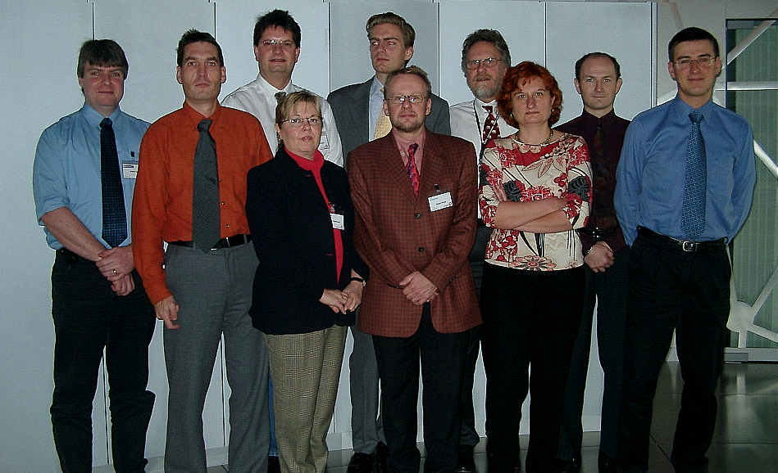

Active Companies in the NVIOT Forum
The NVIOT Forum
Notes:
The companies which founded the NVIOT-Forum at the beginning of 2000 are: Alcatel, Ericsson, Motorola, Nokia, Nortel, Lucent and Siemens.
All vendors are equal members of the IOT Forum.
The forum is informal, providing guidelines, not demanding any single vendor to perform IOT in a forum defined way.
We are committed to open interfaces and ready to perform IOT based on commercial standard versions with network vendors as required by customer cases for GPRS and WCDMA (3GPP rel99 and following releases)

Slide 5


MaaS Core Use Cases
Telecom Providers
Online
Booking Providers
Transport
Providers
Rail
Taxi
Bus
Car sharing
Ride hailing
Car
sharing
Car
renting
Bike
renting
Customers
CUSTOMER
My Mobility Integrator
My Mobility Platform
Payment Solution
Providers
Technology Solution
Providers
The company logos mentioned are only for descriptive purpose.
Based on Frost & Sullivan & Tekes & University of Tampere material
Travel chains

Slide 6

Four Core Processes
Customer
Offering
Booking
Monitoring
Settlement
Fully integrated in current transportation offering.

Slide 7
Transportation
Service Silos
Customer
Offering
Booking
Monitoring
Settlement
Customer
Train
Offering
Booking
Monitoring
Settlement
Customer
Bus
Offering
Booking
Monitoring
Settlement
… ... ... ...
Taxi

Slide 8
Service Layer Separation
Customer
Offering
Booking
Monitoring
Settlement
MaaS operator
Service provider

Slide 9
MaaS Subsystems and Actors
Customer
Offering
Booking
Monitoring
Settlement
Apps layer
Open API
Trip choice
Trip purchase
Customer comms
Invoicing
Open API
Open API
Open API
Open API
MaaS
Operator
Back-end
System
Open API
Trip formulation
Customer id and data collection
Re-routing (if required)
Settlement calc:
Penalties etc
Service offer:
- Choices (speed, price, QoS etc)
Service provider communication
Service provider payment
Open API
Open API
Issue travel docs
Open API
Open API
Open API
Open API
Service
Providers’
Systems
Product with attributes e.g.
Price
Route POIs
T&Cs
Trip confirmation
Re-routing
Payment reception
Capacity reservation
Timetable monitoring

Slide 10

Agreement by Leading Ecosystem Providers
Telecom Providers
Online
Booking Providers
Transport
Providers
Rail
Taxi
Bus
Customer
Car
sharing
Car
renting
Bike
renting
Customers
Offering
Booking
Monitoring
Settlement
CUSTOMER
Apps layer
Open API
My Mobility Integrator
Trip choice
Trip purchase
Customer comms
Invoicing
My Mobility Platform
MaaS
Operator
Back-end
System
Trip formulation
Customer id and data collection
Re-routing (if required)
Settlement calc:
Penalties etc
Service offer:
- Choices (speed, price, QoS etc)
Service provider communication
Service provider payment
Open API
Issue travel docs
Service
Providers’
Systems
Product with attributes e.g.
Price
Route POIs
T&Cs
Trip confirmation
Re-routing
Payment reception
Service
Provider
Payment Solution
Providers
Technology Solution
Providers
Capacity reservation
Timetable monitoring
The company logos mentioned are only for descriptive purpose.
Based on Frost & Sullivan & Tekes & University of Tampere material

Slide 11
User Perspective for
Current Mobility System Offering
MOBILITY OPTIONS AVAILABLE
USERS - Citizens, Entrprises
Logistics
Walk routes
Bike routes
Bus system
Taxi system
Private cars
Mobility Silo
Mobility Silo
Mobility Silo
Mobility Silo
Mobility Silo
Mobility Silo

Slide 12
Smart Mobility System Architecture
ENTERPRISES
CITIZENS
Security
Mobility Integration (eg MaaS)
MyData & Identity (payment)
Smart hub solutions & services (smart node bridging trunk lines with feeding lines)
Pedestrian solutions
City bikes
Shared cars
Demand driven transport
Automated public transport
Bus & tram system
Taxi system
Private cars
TRANSPORT CODE OF CONDUCT
Advanced city planning
Parking and park & ride strategy & solutions
3D High Density maps
E-mobility and charging strategy & solutions
Sensors & robotics
IoT solutions (eg gateways)
Logistics solutions
Urban data packages
Positioning solutions (urban location awareness)
Security
KEY ENABLERS (eg location, sensor & city data)

Slide 13
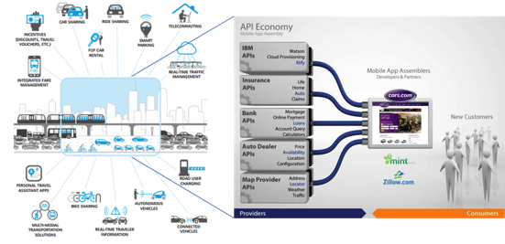
API Framework for Subfunctions
MaaS
Operator
Back-end
System
Service offer:
- Choices (speed, price, QoS etc)
Open API
Service
Providers’
Systems
Product with attributes e.g.
Price
Route POIs
T&Cs
http://dupress.com/wp-content/uploads/2012/12/Digital-Age-TRANSPORTATION.pdf
http://www.slideshare.net/Prolifics/api-economy-apimanagementcuomo2014v1

Slide 14

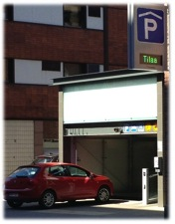
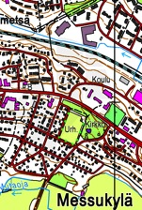
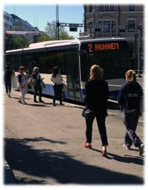
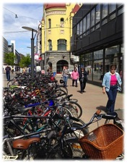
"In God we trust.
Everyone else bring data.”
Michael Bloomberg, Mayor of New York 2002 – 2013
ITS (MaaS) Data Sources
New data sources for innovative services and applications for the end users
Road Traffic
Parking
Geodata
Occupancy
Facility Information
Road network
Other traffic infrastructure
Street
addresses
Map data
POIs
Traffic Flow
Roadworks and Streetworks
Incidents and Accidents
Road Weather
Public Transport
Pedestrians
and Cyclists
Timetables
Stop Timetables
Bus Location
Route Planning
Cyclist &
Pedestrian
Traffic Flow
Route Planning

Slide 15
Telecom Providers
SMART INTEGRATED CITIES & COMMUNITIES
Online
Booking Providers
Customers
CUSTOMER
Transport
Providers
Mobility Integrator
Mobility Platform
SMART INTEGRATED MULTIMODAL TRAFFIC
Payment Solution
Providers
Technology Solution
Providers
SMART
VEHICLES
Joint Mobility Architecture
Joint Smart City Architecture
Single market
(Roaming & clearing)
Joint Master Architecture
System Interoperability
Open data

Slide 16
Conclusions
MaaS ecosystem is much more than just the App
Core use cases to be agreed and described
Core MaaS processes to be agreed (offering, booking, monitoring, settlement)
API management to be agreed
MaaS platform(s), what does it mean?
City-originated (transport) data is fundamental for MaaS success
Acquisition of business partners to MaaS WGs to define APIs / interfaces for 4 core processes
We are still in the learning phase: Dissemination, dissemination, dissemination

Slide 17
Jukka Lintusaari
+358 40 190 1332
jukka.lintusaari@staff.uta.fi

