Slide 1
EU policy objectives relating to a resource efficient, safe and environmentally friendly transport network
IRU Report Launch: the commercial vehicle of the future
DG CLIMA C4 - Road Transport Unit

Slide 2
Outline
Outline
Policy initiatives
CO₂ emission certification, monitoring & standards
Supporting regulatory steps
What technologies will the future bring?

Slide 3
Context
Low emission mobility strategy (July 2016): Transport, as a whole, should reduce its CO₂ emissions by at least 60% by 2050 compared to its 1990 level and be firmly on the path towards zero CO₂ emissions
2030 Climate and energy framework requires a 30% reduction in greenhouse gas (GHG) emissions in sectors outside of the EU Emissions Trading System (ETS) by 2030 compared to 2005
2014 Heavy Duty Vehicle (HDV) Strategy: HDV fuel consumption and CO₂ emissions to be measured and monitored to address some of the key market barriers by increasing market transparency and vehicle comparability
Notes:
Communication on a Strategy for reducing Heavy-Duty Vehicles' fuel consumption and CO2 emissions

Slide 4
EU28 Road transport emissions 1990 - 2014
Source: GHG Emission Inventory data 2016 http://www.eea.europa.eu/data-and-maps/data/data-viewers/greenhouse-gases-viewer
Notes:
HDV CO₂ emissions represent about 5% of total EU emissions (compared to a share of emissions from cars and vans of 14% in total EU emissions), about a quarter of road transport emissions and a fifth of all transport emissions. (GHG Emission Inventory data 2016)
HDV emissions have risen until the 2007 crisis in line with increased freight volumes in the EU. However, as road freight decreased by more than 10% in the five subsequent years, HDV CO₂ emissions followed a similar trend, remaining however (14%) above 1990 levels in 2014. In the case of transport as a whole, emissions rose by 13% between 1990 and 2014. Without action HDV CO₂ emissions are set to increase by up to 10% between 2015 and 2030. Given action already taken to curb cars and vans emissions, HDV CO₂ emissions are bound –particularly as regards lorries' emissions– to represent an increasing share of vehicles' emissions within road transport.

Slide 5
Scope and objective
CO₂ emissions from HDVs are not certified nor monitored and reported
Knowledge gap
Lack of transparency & → competitive pressure for uptake of most energy efficient technologies/vehicles
Notes:
Problem tree

Slide 6
Scope and objective
Certification legislation:
CO₂ emissions from new HDVs will have to be certified
VECTO simulation tool to calculate fuel consumption and CO₂ emissions from HDVs
Monitoring and reporting legislation:
certified CO₂ emissions & fuel consumption
from every new HDV registered in the EU
to be monitored and reported
Notes:
Three-step solution identified by the 2014 HDV Strategy

Slide 7
HDV CO₂ emission certification & monitoring
Monitoring necessary to complete certification → without monitoring, benefits of certification not fully attained
Monitoring legislative proposal to follow adoption of certification regulation
Certification regulation → likely first half 2017
Notes:
In the absence of proper EU-wide monitoring/reporting, some of the benefits of HDV CO2 emissions' certification cannot be attained as information on fuel consumption and CO2 emissions is not reported, although it is expected to be already available for new vehicles at the stage of vehicle production.
This initiative to monitor and report HDV fuel consumption and CO2 emissions is being prepared in tandem with the adaptation of type-approval legislation to certify new vehicles' fuel consumption and CO2 emissions. As both are closely linked, there are no other identified policy approaches to close the knowledge gap on HDV CO2 emissions and thereby improve market transparency: data to be monitored are those that would ensue from HDV certification as defined in the type-approval process, once it comes into force.

Slide 8
HDV CO2 emission standards
Proposal during this Commission's mandate
Date of regulatory application still tbd
More complex than CO2 standards for LDV:
17 vehicle classes, utility parameters, limited historical data,…
Analysis:
CO2 emission baseline
Technology improvements, cost & benefits
Notes:
Go to next slide to explain

Slide 9
Identification of vehicle class |  |  | Vehicle class | Allocation of mission profile and vehicle configuration |  |  |  |  |  |  | Standard body allocation
Axle configuration | Chassis configuration | Maximum GVW |  | Long haul | Long haul (EMS) | Regional delivery | Regional delivery (EMS) | Urban delivery | Municipal utility | Construction
4x2 | Rigid | >3.5 – 7.5 | (0)
 | Rigid (or tractor)* | 7.5 - 10 | 1 |  |  | R |  | R |  |  | B1
 | Rigid (or tractor)* | >10 - 12 | 2 | R+T1 |  | R |  | R |  |  | B2
 | Rigid (or tractor)* | >12 - 16 | 3 |  |  | R |  | R |  |  | B3
 | Rigid | >16 | 4 | R+T2 |  | R |  |  | R |  | B4
 | Tractor | 7.5 - 16 | 5 | T+ST | T+ST+T2 | T+ST | T+ST+T2
4x4 | Rigid | >16 | (6)
 | Rigid | >16 | (7)
 | Tractor | all weights | (8)
6x2 | Rigid | all weights | 9 | R+T2 | R+D+ST | R | R+D+ST |  | R |  | B5
 | Tractor | all weights | 10 | T+ST | T+ST+T2 | T+ST | T+ST+T2
6x4 | Rigid | all weights | 11 | R+T2 | R+D+ST | R | R+D+ST |  | R | R | B5
 | Tractor | all weights | 12 | T+ST | T+ST+T2 | T+ST | T+ST+T2 |  |  | R
6x6 | Rigid | all weights | (13)
 | Tractor | all weights | (14)
8x2 | Rigid | all weights | (15)
8x4 | Rigid | all weights | 16 |  |  |  |  |  |  | R
8x6 8x8 | Rigid | all weights | (17)
Initially: standard bodies & trailers, only vehicle standards
Final objective: consider real vehicle configuration, separate trailer standards

Slide 10
Energy efficiency of trucks
Directictive 96/53 as amended by Directiv 2015/719 on weights & dimensions of road vehicles in international traffic:
Retractable or foldable aerodynamic devices to the rear
New (elongated) cab profiles
are allowed, even if maximum length is exceeded
Certain type approval requirements:
Safety assessment (pedestrians/cyclists, collisions)
Improved aerodynamic performance
To be specified in Comitology under General Safety Regulation 661/2009 => vote in TCMV scheduled for end 2017
Notes:
Go to next slide to explain

Slide 11
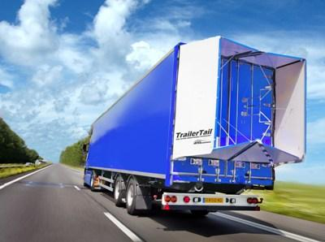
"Typical" European truck of the future (Copyright T&E)

Slide 12
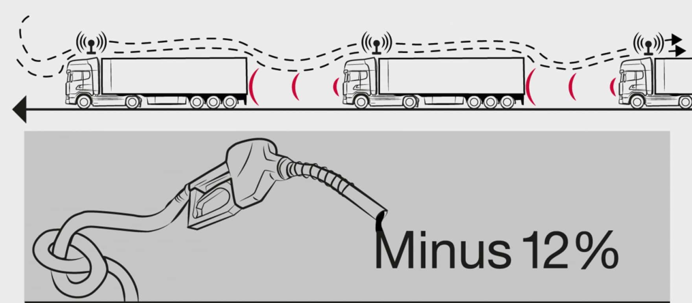
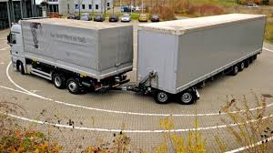
New forms of road transport
Platooning & autonomous driving: only the first and last truck experience large air drag forces.
Fuel savings up to 15% are discussed. Can improve safety and reduce traffic jams.
Mega & EMS trucks:
length > 18,75 m or
gross vehicle weight > 40 t.
Significant fuel savings, but issues with safety, infrastructure logistics and wear. Currently national registration possible in some Member States, future cross-border traffic to be decided on EU level.
Notes:
Go to next slide to explain

Slide 13
Towards carbon-free transport
Renewable fuels (bio & synthetic)
Hydrogen / fuel cells
Electrification
Prefer transport by railway where possible, adapt infrastructure & logistics
Notes:
Go to next slide to explain

Slide 14
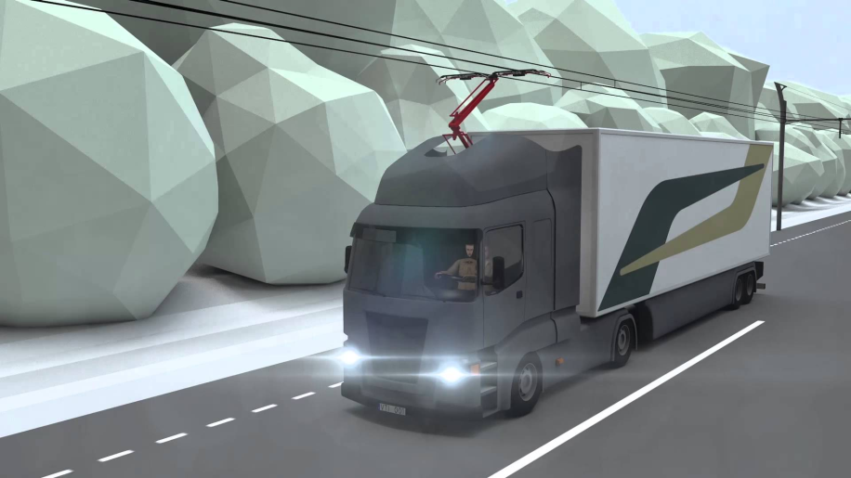
Towards carbon-free transport
Electrified roads: certain share of the road network to be equipped with overhead wiring (or inductive charging?), driving on the non-electrified parts with battery power or diesel/gas engines. Costs of 2 mio. €/km have been quoted.
Battery-electric trucks: currenty electric range up to 200 km, probably only suitable for urban and regional delivery and the smaller truck segments.
Notes:
Go to next slide to explain

Slide 15
Thank you for your attention!
DG CLIMA C4 - Road Transport Unit
HDV CO2 Emissions Team
Dimitrios SAVVIDIS: Dimitrios.savvidis@ec.europa.eu
Tiziana FRONGIA: Tiziana.frongia@ec.europa.eu
Nikolaus STEININGER: Nikolaus.steininger@ec.europa.eu

