Slide 1
The coach tourism business perspective on the seniors travel market
8th IRU European Bus and Coach Forum, Kortrijk,
17 October 2013
Jean-François Defour
Managing Director Voyages Léonard & Sales-Lentz

Slide 2
20%
+20.000

Slide 3
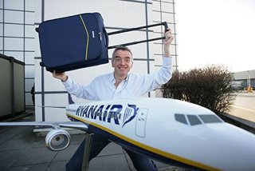
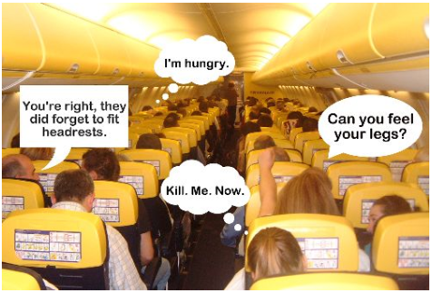

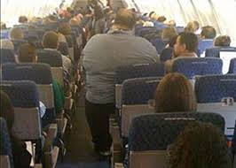

1. the low cost airlines

Slide 4
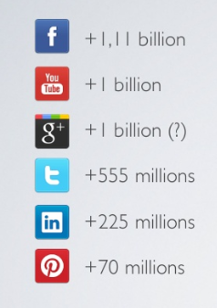
2. Social Media
55+
30,4%
65+
9,5%

Slide 5
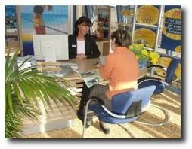
3. Travel Agencies
Agence
Internet
Moi-même
NSP

Slide 6
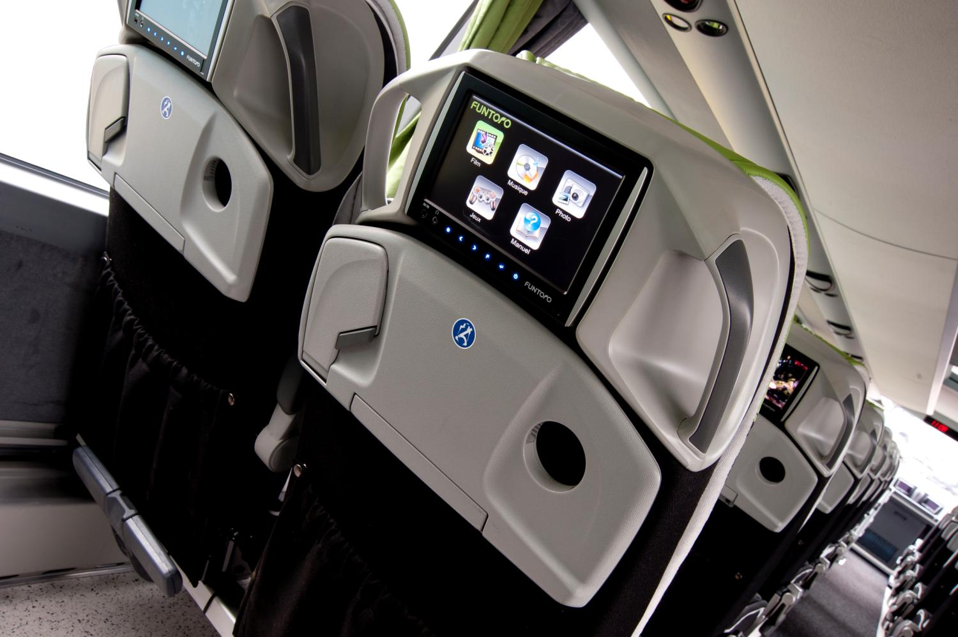
Thank you!

