Slide 1
Bus and coach transport for greening mobility
Contribution to the
European Bus and Coach Forum 2011
Huib van Essen, 20 October 2011

Slide 2
The great challenge of decarbonizing transport requires low-carbon technology and decoupling
Total CO₂ emissions
CO₂ emissions
of transport

Slide 3
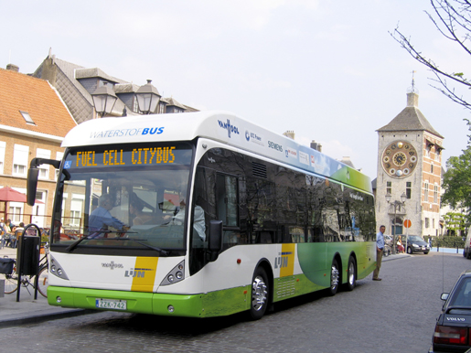
Environmental performance of transport modes: how to compare?
Types of impacts:
  Emissions: CO₂ (climate change), NO_{x}, PM (air quality)
  Other environmental impacts: noise, upstream emissions
  Other socio-economic impacts: accidents and congestion
Fair comparisons require:
  Well-to-wheel approach
  Real life emission factors
  Door-to-door
  Detour factors
  Realistic occupancy rates and empty driving

Slide 4
GHG emissions - short distance transport

Slide 5
GHG emissions - long distance transport

Slide 6
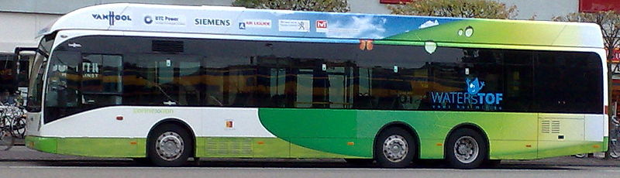
Comparison of modes and future trends
Occupancy rates decisive
CO₂ reduction for bus & coach:
  Short term limited, but coaches still among best-in-class
  Longer term options: fuel efficiency, low carbon energy, logistics
Air pollutant emission relatively high; will improve with Euro-VI
Competing modes improve their emission performance:
  Euro standards
  CO₂ standards for cars
  Decarbonization of electricity

Slide 7
White Paper on Transport 2011: objectives
60% GHG reduction in 2050 compared to 1990 (overall: 80-95%)
No conventional cars in urban areas in 2050; -/-50% in 2030
Passenger transport over medium distance (<1000 km) mainly by rail
40% sustainable low-carbon fuels for aviation in 2050
Road accident fatalities to zero in 2050
Full application of user/polluter pays principles (internalisation of external costs)

Slide 8
White Paper on Transport 2011: assessment
Modal shift is a target but not significant in impact assessment
Decoupling transport growth from GDP: not a target but assumed in impact assessment
Not much attention for bus and coach
No clear vision on their contribution to long-term objectives (in contrast to rail transport)

Slide 9
Potential of bus and coach transport for greening transport
Bus and particularly coach transport have important advantages:
Flexible modes of transport; door-to-door
Low external and infrastructure costs (2 to 4 times lower than cars per passenger)
Main challenges:
Many practical improvements, e.g. infrastructure, ticketing, marketing, ICT, service levels, etc.
Increase of load factors (particularly for public transport buses)
Further decarbonization required to stay among best-in-class
Not much attention from policy makers: no long-term vision

Slide 10
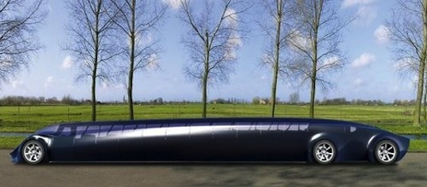
Elements of a policy framework
Generic instruments:
  Harmonized fuel and carbon taxes, ETS, road pricing
Stimulation of bus and coach transport:
  Infrastructure such as bus/coach lanes, P+R, terminals
  Opening of intercity coach markets
  Improving regulation regarding driving times and rest periods
  Harmonization of VAT rates across all modes
  Promotion of collective transport modes
Policy instruments aimed at passenger cars:
  Parking policies, congestion pricing and taxation
  Harmonization of speed policy (e.g. motorway speeds of 90-100 km/h)
  Car-free and environmental zones
Policies for improving the environmental performance of bus and coach

Slide 11
Main conclusions and recommendations
Coach:
  Lowest CO₂ emissions of all long distance modes (with E-trains)
  Competitive pollutant emissions
Public transport buses:
  CO₂ emissions lower than cars
  Relatively high pollutant emissions
Further decarbonization and emission reductions needed
Bus and coach have potential to contribute to White Paper targets
No clear vision on collective bus and coach transport in White Paper
Development of a clear ambitious realistic vision on the role of bus and coach in the future of transport Europe needed

Slide 12

Questions?

Slide 13
Pollutant (NO_{x}) emissions - short distance

Slide 14
Pollutant (NO_{x}) emissions - long distance

Slide 15
Options for decarbonizing buses and coaches
Improving energy efficiency of conventional vehicles:
Engine and transmission, including hybridization (city buses)
Aerodynamics and Rolling resistance of tyres
Eco-driving
Shift to alternative energy carriers:
Gas (LNG, CNG, Bio-gas)
Bio-fuels
Electricity
Hydrogen
Logistic optimizations (higher occupancy rates)

