Slide 1
Groups mean Business
A Charter for Successful Tourism

Slide 3
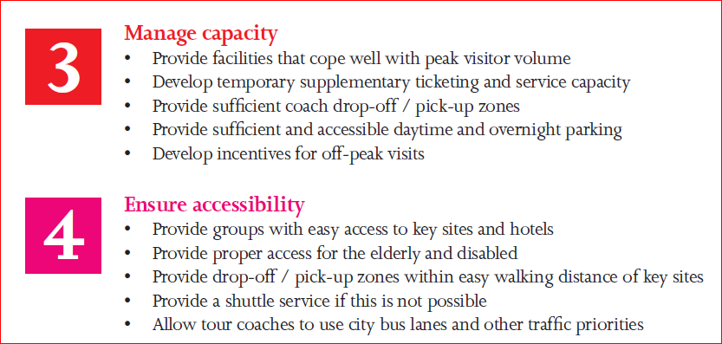

Slide 4
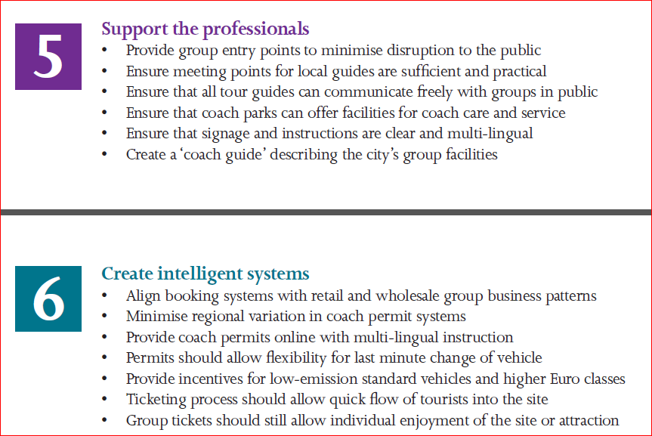

Slide 5
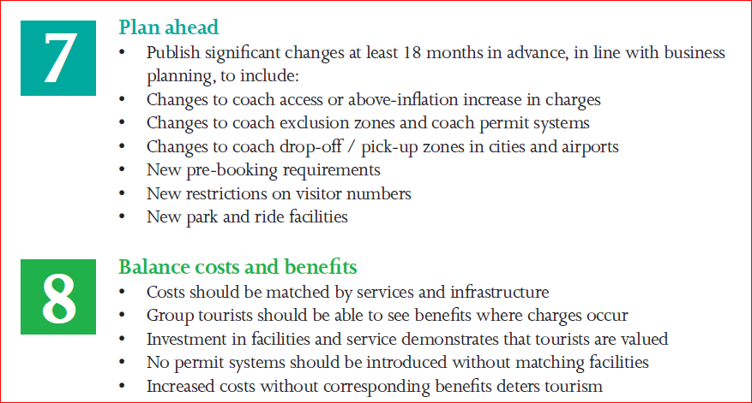

Slide 6
