Slide 1
8th IRU European
Forum
Kortrijk, 16 October 2013
Umberto de Pretto IRU Secretary General
Notes:
Moderator: juliette Ebélé

Slide 2
8th IRU European Bus & Coach Forum
IRU Bus & Coach Forums – 20 years of partnership with Busworld
Our partners & supporters today

Slide 3
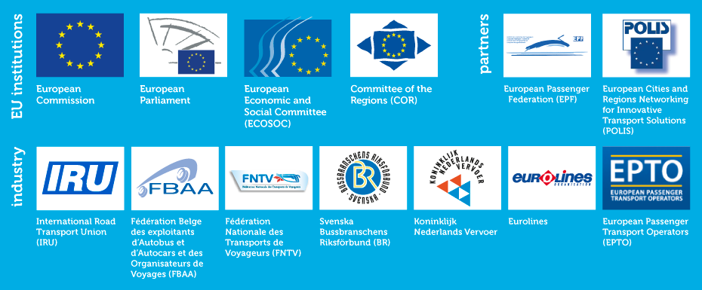
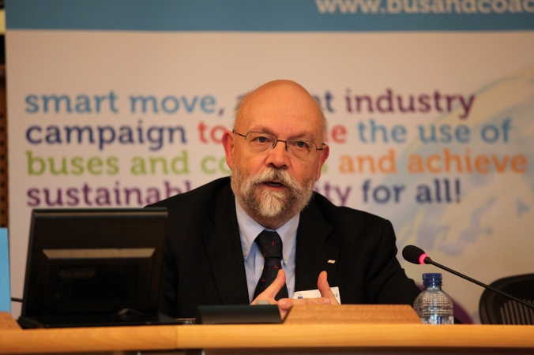
How can we achieve ‘doubling’?
EU Smart Move High Level Group (HLG) priority guidelines
Recognise buses, coaches & taxis as the most dynamic part of the collective transport chain
Establish the objective of ‘doubling’ as a formal EU policy and business objective
16 HLG recommendations proposed
Creation of a permanent EU Smart Move Citizens Mobility Forum

Slide 4
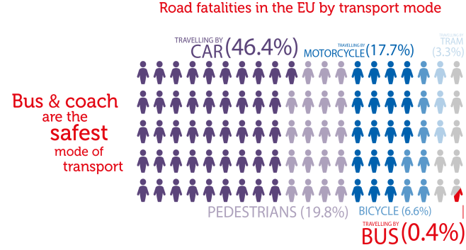
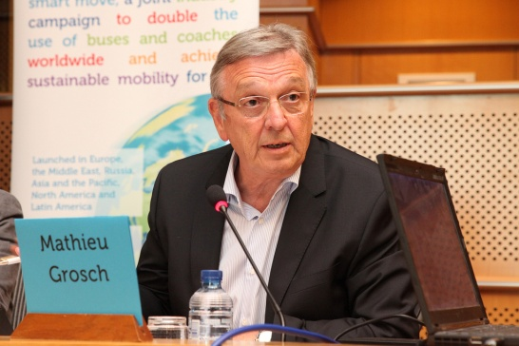
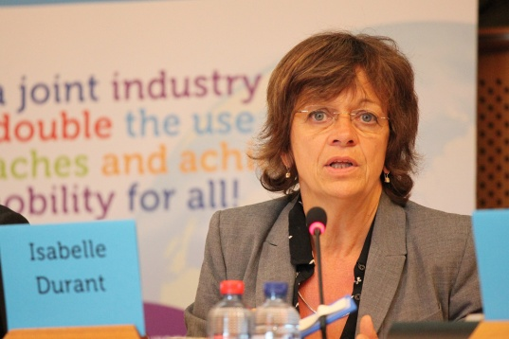
What are the benefits of ‘doubling’ in the EU?
1500 less road fatalities per year

Slide 5
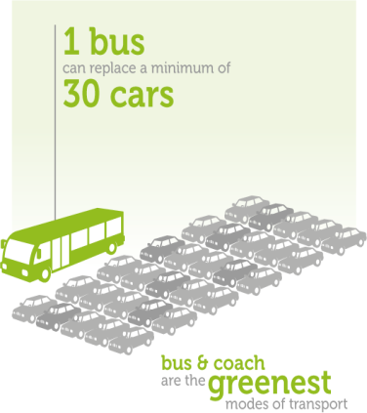
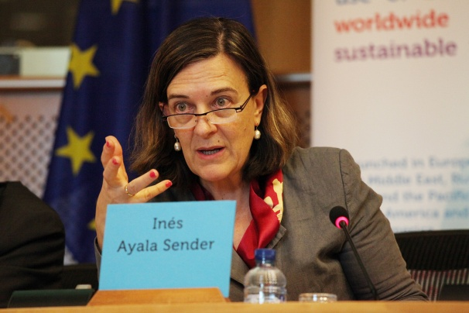
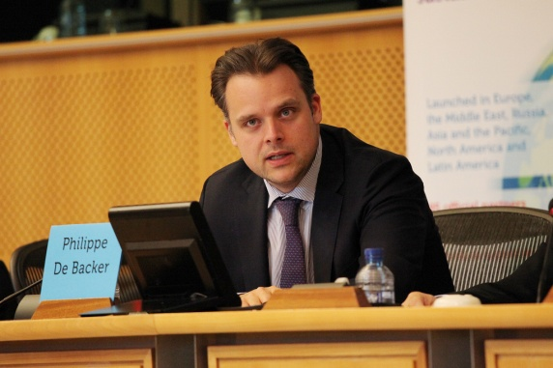
What are the benefits of ‘doubling’ in the EU?
40 – 50 million tonnes less CO₂ per year

Slide 6
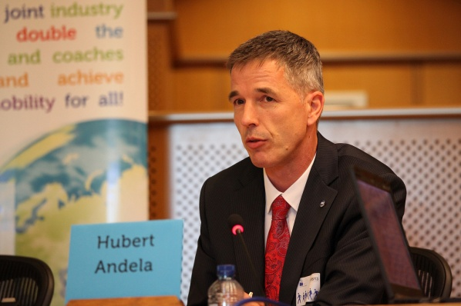
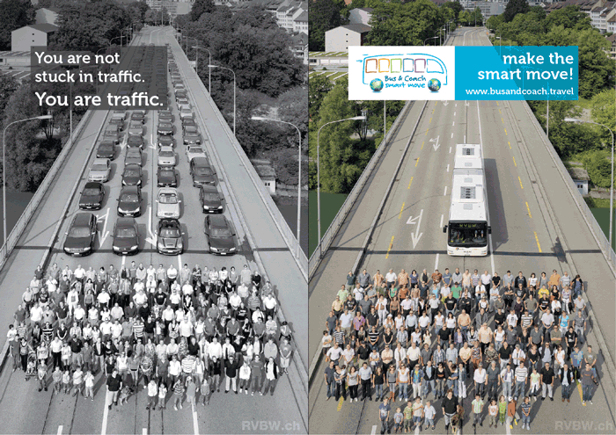
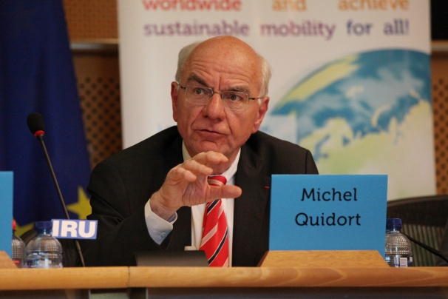
What are the benefits of ‘doubling’ in the EU?
10 -12 % less car traffic

Slide 7
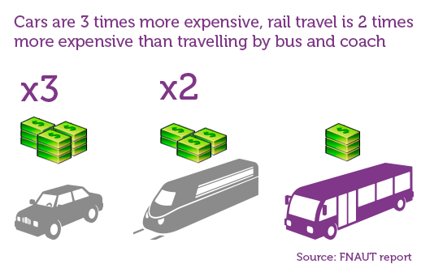
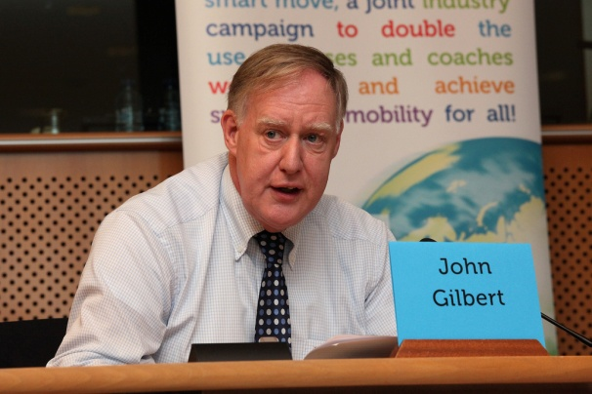
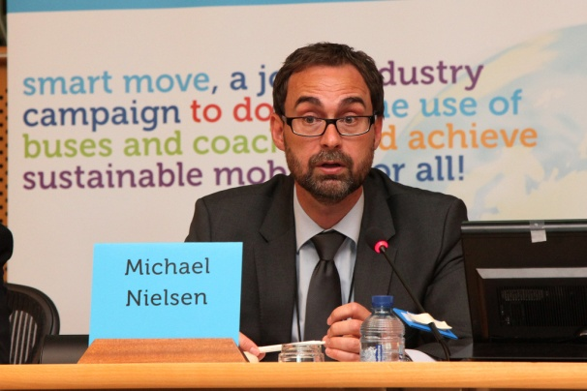
What are the benefits of ‘doubling’ in the EU?
3 million green, sustainable jobs at lowest cost to society

Slide 8
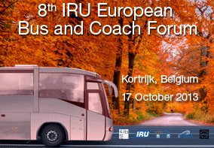
8th IRU European Bus & Coach Forum
Private bus and coach industry’s offer:
Work together to achieve ‘doubling’ by 2025
Identify obstacles and propose solutions for the social and out of season tourism markets

Slide 9
www.iru.org

