Slide 1
EC Draft Regulation on
Bus Passenger Rights

Slide 2
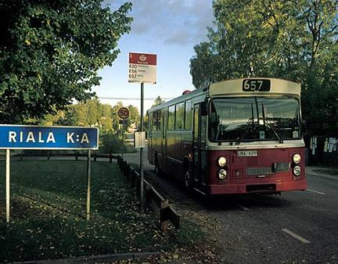
The aim of the Regulation
Compensation in case of
Death and Personal Injury

Slide 3
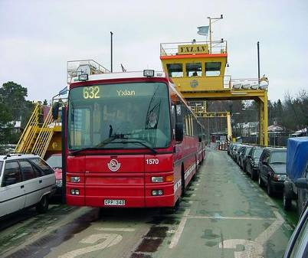
The aim of the Regulation
Assistance to PRM’s

Slide 4
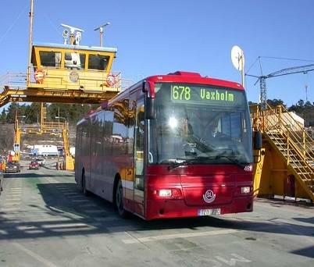
The aim of the Regulation
Assistance and possibly compensation to passengers in general

Slide 5
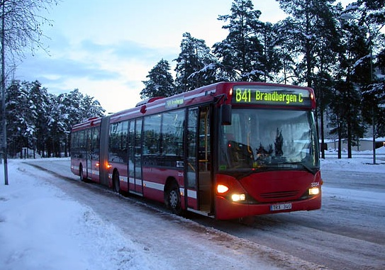
The aim of the Presidency
— Balanced solution

Slide 6
The aim of the Presidency
— Balanced solution
— Workable solution

Slide 7
The aim of the Presidency
— Balanced solution
— Workable solution
— Solid basis for further discussions with EP

