Slide 1
ECOeffect roll-out – Croatia
Vilnius, 17 September 2013
Zvijezdana Samardzic General Manager

Slide 2
About ORYX Grupa
ORYX Grupa specializes in providing the following services:
Roadside and Sea Assistance Driver Education Short- and Long-Term Loans
for Vehicles and Boats
Technical Inspection of All Vehicles Safe and Economical Driving Vehicle, Boat and Property Insurance,
Trainings and Event Organization as well as Life and Health Insurance

Slide 3
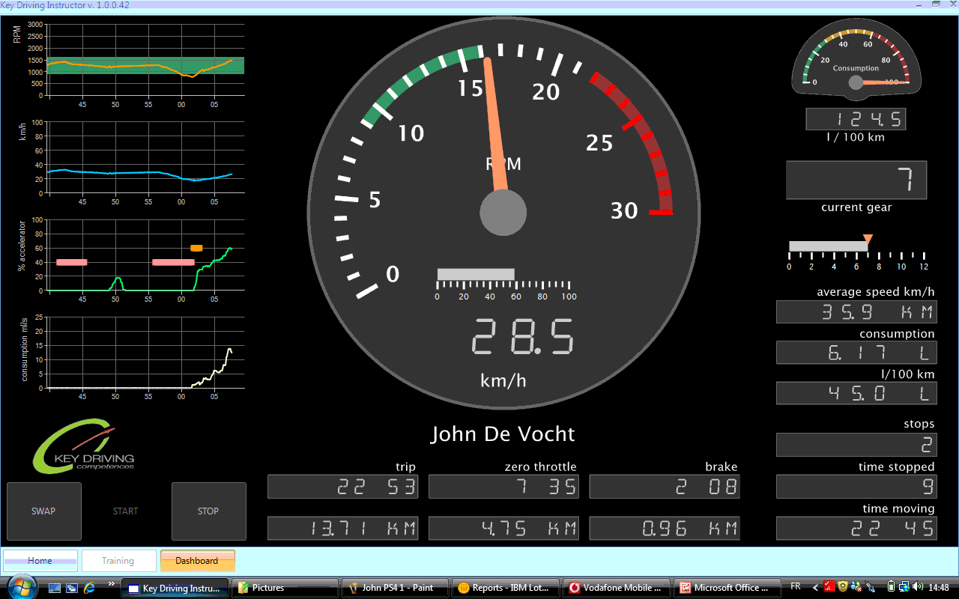
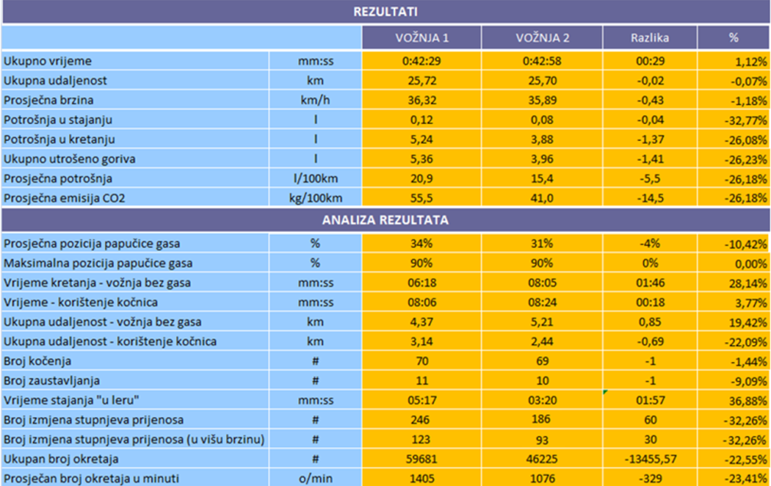
ECOeffect
ORYX is an IRU Academy Accredited Training Institute:
Our trainers were trained by Key Driving Competences’ trainers in November 2012
We use EETS for eco-driving Training

Slide 4
ECOeffect Focus
The driver

Slide 5
ECOeffect
Savings:
Fuel consumption
Mechanical wear (brakes, clutch, gear box, engine, tires, oil, suspension, spare parts…)
Traffic accidents and insurance
CO₂ and noise pollution
Image improvement:
Company positioning as an environmentally-friendly company
A more satisfied driver:
Less stress, a more comfortable and relaxed drive
Improved safety
Challenge, motivation, professional development

Slide 6
ECOeffect – Experiences in 2013
During the first half of 2013 eco-driving training was provided to the following companies:
CITYEX
PHILIP MORRIS
ŠPOLJAR TRANSPORT

Slide 7
ECOeffect – Experiences in 2013 – CityEX
29 drivers from Zagreb participated in ECO Trainings
Average reduction in consumption and CO₂ emissions was 15,44%
Fuel efficiency was higher than average for 15 drivers, with maximum savings in fuel consumption of 30, 5%
Continued education for all CityEX drivers in Croatia is planned
KEY DRIVING TRAINING SYSTEM
Eco-Proactive Driving Behaviour "What You Can't Measure, You Cant' Manage"
Driver | Date
Franc | 8.6.13
RESULTS
 |  | TRIP 1 | TRIP 2 | Différence | %
Elapsed Time | mm:ss | 26:11 | 24:23 | 01:48 | 6.88%
Total Distance | km | 19.90 | 19.90 | 0.00 | 0.00%
Average Speed | km/h | 45.60 | 48.97 | 3.37 | 7.40%
Average speed in motion | km/h | 50.98 | 51.81 | 0.84 | 1.64%
Consumption standstill | l | 0.04 | 0.02 | -0.03 | -63.41%
Consumption moving | l | 1.29 | 0.91 | -0.38 | -29.45%
Total Fuel Consumption | l | 1.33 | 0.92 | -0.41 | -30.50%
Average Consumption | l/100km | 6.7 | 4.6 | -2.0 | -30.50%
Average CO2 Emission | g/km | 177.5 | 123.4 | -54.1 | -30.50%

Slide 8
The ECOdriving Pilot Project
ORYX Grupa d.o.o., Ministry of Environment and Nature Protection, Ministry of Maritime Affairs, Transport and Infrastructure and the Environmental Protection and Energy Efficiency Fund developed the ECOdriving Pilot Project, with the Faculty of Transport and Traffic Sciences’ study “The Aspects of ECOdriving and their Influence on the Environment” from 2011 as the scientific background to the project.
The Ministry of Environment and Nature Protection has taken the initiative to implement the Pilot project and the system for educating road vehicle drivers in ECOdriving.
The pilot project implementation will be overseen by the Environmental Protection and Energy Efficiency Fund as the co-investor.
The Ministry of Maritime Affairs, Transport and Infrastructure and the Ministry of Environment and Nature Protection will serve as the regulatory body during the implementation.
The company ORYX Grupa is the project implementer.

Slide 9
The ECOdriving Pilot Project
The pilot project aims to prove the justifiability and the advantages of ECOdriving education: increased traffic safety, improvement of driving competency, economic justifiability by reducing fuel consumption and maintenance costs, social responsibility through more responsible driving, stress reduction during driving and a more pleasant drive for drivers and passengers, as well as the contribution to environment protection by reducing the emissions of greenhouse gas (CO₂), air pollutants and noise
The results of the pilot project implementation will be analyzed and conveyed in the final report.
The model for road vehicle drivers’ education in ECOdriving will be based on the results of the pilot project.

Slide 10
The ECOdriving Pilot Project
In August the Tender for drivers' education with free ECOdriving trainings, a collaboration of the ORYX Grupa and the Environmental Protection and Energy Efficiency Fund, was published:
100 ECOdriving trainings for light vehicles
100 ECOdriving trainings for heavy duty vehicles and buses
Grants are given to trainees for participating in ORYX and Fund’s trainings.
Total available assets for trainings, per the published tender, are 62,150 EUR, with ORYX participating with 60% which amounts to 37,300 EUR, while the Fund’s expense of 40% of the project value is equal to 24,850 EUR.

Slide 11
The ECOdriving Pilot Project
The bids had to be submitted until August 20, 2013, at the latest.
Bidders could submit 2 bids with a maximum of 6 drivers per bid for this project.
When the complete tender documentation was submitted, the selection was done in chronological order, taking into consideration the bid receipt date, until the planned participation was filled, i.e. 100 light vehicle drivers and 100 heavy duty and bus drivers.

Slide 12
The ECOdriving Pilot Project
ECOdriving trainings will take place in September and October
Monitoring will be performed in November
The Study will end in December, 2013

