Slide 1
  “Smart Driving Solutions for Safer and Greener Road Transport”
Vilnius, 17 September 2013
Patrick Philipp
Head – IRU Training

Slide 2

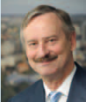

Road Transport
Road transport is part of the lifeblood of the European economy and single market. It delivers goods across Europe fast, efficiently, flexibly and cheaply.
Road transport is a vital economic sector in its own right, employing about 5 million people across the EU and generating close to 2% of its GDP.
Road transport is a tool for reviving growth through the enhancement of competitiveness and the creation of jobs.
Notes:
Transport in the EU = 10 mio and 5% of GDP
2009
Direct Jobs
Number of companies
Freight Transport
2 943 000
555 970
Passenger Transport
2 106 000
227 772

Slide 3
EU objectives and policy
The EU 2011 White Paper on transport defines them: ensure mobility on ever more congested road networks, significantly further reduce road fatalities, lower CO₂ and other emissions of pollutants from road transport to preserve the environment and lessen the impact of climate change on future generations, and decrease fossil fuel use to improve the Europe’s fuel security.
Notes:
The EU needs to reduce the emissions by 80-95% below 1990 levels by 2050
EU still remains dependent on oil and oil products for 96% for its energy needs.

Slide 4
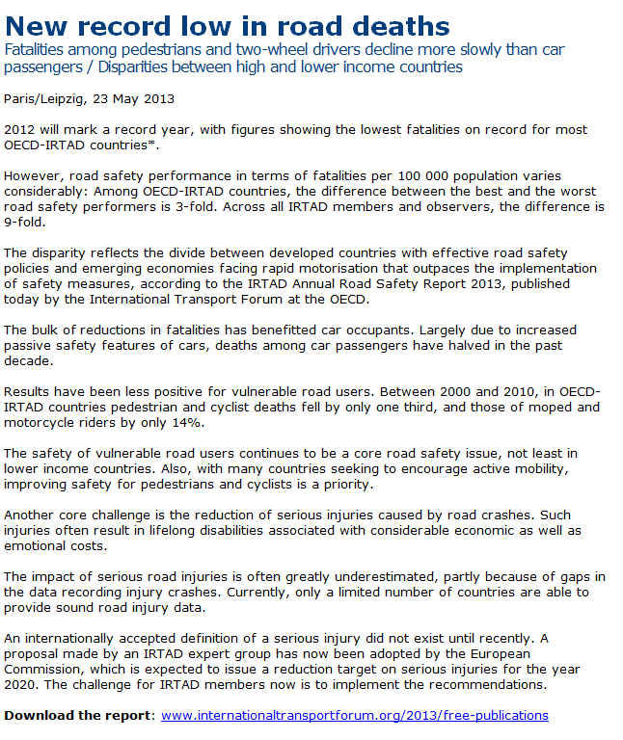
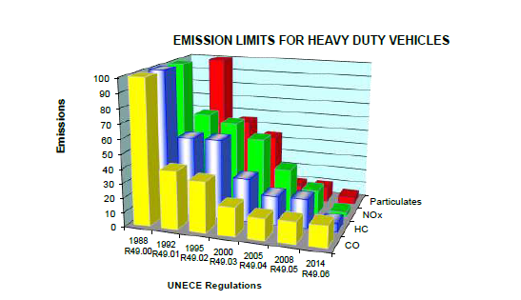
Policies are reaping benefits

Slide 5



Challenges remain

Slide 6

State of Play
Road Transport accounts for nearly 75% of all delivered goods in the EU
Transport of passengers and goods by road will remain 100% dependent on the services of skilled and motivated drivers
Commercial road transport undertakings around the world have suffered persistently from shortages of skilled drivers; most acutely during periods of economic growth and low unemployment

Slide 7
State of Play
Need to respond to the EU transport and energy policy
Road freight transport:
    24% increase from 2000 to 2008
    Concern of CO₂ emissions
    Road Safety a key focus
  Safer, greener, smarter road transport – How?
  Change driver behaviour
  More energy efficient – technological changes
  Innovative road safety technologies (ITS)
  Source: Keep Europe moving: a transport policy for sustainable mobility / June 2006,
  EU energy and transport in Figures – 2010
Notes:
Objective to achieve Europe’s targeted 80% CO₂ reduction by 2050 compared to 1990, oil consumption in the transport sector must drop by around 70% from today.
25 modern trucks make less noise than one built in 1980. Trucks have become much quieter over the last 30 years thanks to such technological innovations as special insulation, low-rolling resistance tyres and other noise control techniques. Further reductions could be made by using low-rolling resistant surfaces for new roads.

Slide 8
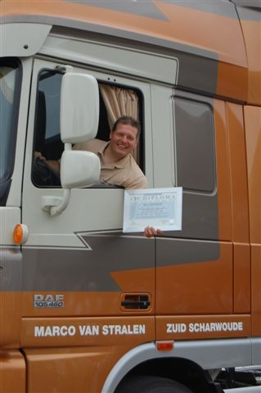
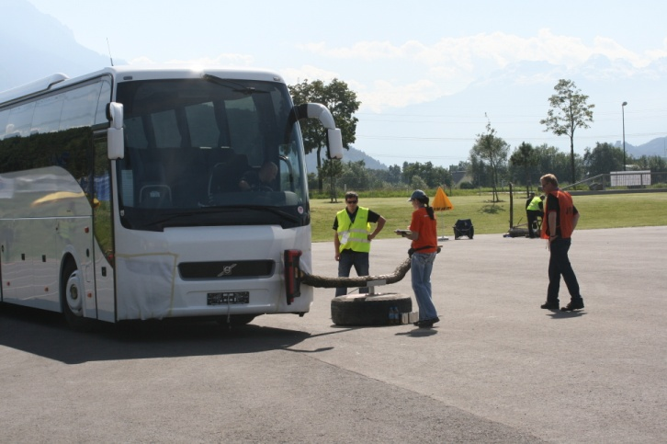

Professional Qualification

Slide 9
European Professional Driver Qualification Framework
To address the above mentioned challenges, the EU implemented Directive EC/2003/59:
  CPC Driver compulsory for professional drivers throughout Europe
  Initial Qualification and Periodic Training (35 hours training every five years)
Focus on:
  Advanced Training in Rational Driving based on Safety Regulations
  Applications of Regulations
  Health, Road and Environmental Safety, Services and Logistics
Notes:
To mitigate the environmental impact through rational driving (eco- driving)
To decrease fatalities through increased road safety
To improve image of the profession

Slide 10
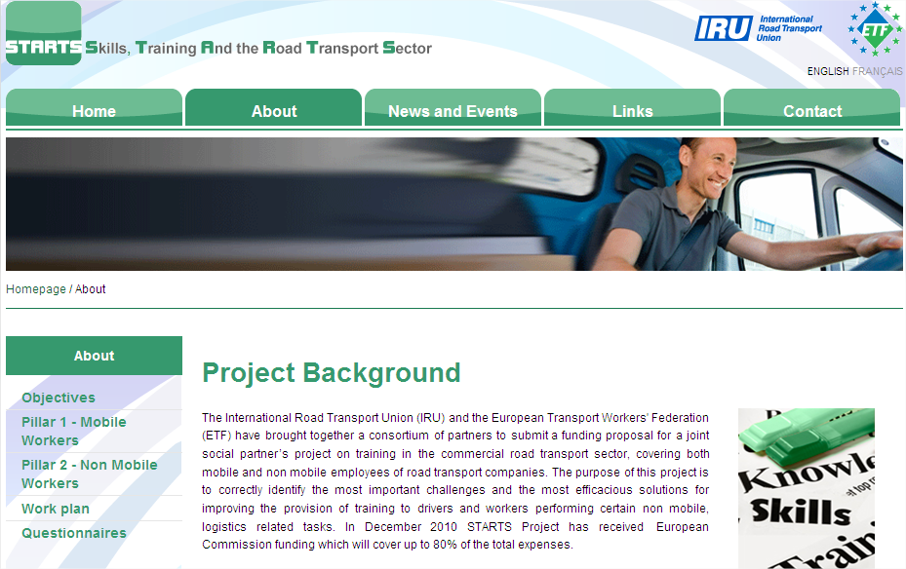
STARTS: Skills, Training and the Road Transport Sector

Slide 11

CPC Driver EU – State of Play
CPC Driver Initial Qualification
Option 1: course attendance and test
Option 2: test only
Both systems
Evidence of (partial) periodic training carried
out in other member state
Accepted, but evidence will be checked | Not accepted
Austria | Belgium (partial)
Croatia | Czech Republic
Cyprus | Finland
Estonia | France
Germany | Hungary
Great Britain and Northern Ireland | Latvia
Ireland | Poland
Malta | Sweden
The Netherlands
Norway
Slovenia
Switzerland
& lack of harmonisation on:
Training curricula
Requirements on CPC Driver Instructors
Notes:
“The very varied degrees of the quality of training and training curricula are still a major obstacle to mutual recognition”
Problems of mutual recognition for initial qualification in
Denmark,
Hungary,
Lithuania,
Sweden
“Mutual recognition of the periodic training seems to be a more ticklish issue, above all when the training is not fully completed“

Slide 12
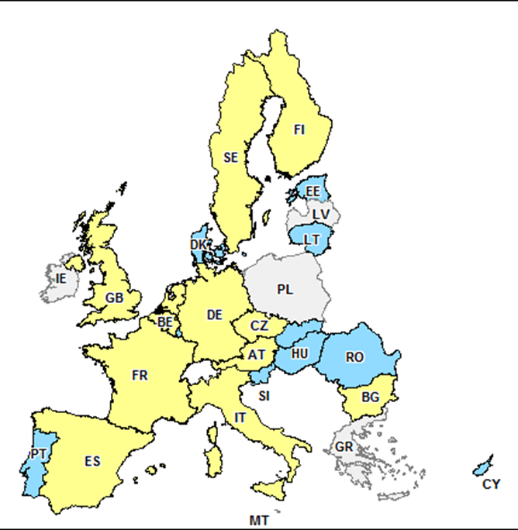

CPC Driver EU – State of Play
 | Allowed | Not allowed
Austria | ü
Belgium | ü
Bulgaria | ü
Czech Republic | ü
Cyprus |  | ü
Denmark |  | ü
Estonia |  | ü
Finland | ü
France | ü
Germany | ü
Hungary |  | ü
Italy | ü
Lithuania |  | ü
Luxembourg |  | ü
Netherlands | ü
Portugal |  | ü
Romania |  | ü
Slovak Republic |  | ü
Slovenia |  | ü
Spain | ü
Sweden | ü
United Kingdom | ü
In-house training
Allowed
Not allowed

Slide 13

CPC Driver EU – State of Play
  “Respondents have reported failures in the training programs of their member states”. In some occurrences this was due to a poor quality trainer profile.”
  “Therefore, the principle of the Directive EC/2003/59, which aims at driver professionalisation by adopting a better driving behaviour acquired during training sessions, such as safe and economically driving courses, is misguided since periodic training is sometimes used only as a business opportunity for training operators. “

Slide 14
CPC Driver EU – State of Play
EC Report on Transposition of Directive 2003/59/EC Published 12 July 2012 reiterates existing knowledge.
Key conclusions:
  EU Driver Training Committee to adopt guidelines for MS on the application of exemptions via article 2.
  Big differences between MS in: training programme design; teaching method; class size; technology and requirements to become an instructor or approved training centre.
  Equivalence of qualification guaranteed by minimum requirements of annex 1 of the Directive.
  No major problems in cross border enforcement.
  EU Social Partners should join EU Driver Training Committee

Slide 15
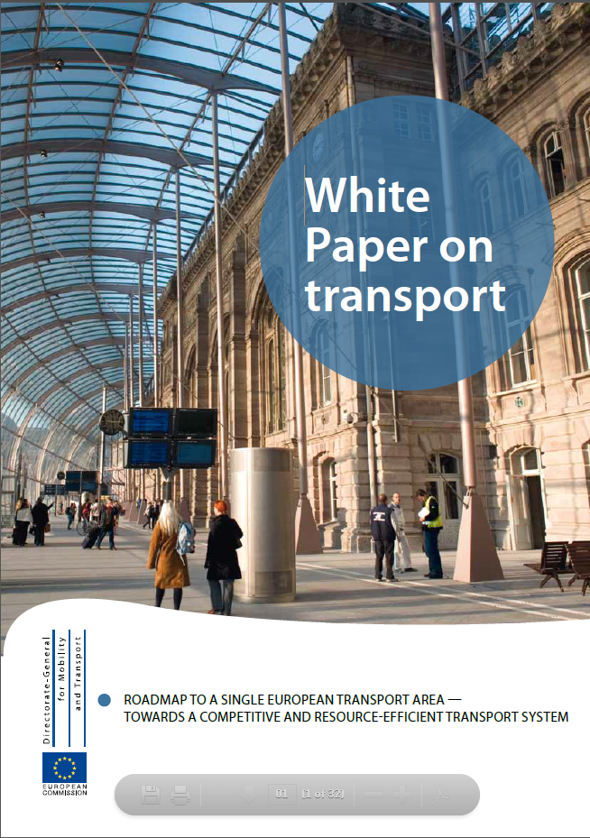

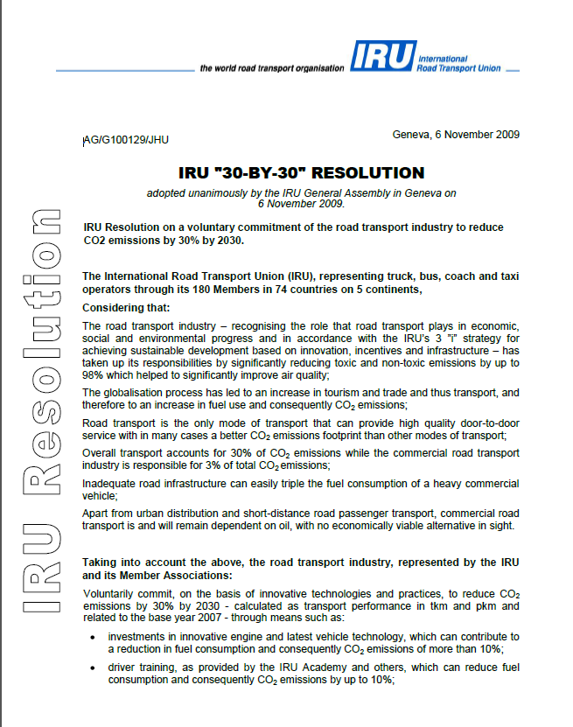


The Way Forward
Focus on policies and industry requirements
established in cooperation with the social
partners and providing an harmonised
qualification framework.
Define an EQF compatible job/qualification and profile that describes skills, knowledge and competencies required to perform competently in the workplace and thus create conditions for employability,
Draft a "European educational standard”
Harmonise Trainer’s requirements,
MS must develop a quality assurance systems for training institutes, curricula, trainers and inspectors, as well as step up their coordination, approval and audit.

Slide 16
Focus on Priorities – Road Safety - Main Cause: The Human Factor
Investigation of 624 accidents showed the main cause of the accident is human error
However, from the 85.2% linked to human error,
75% were caused by other road users!
Source: EU, IRU
Notes:
16
Result – Human factor is the central element we have to act upon in order to increase road safety effectively. But prof. driver only the main reason in 25% of the accidents!

Slide 17
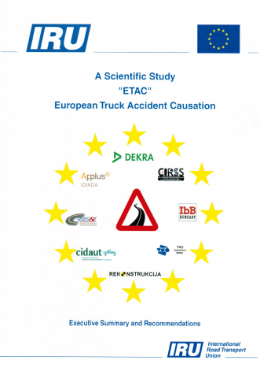

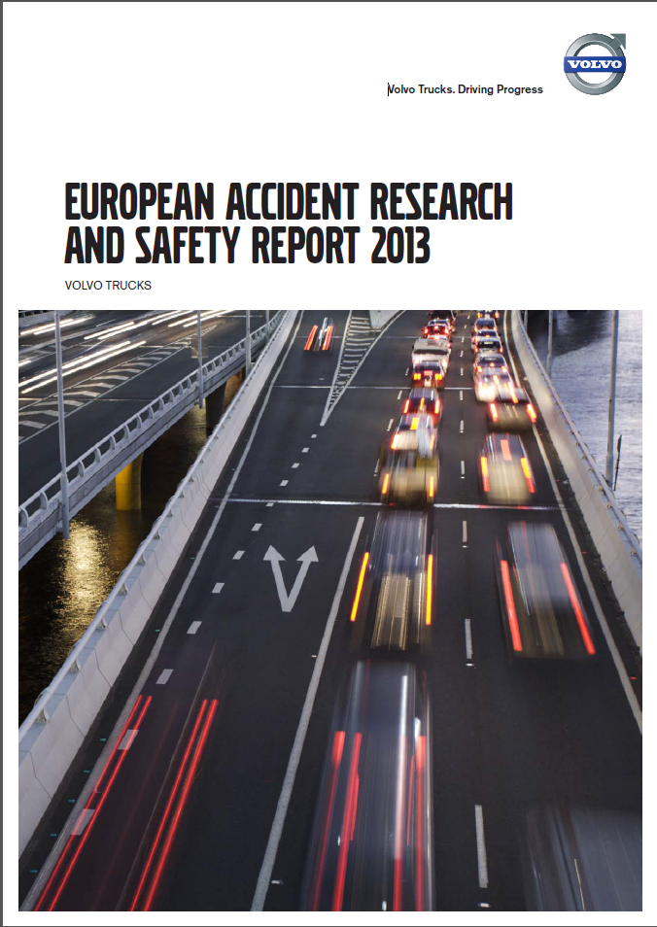
Accident Analysis ETAC –
A Scientific Study
Results confirmed by:
Notes:
ETAC is a study that analysed more than 3000 variables on 624 accidents involving trucks and for which there has been a severe casualty.
Study is available from: http://www.iru.org/en_bookshop_item?id=169

Slide 18
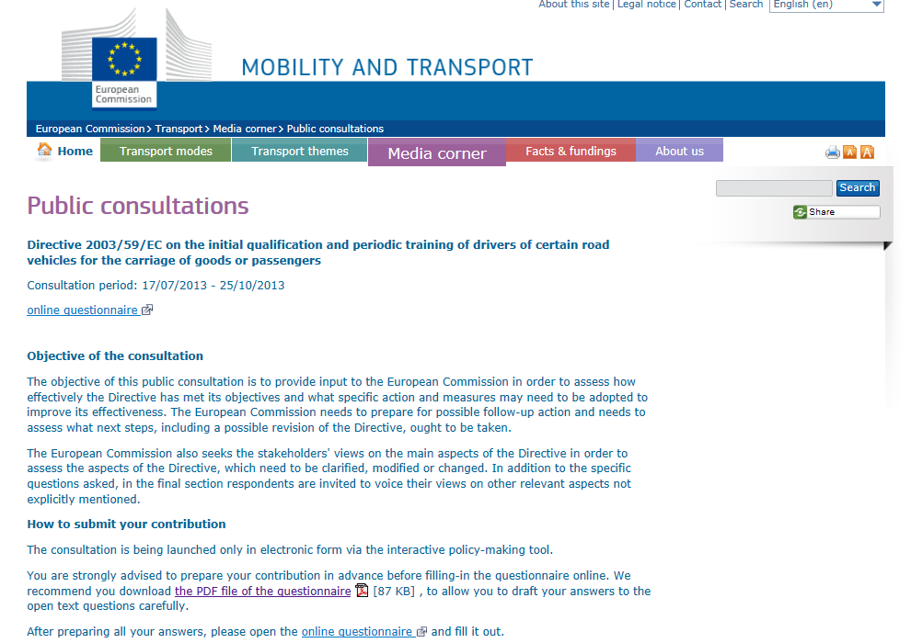
Raise your driver qualification concerns
http://ec.europa.eu/transport/media/consultations/2013-professional-drivers-training_en.htm

Slide 19

Focus on Priority –
ECO-Driving
An ECO driving programme combining technology and the latest training techniques that will improve efficiency and safety for the commercial sector;
Train-the-Trainer & Driver training that have been specifically designed for the road transport sector and contribute to:
  important financial savings in fuel and fleet costs,
  significant reduction of CO₂ emissions and improve fuel-efficiency,
  indirect impact on the reduction of the road risks, accidents and casualties.

Slide 20
Focus on Priority –
ECO-Driving
ECOeffect aims to:
Provide sustainability and continued growth in ECO driving training,
A long-lasting workable business model for the partners and for the associated partners that join the concept,
Become established into the professional qualification of the commercial drivers,
Incorporate ECO driving into the certificate of professional competence (CPC) programmes of the target countries, providing the potential to ensure that all drivers receive training.

Slide 21


Impact of Training
Education, vocational training and lifelong learning play a vital role in both economic and social context.
  Safety
  Behavioral
  performance change
  Process improvements
  Increased customer
  satisfaction
  Staff retention
  Profitability
Copyright cic.gc.ca
Notes:
It is often said that people are the most important elements of businesses and societies. The truth is those organisations and societies can only achieve their goals if the people have the right knowledge, skills and attitudes.
All countries shall implement a professional qualification framework, established on the basis of international best practices as those provided by the IRU Academy in order to ensure a sustainable development of their industry and ultimately economies.

Slide 22


