Slide 1
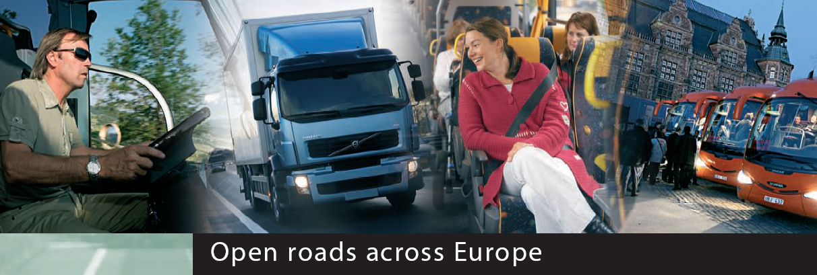
5th European Bus and Coach Forum, Kortrijk
●
Current and future EU market and legal
framework for bus and coach services in Europe
Land Transport Policy
Attila Eordogh
19/10/2007
EUROPEAN COMMISSION

Slide 2
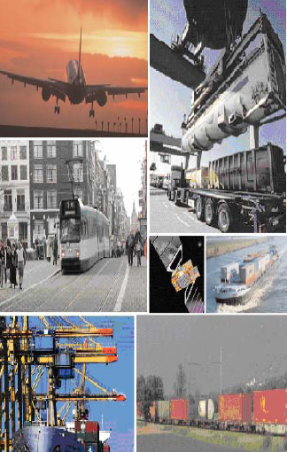
Broad EU transport policy goals
●
Mobility: offer a high level of mobility throughout the Union
Protection: protect the environment, the security of energy supplies, the safety and security of passengers, promote minimum labour standards
Innovation: increase the efficiency and sustainability of the growing transport sector
International dimension: the EU must be a united, leading player in the international transport stage
|
2

Slide 3
EU initiatives for road transport
●
Social: smooth transition to new driving time, rest period and tachograph rules
Environment : implement Eurovignette Directive and assess possible smart charging to better reflect external costs of all transport modes
Innovation: action plans for logistics, intelligent transport systems and green propulsion systems
Market and profession : modernize rules on the admission to the occupation and the access to the market
|
3

Slide 4
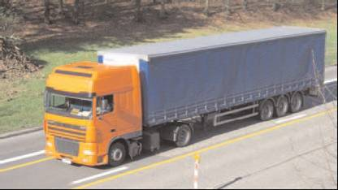
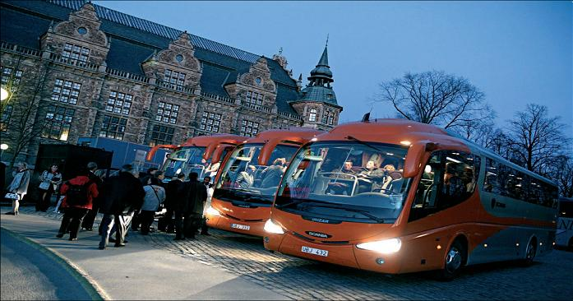
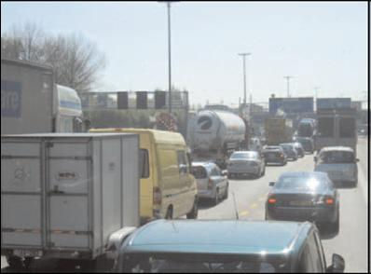
New EU rules on admission to the occupation and access to the market

Slide 5
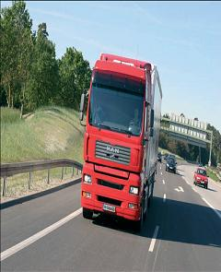
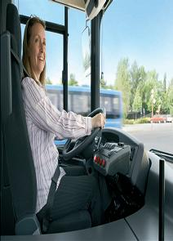
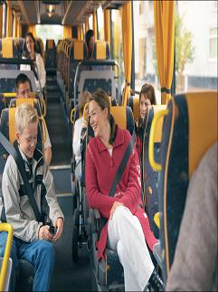
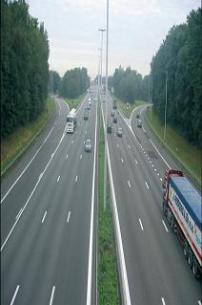
New EU rules on admission to the occupation and access to the market
●
Main objectives
Contribute to a level playing field
Reduce legal uncertainty and unnecessary administrative burden
Enhance compliance with safety, social and technical rules
Raise the level of professional qualification for managing road transport activities
|
5

Slide 6
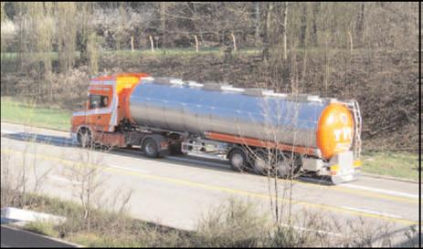
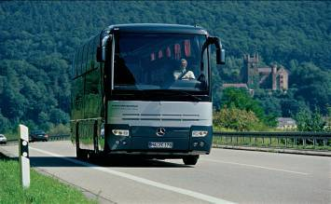
Proposed way forward
●
“Harmonisation”
Making existing EU rules:
clearer
simplified
easily enforceable
more harmonized
|
6

Slide 7
Draft legislative package
●
Under discussion in the European Parliament and the EU Council of Ministers
Proposal for a Regulation on the conditions to pursue the occupation of road transport operator
Proposal for a Regulation on the access to the international road haulage market
Proposal for a Regulation on the access to the market for coach and bus services
|
7

Slide 8
Regulation on the admission to the occupation
●
Replace Directive 96/26/EC by a Regulation
To ensure more harmonised national provisions
Updated requirements on good repute, financial standing and professional competence
EU definition of infringements, serious and repeated minor infringements, financial indicators, training
New provisions on monitoring, checks, administrative cooperation between Member States and sanctions
Reinforced role of licensing authorities, electronic registers
|
8

Slide 9
Regulation on access to the market for coach and bus services
●
Enhanced clarity and readability
Recast of two existing texts merged into one: Regulation 684/92 and Regulation 11/98
Streamlined and simplified authorisation procedure
Applies to international regular coach services
Standardised control documents
Community license and certified true copies
|
9

Slide 10
STRENGHTENING PASSENGER RIGHTS WITHIN THE EUROPEAN UNION
●
EUROPEAN COMMISSION

Slide 11
Passenger rights in bus and coach transport
Background Commission Communication of 16 February 2005 on strengthening passenger right within the EU. Pointed out 3 main areas of concern with regard to international coach transport:
Rights of persons with reduced mobility
Liability issues
Compensation and assistance in the event of interrupted travel

Slide 12
Passenger rights in bus and coach transport
Timeline
Public consultation launched in 2005
Stakeholder meeting held on 29th March 2006
European Energy and Transport Forum gave an opinion encouraging Community action in the field
Next step: interservice consultation within the Commission on the proposal for a regulation
Adoption of the proposal by the Commission is scheduled for mid December 2007

Slide 13
Passenger rights in bus and coach transport
Issues likely to be covered by the proposal:
Liability schemes in the event of death or injury of passengers
Rights of disabled persons and persons with reduced mobility (non-discrimination and assistance on board of coach and at coach terminals)
Assistance in case of interrupted journey (cancellations and delays)
Obligation to inform passengers
Complaint handling procedure
Enforcement rules and designation of national enforcement bodies

Slide 14
GREEN PAPER "TOWARDS A NEW CULTURE FOR URBAN MOBILITY"
●
EUROPEAN COMMISSION

Slide 15
Green Paper on urban mobility
Guaranteeing European citizens a high quality of life
Facilitating economic development of cities
Respecting the environment, for sustainable development
Problems are local but impacts are global:
cooperation at local, regional, national, EU level is needed.
No single solution, an integrated approach is needed: technological innovation, development of clean, safe and intelligent transport systems, economics incentives and amendments to legislation.
The Green Paper explores how EU can add value to actions undertaken at local, regional and national level.

Slide 16
CHALLENGES FACED BY CITIES
Congestion
costing 1% of GDP annually
Energy consumption
domination of oil as a transport fuel
Climate change
40% of CO² emissions of road transport in urban areas
Health issues
air pollution and noise problems
Safety and security
2/3 of road accidents, 1/3 of road fatalities in urban areas

Slide 17
Green Paper addresses 5 challenges
FREE-FLOWING TOWNS AND CITIES
GREENER TOWNS AND CITIES
SMARTER URBAN TRANSPORT
ACCESSIBLE URBAN TRANSPORT
SAFETY AND SECURITY IN URBAN TRANSPORT

Slide 18
THE ADDED VALUE OF EU ACTION EU wishes to facilitate change without imposing solutions
Exchange of knowledge and best practices
Simplification of legislation
Standard setting and facilitating interoperability
Guidance and awareness raising
Financial support
New legislation, if necessary
25 open questions for consultation

Slide 19
NEXT STEPS
Green Paper launches new consultation phase until 15 March 2008.
Comments and suggestions can be sent to the Commission
To lead to publication of a concrete Action Plan in autumn 2008
Consult for all further information: http://ec.europa.eu/transport/clean/index_en.htm

Slide 20
A STUDY ON PASSENGER TRANSPORT BY COACH IN EUROPE
●
EUROPEAN COMMISSION

Slide 21
A thorough investigation and comprehensive analysis of the European coach industry
Statistical data collection
Analysis of coach accident data
Assessment of terminal infrastructure
Case study: new EU driving and rest time rules
Contract notice available from 27th October 2007 on:
http://ted.europa.eu or
http://ec.europa.eu/dgs/energy_transport/tenders/ index_en.htm

Slide 22
5th European Bus and Coach Forum Kortrijk
●
Thank you !
http://ec.europa.eu/transport/index_en.html
|
22

