Slide 1
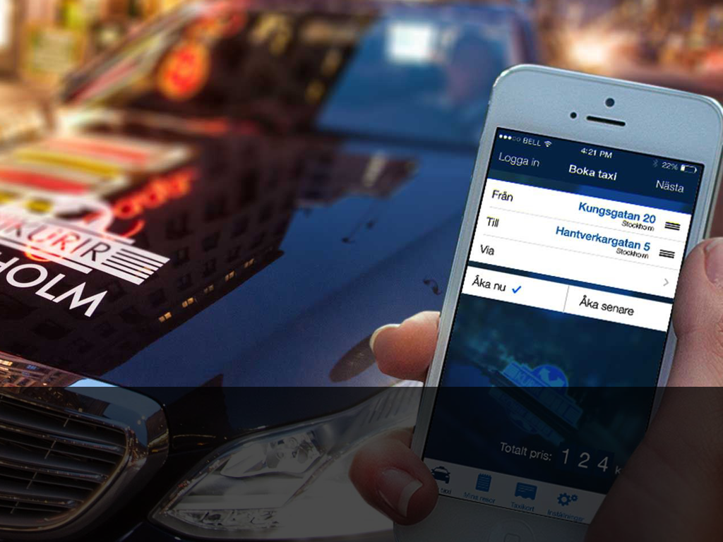

Slide 2
Disruption
What is market disruption
Is anyone disrupting Taxi today?

Slide 3
Evolution
Innovation
The hardest thing - Resistance to change

Slide 4
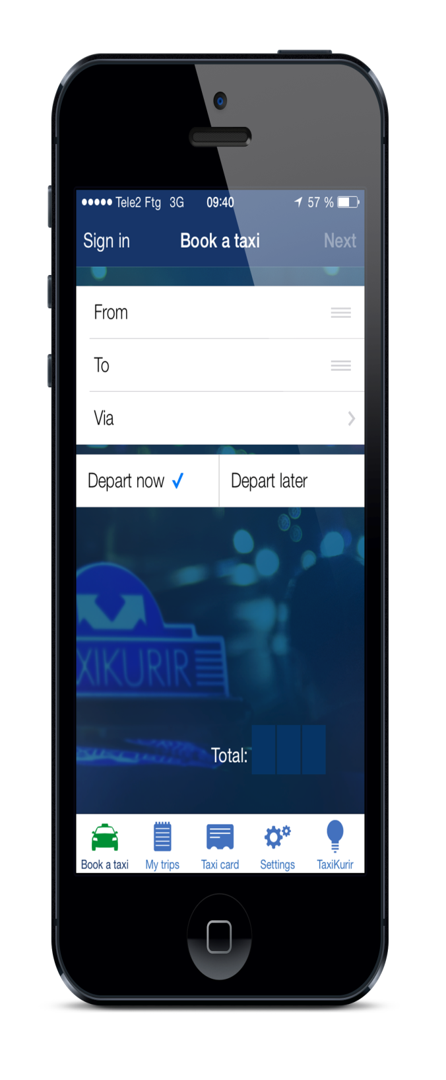
Delighting the customers

Slide 5
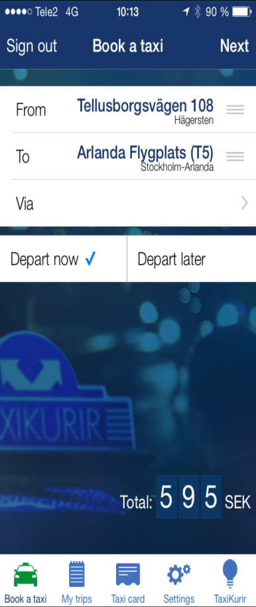
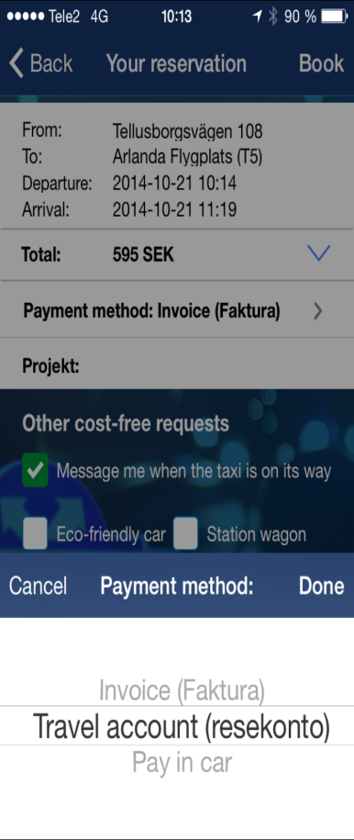
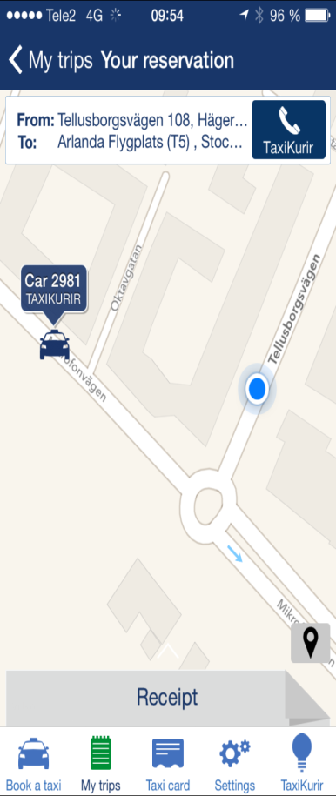
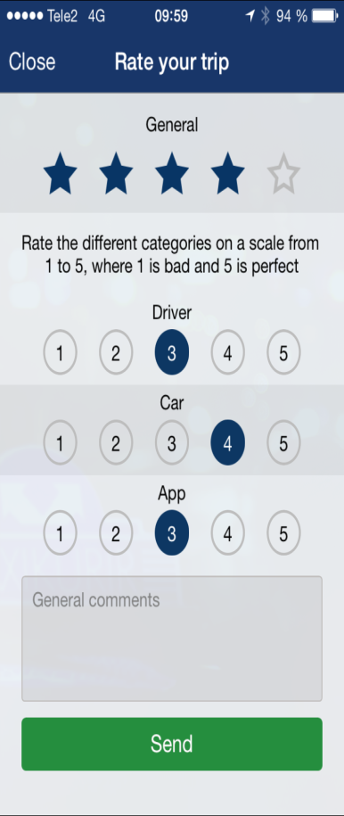

Slide 6
Results
What happened
What we learned

Slide 7
Next steps
Own your brand
Choose your partners wisely

