Slide 1




THE LAW AND THE TAXI: THE RIGHT REGULATORY MIX – THE CHALLENGE OF EMERGING TECHNOLOGIES AND SMART PHONE APPLICATIONS
    Presented By
    Professor Matthew W. Daus, Esq.

Slide 2

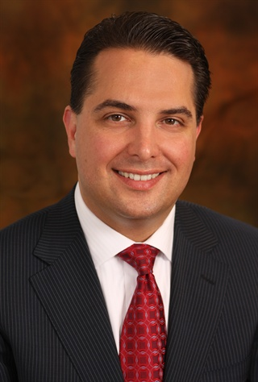
    Presented By
    Professor Matthew W. Daus, Esq.
      Distinguished Lecturer, UTRC
      President, COTA
      President, IATR
      Partner & Chairman, Transportation Practice Group
      Windels Marx Lane & Mittendorf, LLP
      Contact: mdaus@windelsmarx.com
      156 West 56th Street | New York, NY 10019
      T. 212.237.1106 | F. 212.262.1215

Slide 3
In July 2012, the Windels Marx Transportation Practice Group Published A Report Entitled:
“Rogue” Smartphone Applications for Taxicabs and Limousines: Innovation or Unfair Competition?
A National Regulatory Review of Safety, Accountability and Consumer Protection Legal Issues.
http://www.windelsmarx.com/resources/documents/Rogue%20Applications%20Memo%20(updated%208.6.12)%20(10777883).pdf

Slide 4
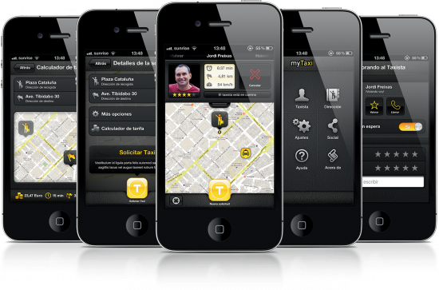
Taxicabs and Limousines…….
Yes, there is an app for that,
but…

Slide 5

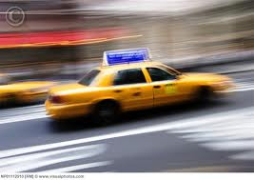
Is it the “Wild West”?

Slide 6











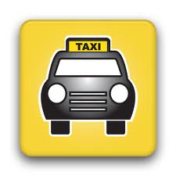


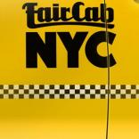
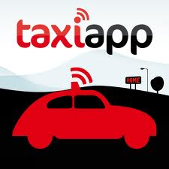

























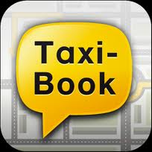












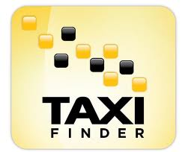
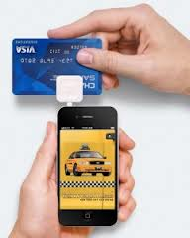



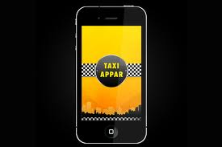

Slide 7
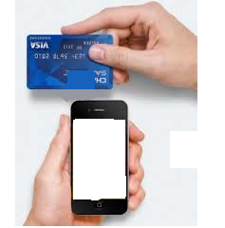


Smartphone Apps
  New apps are constantly entering the market
  Apps are used for electronic hailing
  Arrange rides or share rides
  Expedite payments

Slide 8

How Does It Work?
Download an app
Run the app and locate a service
Book a Taxi/Limo
Payment via text, email or other payment processing devises

Slide 9
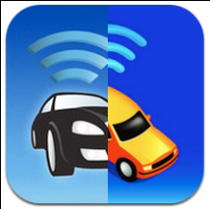




ALL APPS ARE NOT CREATED EQUAL!

Slide 10
Legal Issues Identified with Rogue Apps
Prearrangement or Electronic Street Hail?
Smartphone apps have introduced “electronic hail.”
An “electronic hail” is similar to a street hail, but through an individual’s smartphone.
Some regulators have not addressed this new concept in their regulations……yet.

Slide 11
New York City (TLC) has proposed rule changes that includes;
  Defining E-Hail and amendments to prohibit drivers from charging passengers any additional fee for an E-Hail trip;
  Establishing restrictions on when and where drivers can use E-Hail applications;
  Requiring drivers to utilize E-Hail applications licensed and approved by TLC and;
  Amendments regarding owner payments to drivers for E-Hail trips.

Slide 12
Legal Issues Identified with Rogue Apps
Taxi & Limousine Distinction
What is the distinctions between a taxicab and limousine in post-smartphone app world?
Is an on-demand electronic street hail a prearranged service?
Most jurisdictions have yet to answer these questions.

Slide 13
Legal Issues Identified with Rogue Apps
Safety Concerns
Rogue” Apps cut out the dispatch companies and deal directly with drivers.
This will make it difficult to ensure all vehicles picking-up passengers are licensed.
There is no guarantee if these vehicles are insured and are being driven by properly licensed drivers.

Slide 14
Legal Issues Identified with Rogue Apps
Application Name Confusion
The use of the terms “taxi” or “cab” adjacent to an app does not mean vehicles and drivers dispatched by the app are licensed or meets the definition of a taxi.
This creates consumer confusion and safety concerns.
San Francisco - a cease and desist letter to an app for use of the term “Taxi” in its name.

Slide 15
Legal Issues Identified with Rogue Apps
Illegal Service Refusals
Apps could allow the driver to accept or decline potential dispatches.
Thus, there is potential for drivers to take advantage of the app to discriminate against consumers; offering service to some, and rejecting others.

Slide 16
Legal Issues Identified with Rogue Apps
  “Fair” Fares
Some apps operate by charging passengers at the end of their trip, therefore the consumer has no assurance as to the final fare, or whether or not it IS fair.
Some apps have been criticized for “demand” or “surge” pricing at the time of national disaster. For example, Uber app implemented “surge” pricing in the immediate aftermath of hurricane Sandy in NYC resulting in excessive trip fare.

Slide 17
Legal Issues Identified with Rogue Apps
Is It a Taximeter?
Taxis are usually required to have a taximeter.
Only taxicabs charge fares based on distance and time.
These taximeters are regulated by the NIST and are calibrated and inspected.
Apps might use GPS to calculate the fare based on time, mileage and demand – this does not meet taximeter standards.

Slide 18
Danger to Transportation Businesses
Collaboration with an unruly or rogue app could lead to loss of:
      Drivers
      Reputation with customers
      Goodwill (Its the app not the company that may matter with passengers in the long run)
      Total dependency to an app company
      Diminished service coverage to longstanding corporate clients
      Loss of brand
      etc…,

Slide 19
How Can You Protect Your Business?
Next Steps?

Slide 20
Develop your own app (or white label app)
Contract with those apps that are legal
Carefully review all 3rd party app contracts
Be vigilant to protect your
      business,
      clients,
      drivers affiliated with your base, and
      your business reputation and goodwill.

Slide 21
Things are moving fast!
Litigation
    Cambridge, MA
    Chicago, IL
    San Francisco, CA
    New York City
IATR App Committee

Slide 22

IATR App Committee
The purpose of the App Committee is to develop a model code of regulations to ensure smartphone app technology can exist fairly, safely and with accountability to protect the consumer, while also protecting existing businesses against unfair competition.

Slide 23
IATR App Committee
Professor Matthew W. Daus, Chair
Boston New York City Australia
Chicago Philadelphia Montreal
Los Angeles San Francisco Toronto
Austin Seattle San Diego
Denver Washington, D.C. Houston
NIST (National Institute for Standards & Technology)
NCWM (National Conference of Weight & Measures)

Slide 24
IATR App Committee
Will produce model regulations for apps standards
Working with Taxi, Limousine & Paratransit Association (TLPA) App Committee
The model regulations will be presented for comment and input at the IATR Conference
Regulations & Smartphones – “There’s an App for That” (Washington, DC Conference)
To be Presented on November 17, 2012

Slide 25
What is the Right Regulatory Mix?
Amend the law to close loopholes to allow safe & accurate smartphone app use to thrive;
Hold existing licensees accountable and/or license companies which produce or operate apps;
Ensure technology has accurate measuring devices and meets taximeter standards.

Slide 26
Thank You!
Q&A

