Slide 1
Making Electric Taxis a Reality by Building an Infrastructure
Torben Andersen, Better Place Danmark.
3rd International IRU Taxi Forum, October 9th, 2009

Slide 2
Agenda
Better Place mission and milestones
Better Place solution overview
Electric taxi opportunity

Slide 3
Better Place mission and milestones

Slide 4
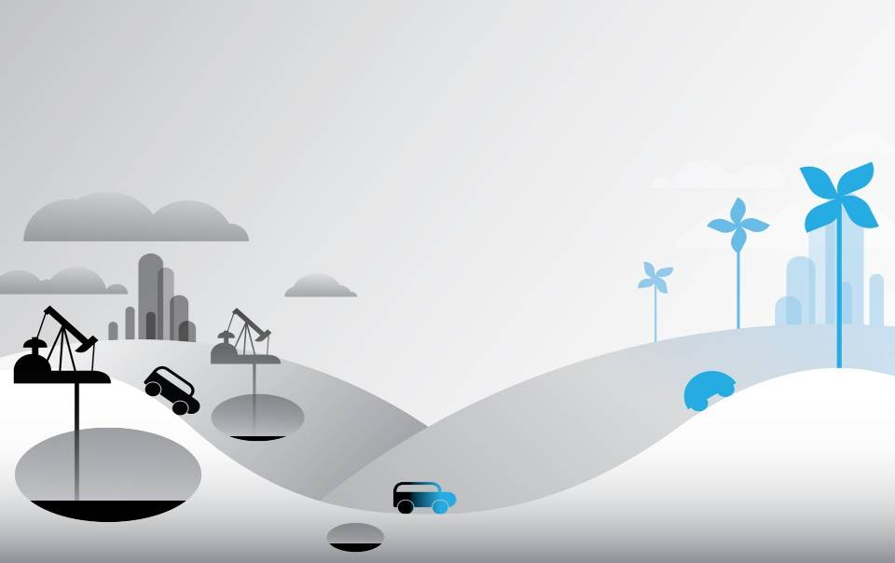
“How do you make the world a better place by 2020?”
End oil...
Accelerate the transformation to a sustainable electric automotive solution
Notes:
Our history is based on a question posed to Shai Agassi and others at Davos in 2007:
“How do you make the world a better place by 2020?”
After a complex analysis, Shai’s simple answer was “end oil”.
With full consideration and much discussion came a commitment and ultimately a company whose objective is to accelerate the transformation of the century-old automotive model, running on oil, to a sustainable electric solution, based on renewable energy.

Slide 5
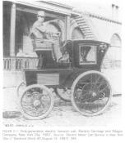
EVs are our past, and…
Electrics lose to Ford’s Model T and abundant gas
Early 1900’s
Promising EV programs succumb to market forces
1990’s
2009
Alignment of new capabilities and market forces
Notes:
Why will electric vehicles work? Electric vehicles are not new, so success requires overcoming history – overcoming the dominance of the internal combustion engine (“ICE”) and gas engine vehicles. Looking back to the early 1900s when gas engine cars became the norm, it’s easy to understand why electric cars did not succeed. The availability of electricity was limited, gas was abundant and inexpensive, and Henry Ford chose a gas engine car for his new manufacturing innovation.
During the 1990’s: what some saw as a very promising EV pilot program succumbed to an array of market forces including the efforts of powerful automakers and oil industries, Hydrogen hype, the limitations of nickel metal hydride batteries, and the apathy of most consumers, and the powerlessness of EV champions.
However, here in 2009, we are now at a time in which a compelling solution meets a highly conducive and receptive marketplace.

Slide 6
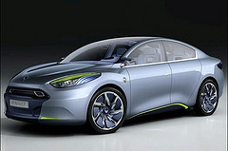
…are the future of transportation
Traditional and new OEMs introducing EVs to the market
Renault ZE Fluence
With recyclable batteries by…
Notes:
Market forces have led traditional automakers as well as new entrants such as BYD, Tesla Motors, Fisker Motors to pursue the development of a broad range of high performance, stylish, no compromise EVs.
Car OEM’s publically announced programs:
Renault-Nissan: Strong partnership with Better Place to deliver EV’s for the Israel and Denmark market in 2011
Ford: EV version of Transit Connect van expected to launch in 2010; EV sedan developed jointly with Magna International expected in 2011
General Motors: Strong commitment to PHEV technology; Chevrolet Volt target launch for November 2010
BMW: Currently running a 500-vehicle test of the electric Mini E vehicle with customer leasing in Los Angeles, New York, and New Jersey
Volkswagen: Joint development of power electronics and battery technology with Toshiba announced Feb 2009; Leading development of diesel-fueled HEV vehicles
Toyota: Market leader in HEV vehicles with the success of the Toyota Prius; Early PHEV version of Prius expected to come out with NiMH battery pack
Daimler: Partnership with RWE to provide Smart EV’s for testing in Berlin and London
Mitsubishi: Launched test fleet of i-MiEV’s (a pure EV design) in 2006 with market introduction planned for summer 2009
Battery makers including A123 and others are continuing to improve lithiom ion battery capabilities and driving down price. Further price declines will come with scale.

Slide 7
Holistic Better Place solution addresses historic barriers to EV adoption
Obstacle | Solution
Upfront Cost | Better Place pays for and owns the battery, charges for monthly services, lowering the initial cost of purchase
160 km Range | Battery switch stations provide fully charged batteries en route, providing unlimited range
Consumer Convenience | Better Place installs charge spots at home, work, and public places for convenient charging
Grid Scalability | Better Place Service & Control Center allows ‘smart’ charging, enabling mass EV adoption with existing utility grid infrastructure

Slide 8
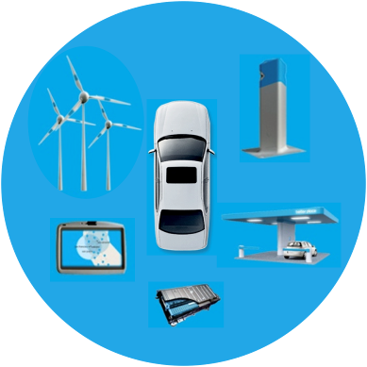
The driving systems: Old vs. new
Notes:
Our gas engine cars have been at the core of our transportation solution. The solution is based on a volatile oil and gas ecosystem to supply and set gas prices. Drivers purchase that gas at the going rate and integrate additional services as needed (oil change, maintenance, roadside assistance etc). The more they drive the more pollution they generate, and the worse our climate and the more vulnerable our economies.
For EVs, BPLC and partners will deliver a clean, complete, and sustainable solution to our transportation needs by leveraging the network technology in EVs and the Better Place system and the clean technology used to generate renewable energy.

Slide 9
Better Place world view circa 2009
Better Place Ontario
Better Place Denmark
Better Place California
Japan Exhibition
Better Place Israel
Better Place Hawaii
Better Place Australia
Notes:
Our initiatives have spawned regional companies in Israel, Denmark and Australia and we have additional offices and activities in US, Canada, Europe, and Japan.
We will launch first in Israel and Denmark where the economics factors favor an immediate and steep adoption curve for electric vehicles.
In denmark where there is currently a 150% on gas engine vehicles, and no tax on Evs, consumer demand may even precede vehicle and infrastructure availability.
Likewise in Israel, where the traditional 72% tax rate on new vehicles will be 10% for Evs, we need to assure drivers that they will be able to get the services they need asap.

Slide 10
Better Place solution overview

Slide 11
Multi-faceted and holistic electric vehicle solution…
Zero-compromise EV
Energy optimizing service & control center
Ubiquitous charging infrastructure
In-car connected software
Battery
Exchange station

Slide 12
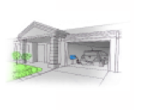
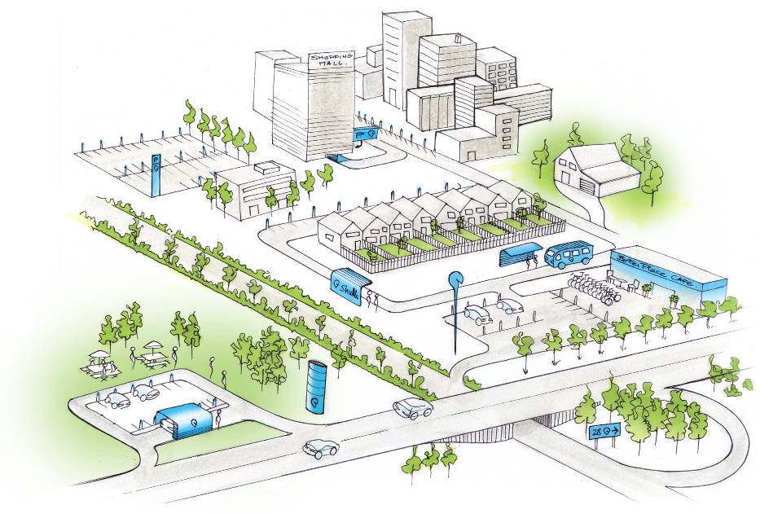
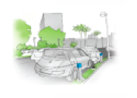
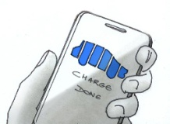
..enable comprehensive EV service offering
Charging
Personal and public charge spots
Battery switch stations
In-car support
Energy monitoring and management
Information and media services
Customer care
Mileage, time of day, location charging options
Roadside and other assistance
Energy management
Power use, distribution and grid stability enabling
Notes:
Better Place will provide the car battery and subscription services options. Customers will be able to select a package depending on mileage and preferred level of care.
Better Place on-board software will offer advanced navigation and detailed battery power management information including directions to the nearest exchange station when indicated by a subscriber’s driving plan. Customers will be able to designate one or more locations for additional charge spots so that they can conveniently charge their vehicle in their garage during the night, or elsewhere.
For utility partners, the service and control center enables high-level energy demand management as well as granular local management that can minimize charging during peak electricity consumption hours. Using tools and information supplied by Better Place, utilities can manage energy demand and provide reliable power to EV drivers.
Peak shaving
Demand side management
Future vehicle to grid (V2G)

Slide 13
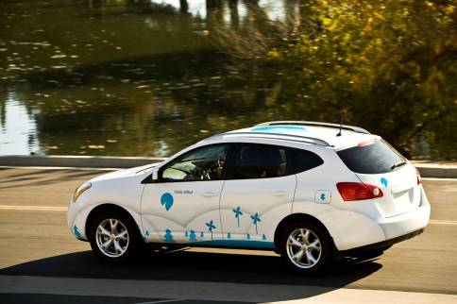
Zero-compromise EVs provide superior driving experience
Instant and smooth acceleration
Quiet (inside and out)
Reduced maintenance
Efficient energy usage
Notes:
These cars, absent the requirements of gas combustion engines and drive trains, provide instant, smooth, and powerful acceleration.
Electric cars are silent both inside and out, creating a more peaceful driving experience regardless of speed. (Can you imagine the difference to those near highways and roadways?)
With about half the moving parts, and absent the high temperatures of gas combustion, EVs are expected to have far lower maintenance requirements and costs.
Even with current energy sources, by creating electricity centrally, there is a significant gain in energy. EVs are expected to have 2-3X the efficiency of a similar gas engine car.
And it goes without saying, that EV owners have the pride of driving in a socially responsible and yet no compromise vehicle.

Slide 14
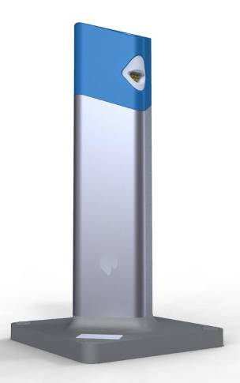
Better Place charge spots
Widely deployed in public locations in advance of cars
Additional spots installed for subscribers
Plug and charge at home, work, school or while you shop or play
Eliminates gas station stops, pumps, and unpredictable prices
Notes:
Specifically,
Charge spots will be deployed in private homes, workplaces and public locations. As the vast majority of driving trips are shorter than the range of a fully-charged EV battery, most customers will use charge spots as their primary source of energy.
Here is an example of how someone would use a charge spot:
The driver parks his/her vehicle near the charge spot.
He/She then waves a key FOB against the charge spot, and plugs in the vehicle
The charge spot communicates with the Better Place service and control center (“SCC”) to obtain a charge plan.
The charge plan is delivered to the charge spot and initiated.
The charging process and battery status (Better Place vehicle) are monitored.
Cost-efficient design produced at scale enables ubiquitous coverage. Charge spots contain the relevant electro-mechanical devices that enable a safe, serviceable connection between the Better Place network and the EV.

Slide 15
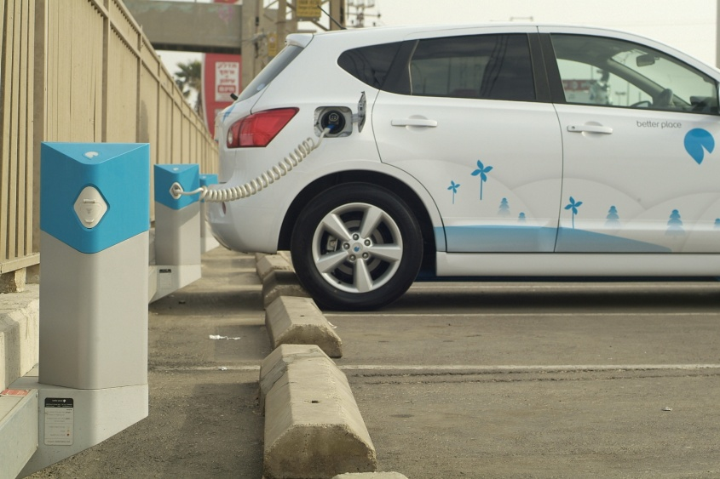
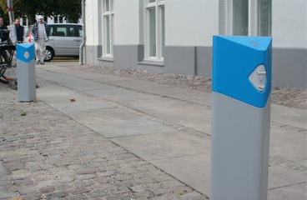
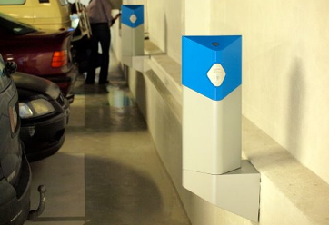
Deployment already underway in Israel and Denmark
public surface lots
home garages
street-side parking
parking garages
Notes:
Of course, there is the occasional long distance trip, for which even a full battery will not be sufficient. BPLC will provide battery switch stations at which a depleted battery will be replaced with a battery which has a full charge, in less time than it takes to fill a tank with gasoline.
It works quite simply. The driver identifies a nearby switch station through his in-vehicle information system. The vehicle enters, much as it would to a car wash, and proceeds down guide rails into a switch-lane conveyor. The automated exchange platform below the vehicle aligns under the depleted battery, initiates the battery release process and lowers the battery from the vehicle. It then replaces the depleted battery with a fully-charged battery. This process can be completed in 3-5 minutes, allowing the driver a fast and safe range-extension solution. The depleted battery is stored in a charging bin and automatically passed into a controlled charging cycle.
(Battery switch station chargers are able to recharge a depleted battery in approximately 30 minutes, thus reducing the total number of batteries that need to be available at a given battery switch station. )
We have a working station which will soon be on display in Yokohama Japan, where Better Place has been invited to a government sponsored exhibit on EVs. Better place is the only non-Japanese company to have been invited to participate in the three month industry event.

Slide 16
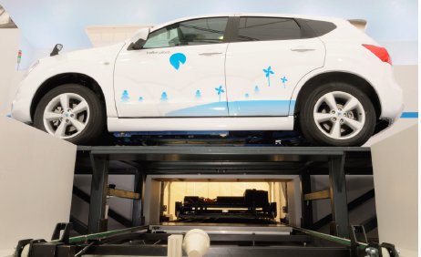
Battery switch stations for rapid and unlimited range extension
Rapidly replaces a depleted battery with a fully-charged one
Completely automated process which takes less time than filling a gas tank
Battery availability for specific car makes and models
Notes:
Of course, there is the occasional long distance trip, for which even a full battery will not be sufficient. BPLC will provide battery switch stations at which a depleted battery will be replaced with a battery which has a full charge, in less time than it takes to fill a tank with gasoline.
It works quite simply. The driver identifies a nearby switch station through his in-vehicle information system. The vehicle enters, much as it would to a car wash, and proceeds down guide rails into a switch-lane conveyor. The automated exchange platform below the vehicle aligns under the depleted battery, initiates the battery release process and lowers the battery from the vehicle. It then replaces the depleted battery with a fully-charged battery. This process can be completed in 3-5 minutes, allowing the driver a fast and safe range-extension solution. The depleted battery is stored in a charging bin and automatically passed into a controlled charging cycle.
(Battery switch station chargers are able to recharge a depleted battery in approximately 30 minutes, thus reducing the total number of batteries that need to be available at a given battery switch station. )
We have a working station which will soon be on display in Yokohama Japan, where Better Place has been invited to a government sponsored exhibit on EVs. Better place is the only non-Japanese company to have been invited to participate in the three month industry event.

Slide 17
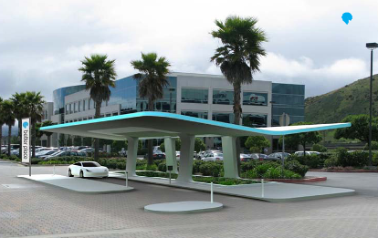
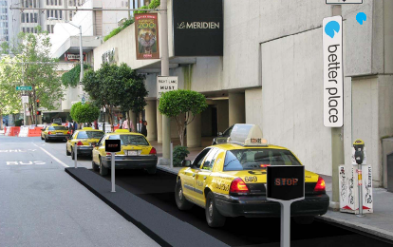
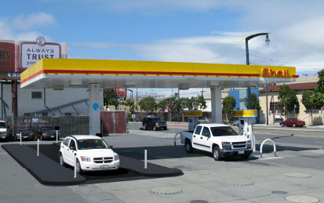
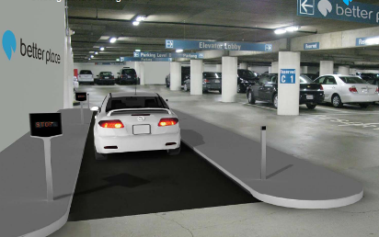
Multiple location-specific configurations
Stand alone station
taxi station
gas station facility
subterranean parking garage
Notes:
Of course, there is the occasional long distance trip, for which even a full battery will not be sufficient. BPLC will provide battery switch stations at which a depleted battery will be replaced with a battery which has a full charge, in less time than it takes to fill a tank with gasoline.
It works quite simply. The driver identifies a nearby switch station through his in-vehicle information system. The vehicle enters, much as it would to a car wash, and proceeds down guide rails into a switch-lane conveyor. The automated exchange platform below the vehicle aligns under the depleted battery, initiates the battery release process and lowers the battery from the vehicle. It then replaces the depleted battery with a fully-charged battery. This process can be completed in 3-5 minutes, allowing the driver a fast and safe range-extension solution. The depleted battery is stored in a charging bin and automatically passed into a controlled charging cycle.
(Battery switch station chargers are able to recharge a depleted battery in approximately 30 minutes, thus reducing the total number of batteries that need to be available at a given battery switch station. )
We have a working station which will soon be on display in Yokohama Japan, where Better Place has been invited to a government sponsored exhibit on EVs. Better place is the only non-Japanese company to have been invited to participate in the three month industry event.

Slide 18
Electric taxi opportunity

Slide 19
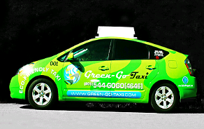
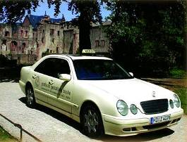
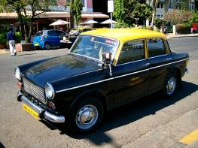
Why taxis first?
Taxis are cultural icons that feature:
High mileage
Highly polluting
Highly regulated
Highly sensitive to rising fuel costs

Slide 20
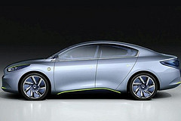
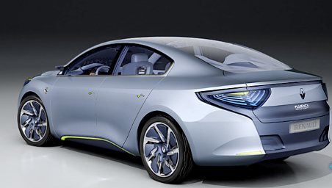
Renault’s ZE Fluence will be first EV capable of meeting rigorous demands of taxi market
Full-size 5-seat passenger sedan with spacious interior (length: 4,820mm; width 1,672mm)
~24 kWh lithium ion battery allows for ~160km driving range on single charge
Switchable battery provides infinite range extension; switch time < 5 minutes
Regenerative braking increases energy efficiency and reduces brake maintenance

Slide 21
BPLC electric taxi offering
Control Center
Charge spot
AutOS
Battery Switch Station
Battery
Personal charge spots at driver home or taxi depot
Battery exchange infrastructure throughout service territory allows for 24/7 driving
Control center & AutOS allows for centralized, online dispatch capability for taxi operators
AutOS supports energy-aware navigation and energy management for taxi driving

Slide 22
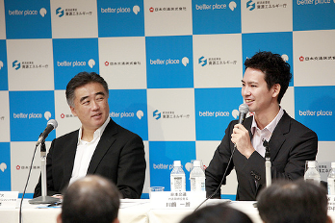
BPLC will introduce world’s first electric taxi with switchable battery in Tokyo, Japan Q1 2010
Japan’s Ministry of Economy, Trade, and Industry awarded Better Place grant to pilot EV taxi program in Tokyo
Pilot paves way for broad incorporation of zero-emission EV technology into Tokyo’s 60,000 taxi fleet
While taxis comprise only 2% of vehicle population, they account for ~ 20% of all passenger vehicle emissions
Multiple companies partnering in taxi demonstration:
BPLC will oversee project, and will install and operate a battery switch station in high-traffic Roppongi Hills neighborhood
Tokyo’s largest taxi operator will incorporate multiple switchable battery EVs into its taxi fleet
Automotive engineering specialist will supply EVs, based on commercially available vehicles, with battery switch mechanism

