Slide 1
Facilitating Transport on the Silk Road Economic Belt through the TIR System
Urumqi, 2 September 2014
Umberto de Pretto
Secretary General

Slide 2
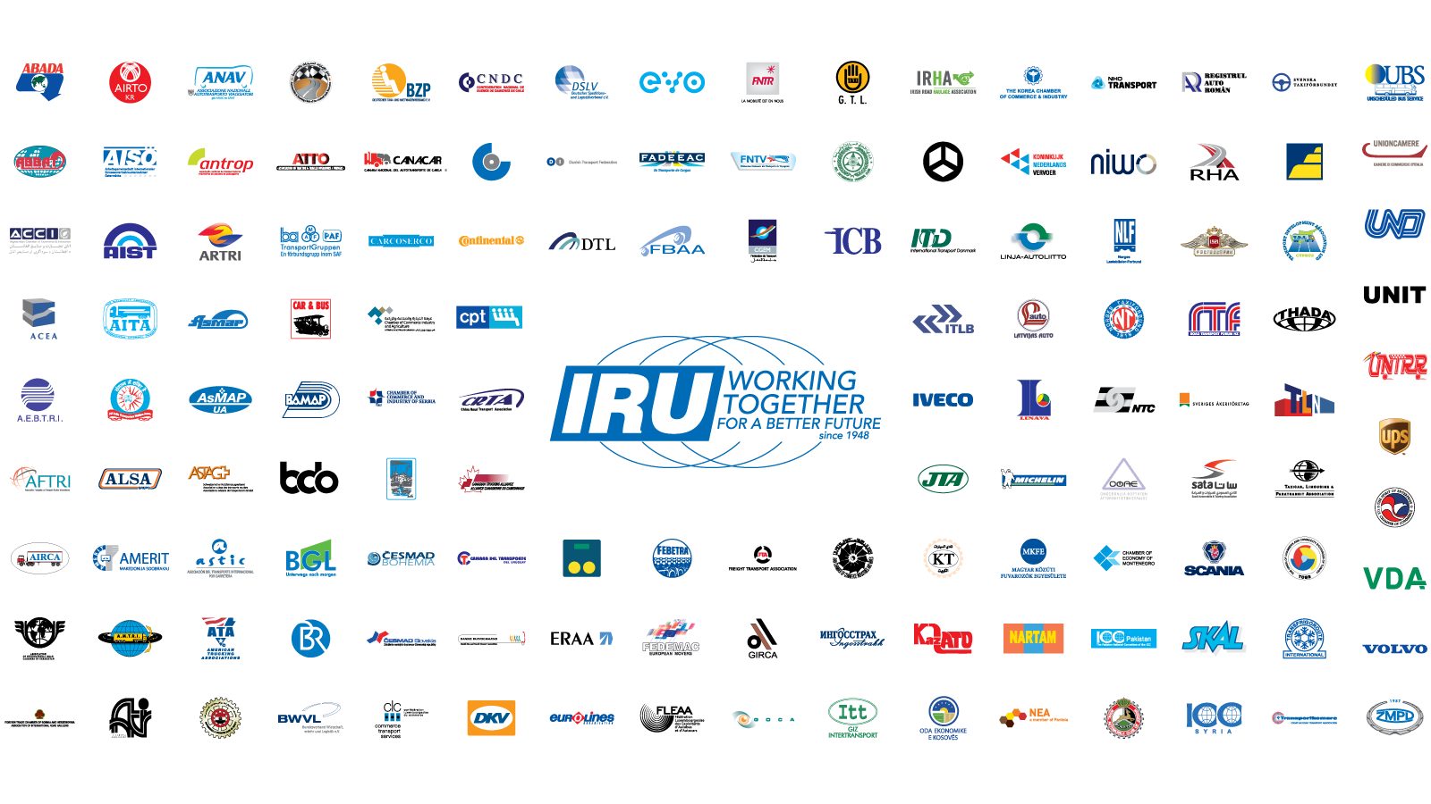

This is the IRU
IRU Member since 29 May 2002

Slide 3
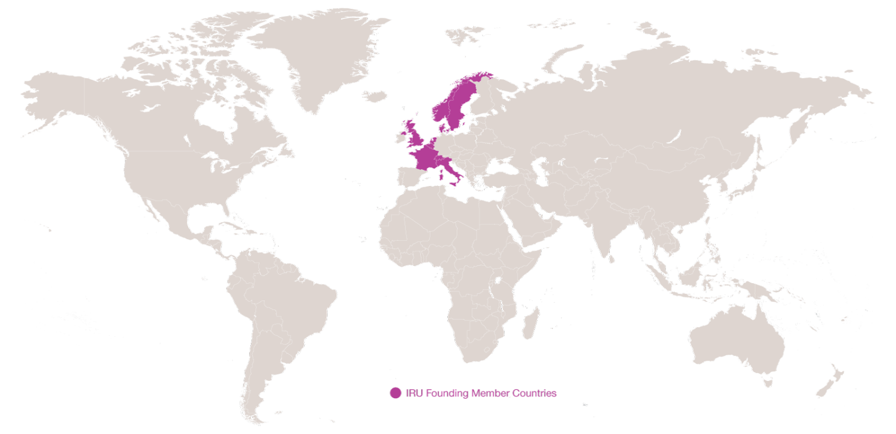
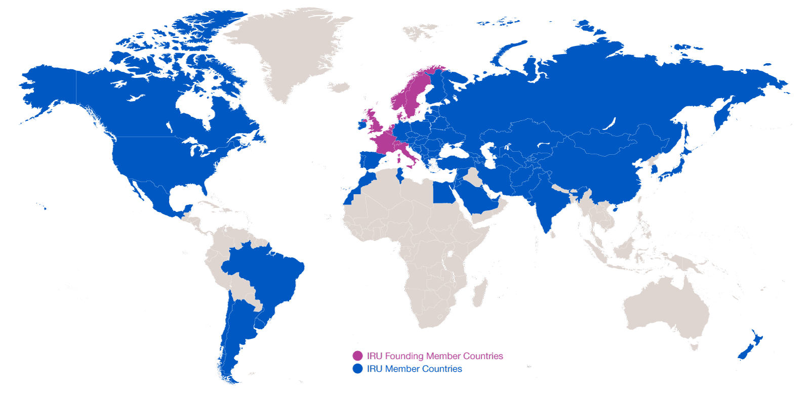
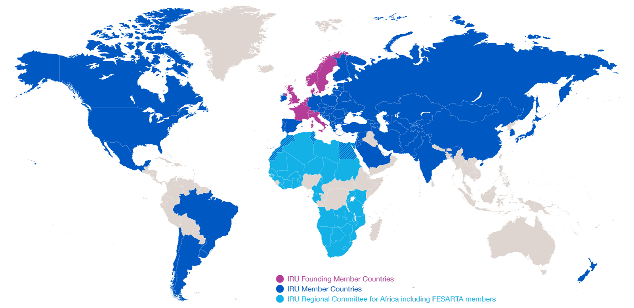
Evolution of IRU Membership
2014: 170 Members in 75 countries
2014: 170 Members in 75 countries
1948: eight founder countries
…and CRIPA: 27 Members + FESARTA in 38 countries

Slide 4







IRU Secretariat General
1948 – IRU founded in Geneva
1973 – IRU Permanent Delegation to the European Union in Brussels
1998 – IRU Permanent Delegation to Eurasia in Moscow
2005 – IRU Permanent Delegation to the Middle East and Region in Istanbul
2012 – IRU Secretariat for Africa in Geneva
2013 – IRU Permanent Delegation to the United Nations in New-York
Next Steps – Office in China

Slide 5
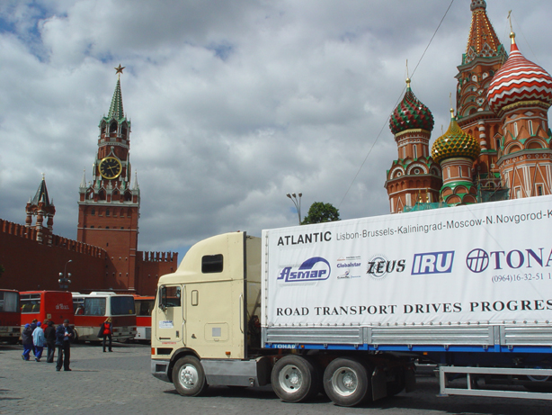
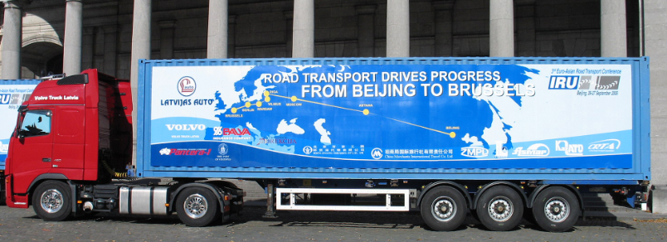
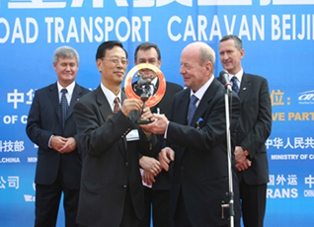

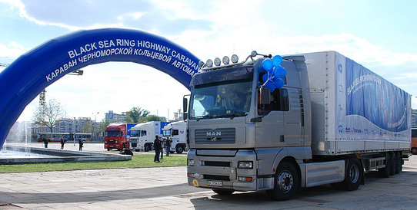
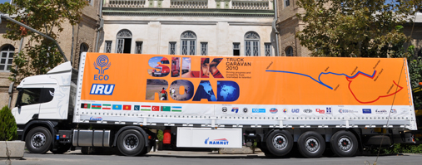
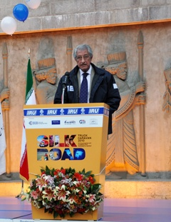
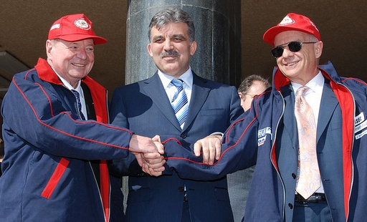
IRU Caravans demonstrate need forTIR
The Lisbon-Vladivostok Caravan
The Beijing-Berlin-Brussels Caravan
Black Sea Highway Caravan
IRU-ECO Silk Road Truck Caravan

Slide 6




IRU New Eurasian Land Transport Initiative (NELTI)
From September 2008
Monitoring over 200,000 border crossings
57% of transport time lost at border crossings
38% of transport costs due to unofficial levies

Slide 7

IRU Caravan drivers saw this… adequate roads but little traffic!!

Slide 8

…until they reached border crossings!!

Slide 9
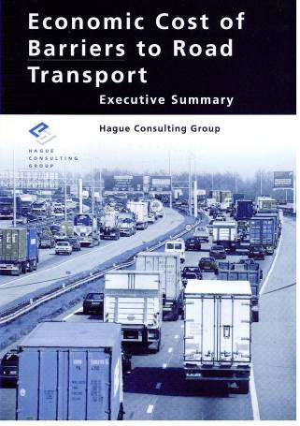
Any penalty on road transport is an even greater penalty on the economy as a whole!
Source: Hague Consulting Group
* Includes lost opportunities

Slide 10
Securing and facilitating trade and international road transport
Transports
Internationaux Routiers
Managed by the IRU since 1949

Slide 11
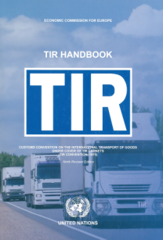


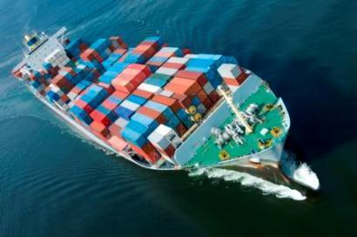
What is the TIR System?
A tried and tested, affordable facilitation instrument for international transport and trade
  Global
  Intermodal (road-rail, road-maritime)
  Secure
Based on TIR Convention of 1975, signed by 68 contracting parties

Slide 12
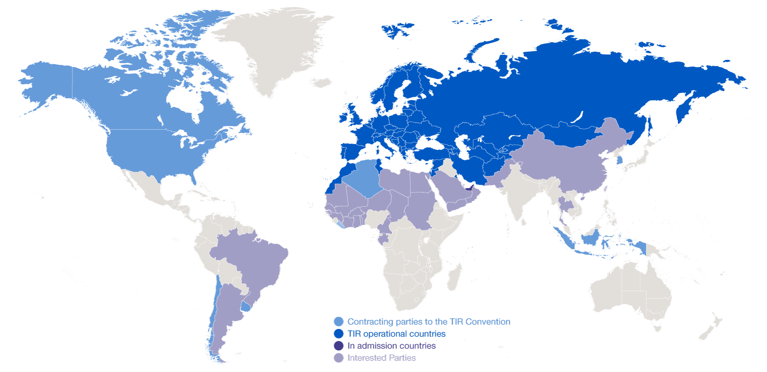
Geographical Scope of the TIR Convention

Slide 13
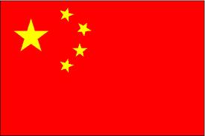

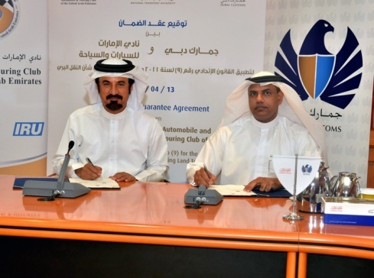
TIR Expansion : latest developments
August 2013 – China informs of its intention to accede to the TIR Convention
Increased cooperation with ESCAP
for the region
April 2014 – UAE Customs sign guarantee agreement
April 2014 – Pakistan officially confirms forthcoming accession to TIR
Interest in TIR also expressed by Argentina, Brazil, Mexico, Iraq, KSA and various African countries

Slide 14
Forthcoming implementation of TIR in China

Slide 15
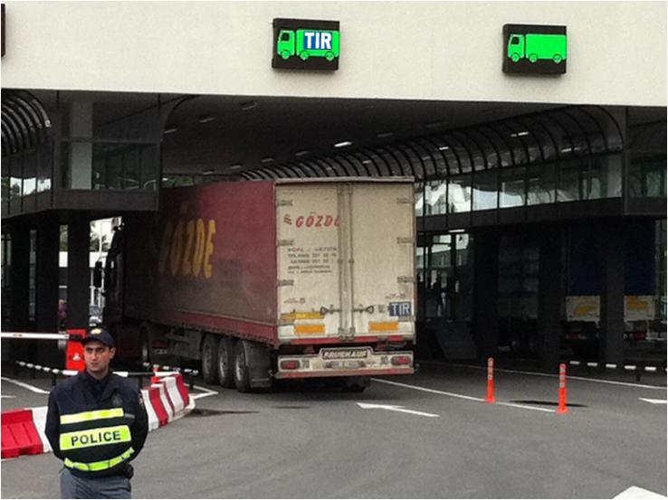

We want to see this ...

Slide 16
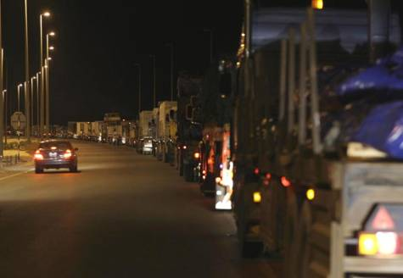
….instead of this by….

Slide 17
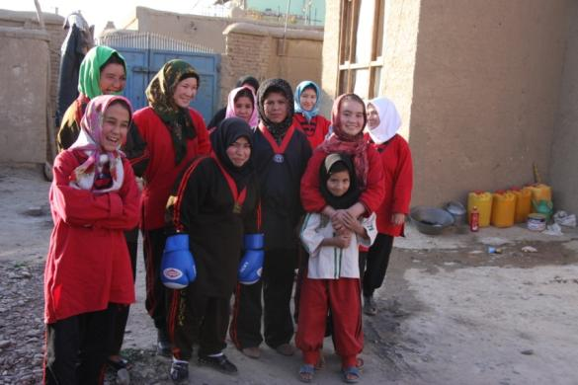
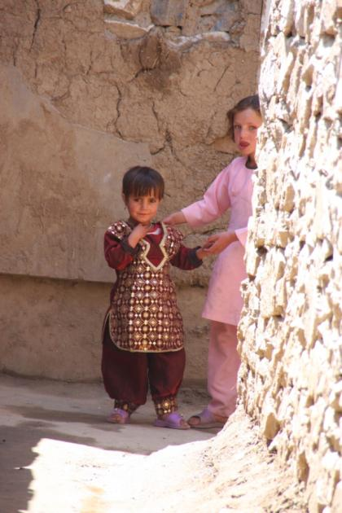
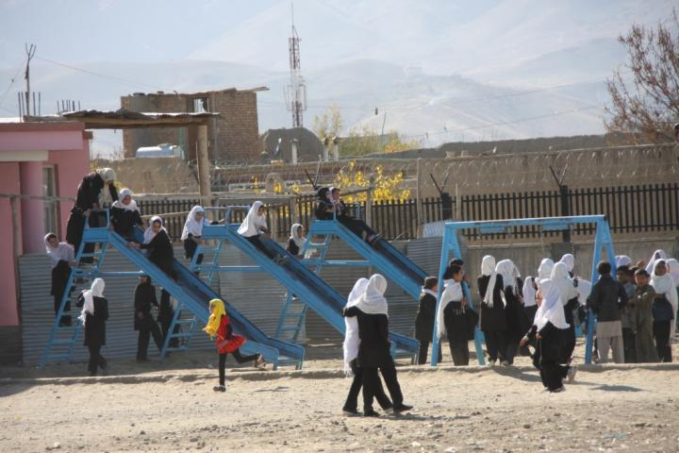
We can bring them hope!

