Slide 1
ASIA-PACIFIC BUSINESS FORUM 2014
Plenary Session 1
Connecting the Region through Trade and Investment
Colombo, 26 November 2014
Umberto de Pretto
Secretary General

Slide 2
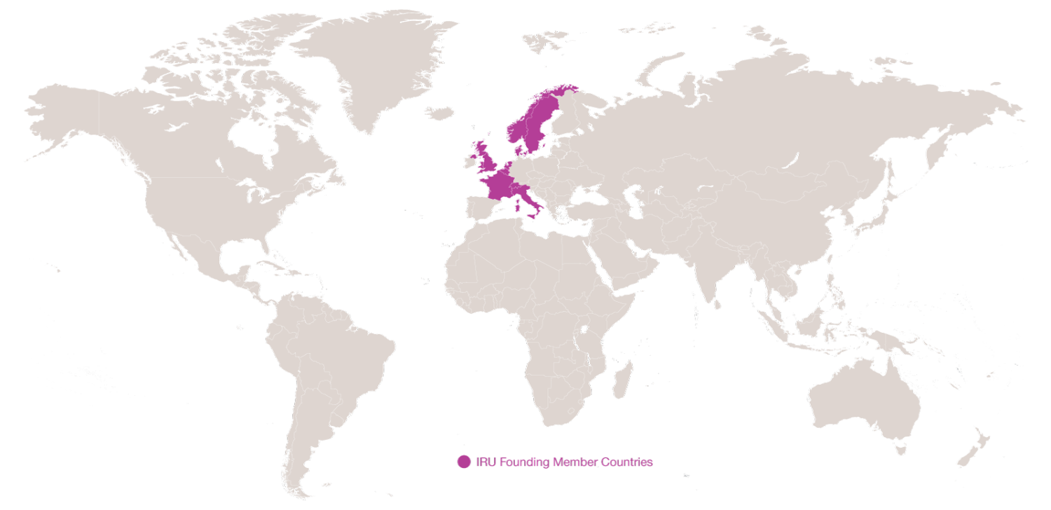
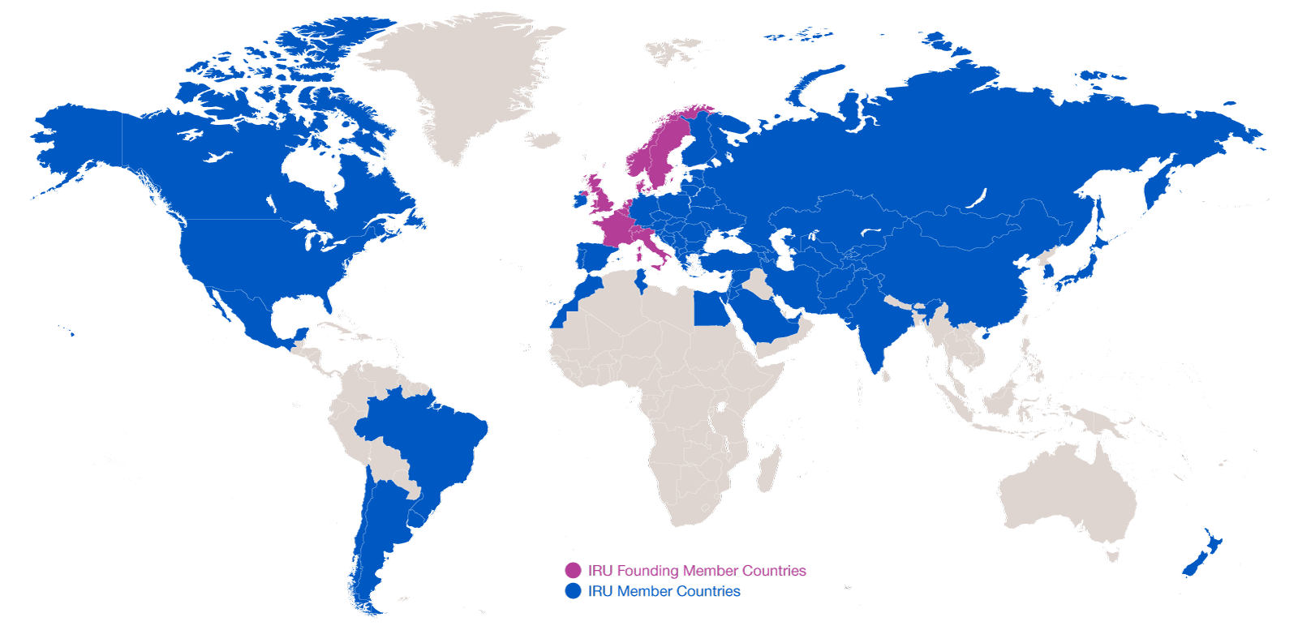
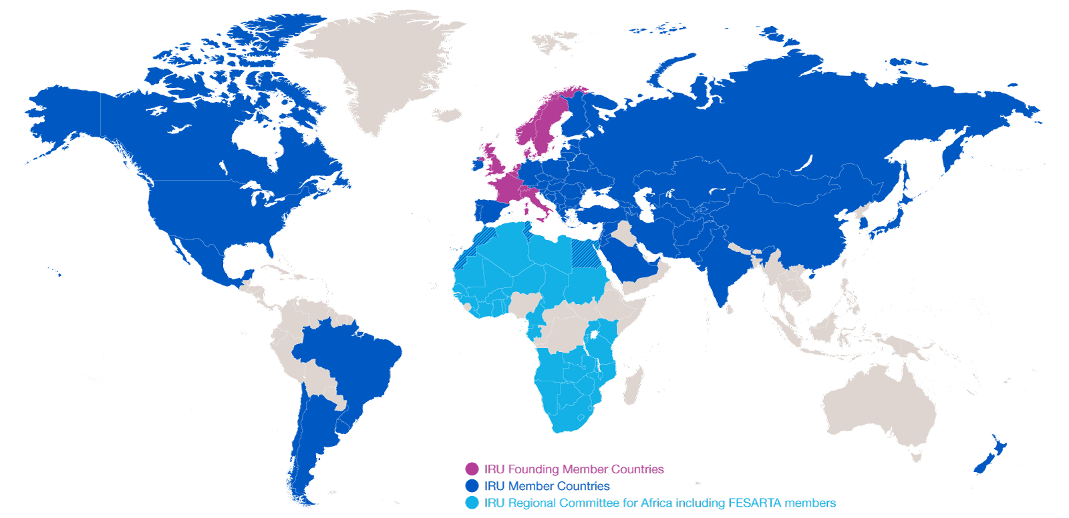
Evolution of IRU Membership
2014: 170 Members in 75 countries
2014: 170 Members in 75 countries
1948: eight founder countries
…and CRIPA: 27 Members + FESARTA in 38 countries

Slide 3

Globalisation
What does it take to have a cup of coffee in a café?
The combined efforts of 29 companies in
18 countries
Road Transport has become a vital production tool!
Source: IRU

Slide 4
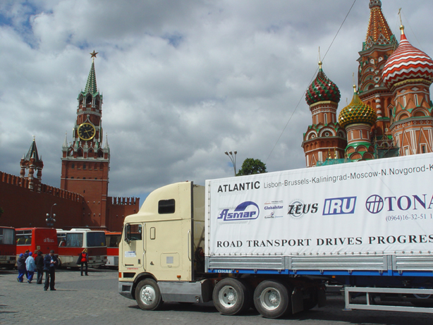
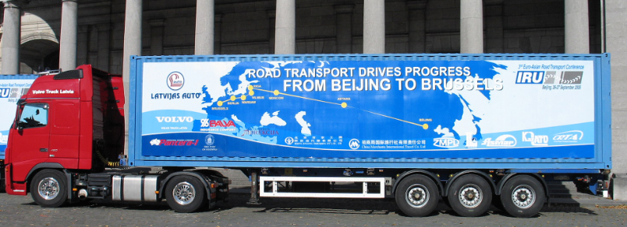
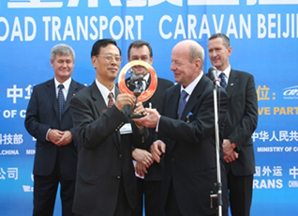
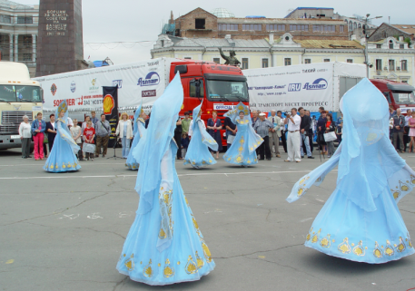
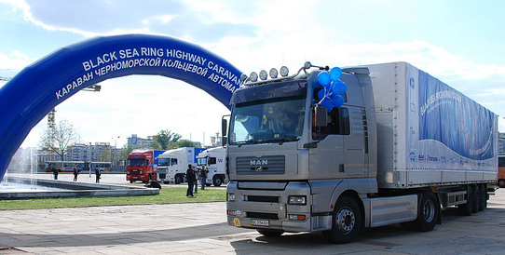
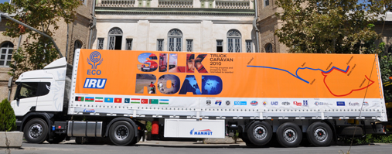
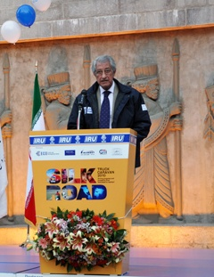
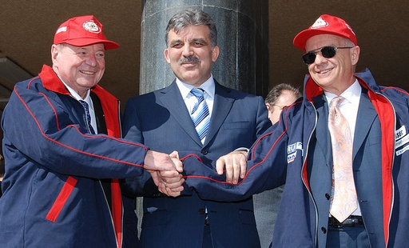
Caravans demonstrate adequate infrastructure exists
The Lisbon-Vladivostok Caravan
The Beijing-Berlin-Brussels Caravan
Black Sea Highway Caravan
IRU-ECO Silk Road Truck Caravan

Slide 5
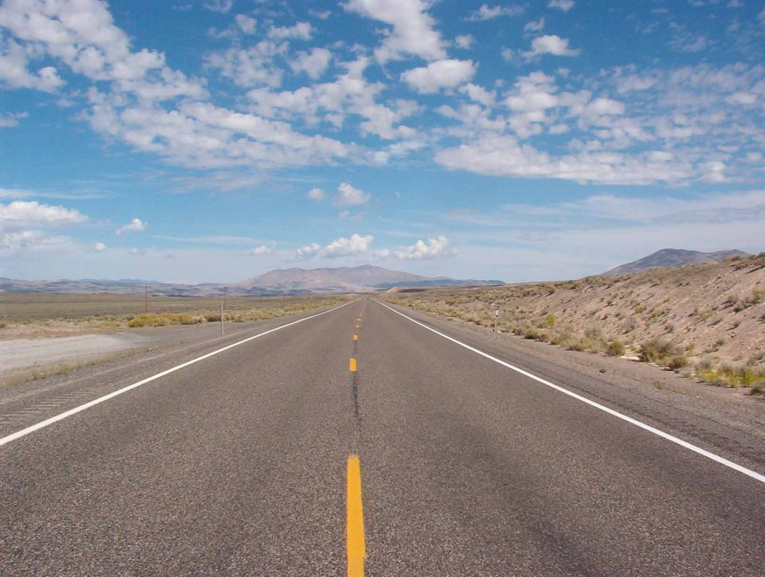
IRU Caravan drivers saw this… adequate roads but little traffic!!

Slide 6
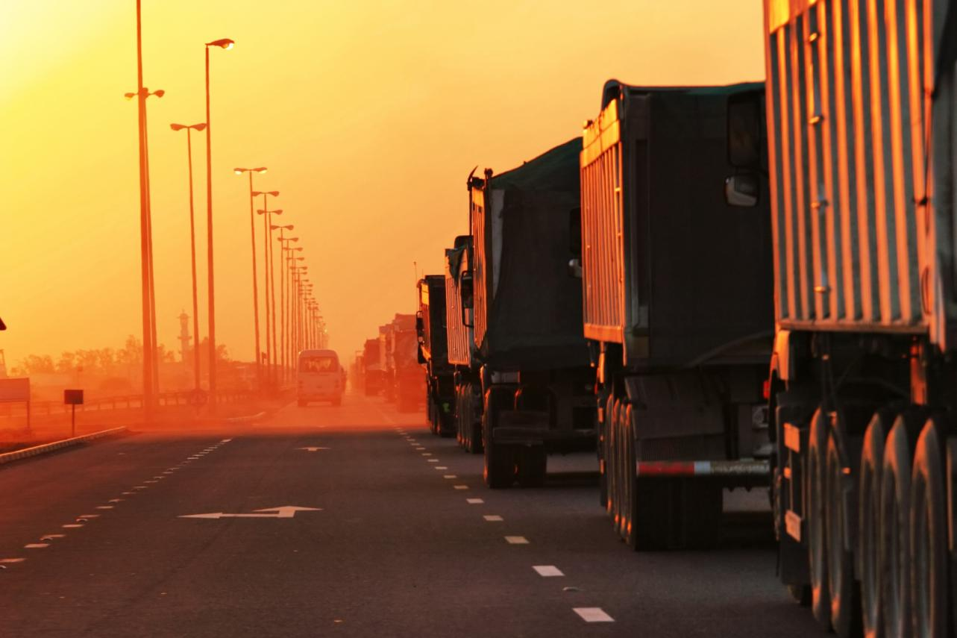
…until they reached border crossings!!

Slide 7




IRU New Eurasian Land Transport Initiative (NELTI)
From September 2008
Monitoring over 200,000 border crossings
57% of transport time lost at border crossings
38% of transport costs due to unofficial levies

Slide 8
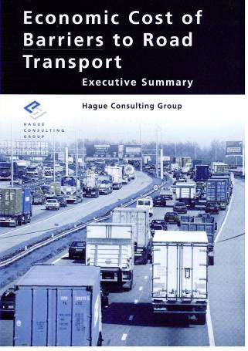
Any penalty on road transport is an even greater penalty on the economy as a whole!
* Includes lost opportunities
Source: Hague Consulting Group

Slide 9
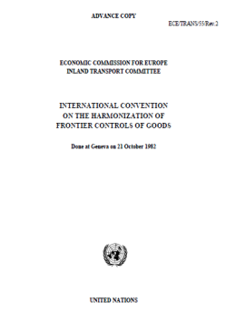

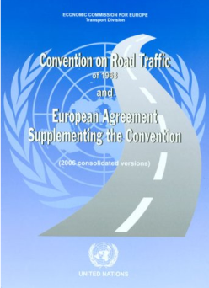

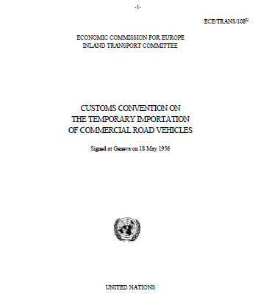
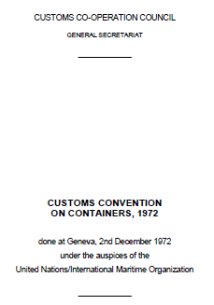
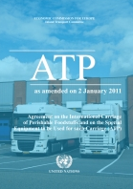
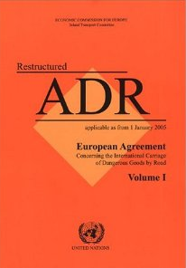
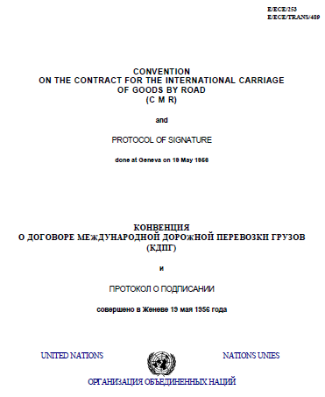
Implement key UN facilitation instruments to allow transport to drive trade!

Slide 10
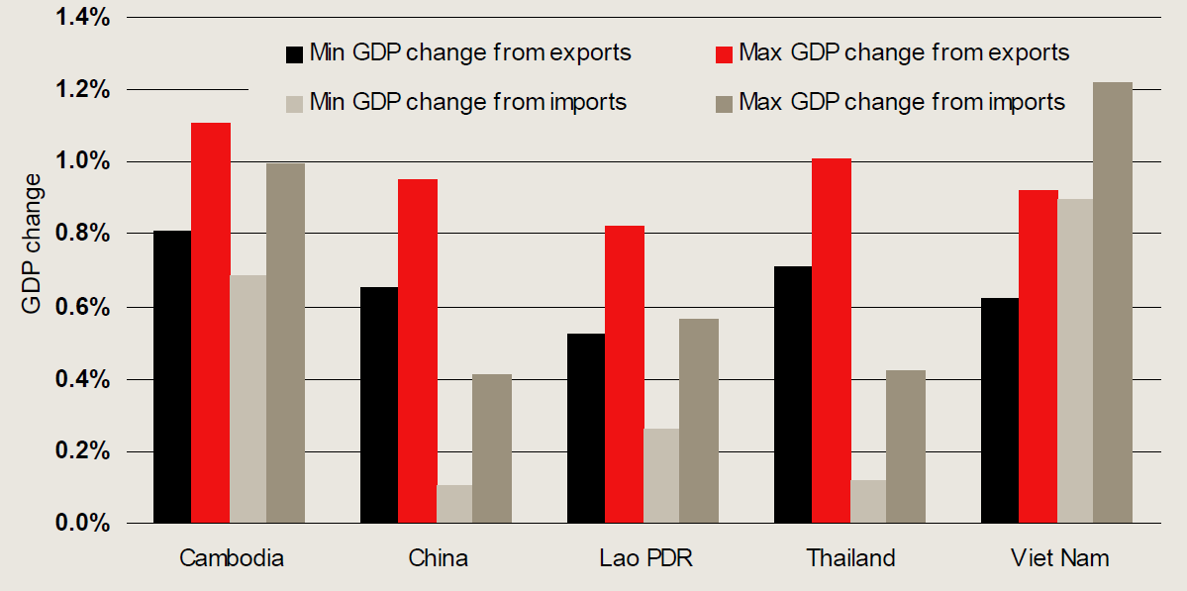
Facilitating transport and thus trade in UNESCAP countries has huge potential
Every one day reduction in time to trade equals an increase in GDP by ~1%
Source: Centre for International Economics – Government of Australia 2010

Slide 11
Securing and facilitating trade and international road transport
Transports
Internationaux Routiers
Managed by the IRU since 1949

Slide 12
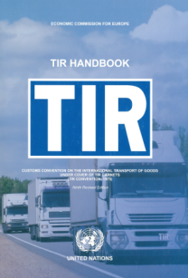


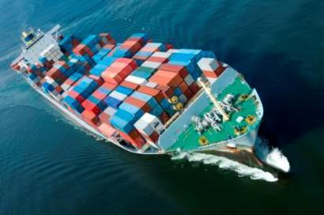
What is the TIR System?
A tried and tested, affordable facilitation instrument for international transport and trade
  Global
  Intermodal
  Secure
Based on TIR Convention of 1975, signed by 68 contracting parties

Slide 13
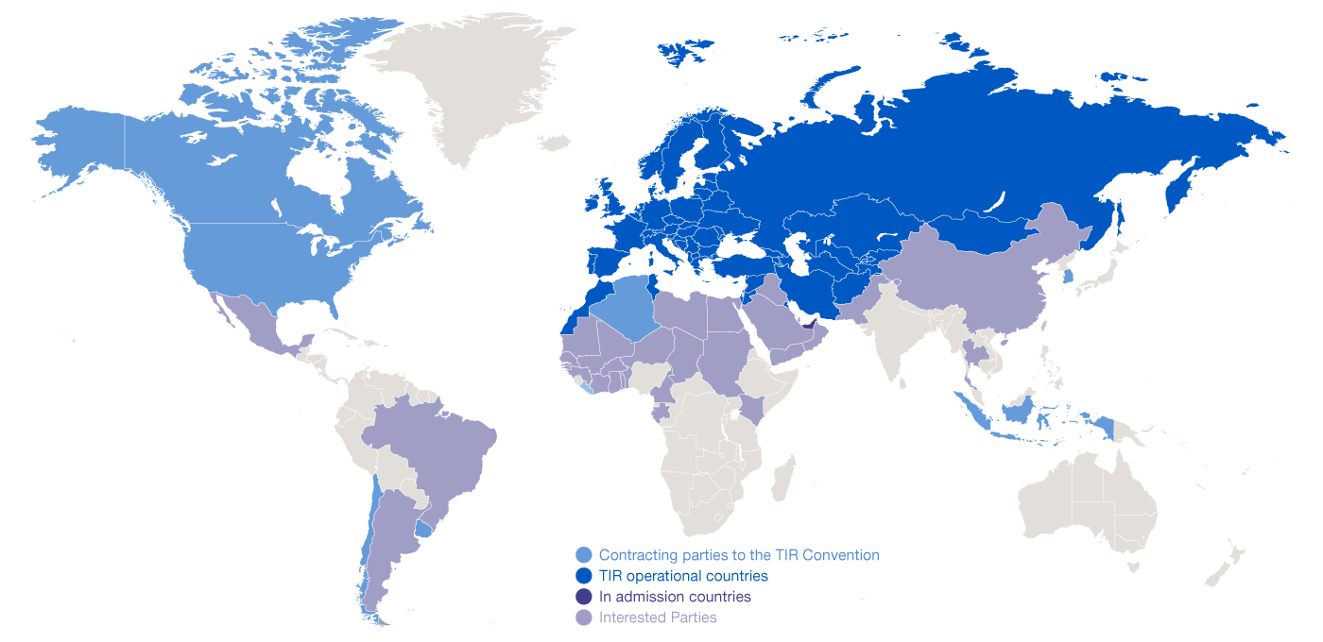
Geographical Scope of the TIR Convention

Slide 14
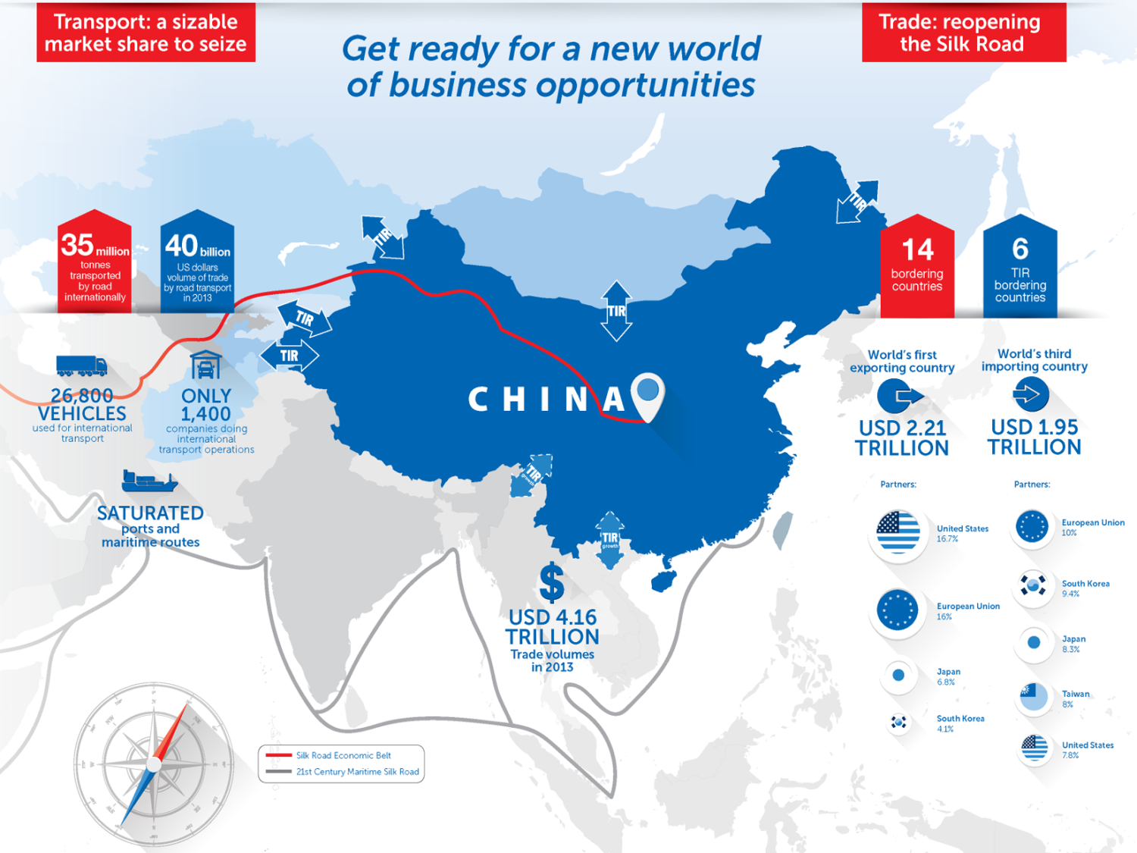
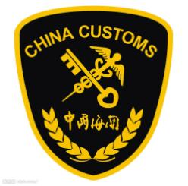
China intensifies steps towards TIR accession

Slide 15
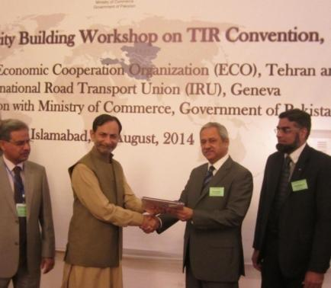
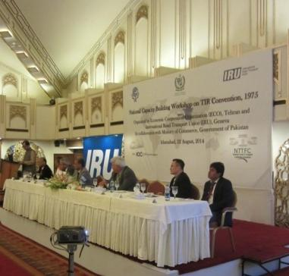


Pakistan finalising accession process
  Authorities have given official commitment to TIR accession
  File is on agenda of Cabinet of Ministers
  Accession could take place as early as Q4 2014 / Q1 2015, according to sources

Slide 16
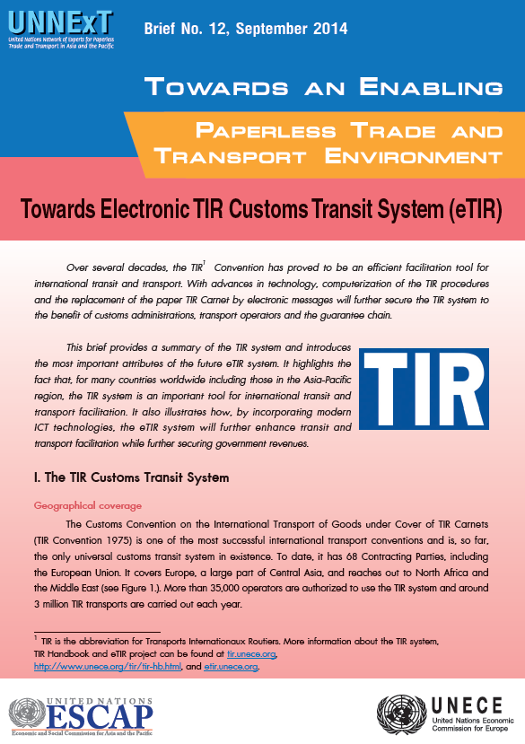
eTIR – the solution for paperless trade

Slide 17
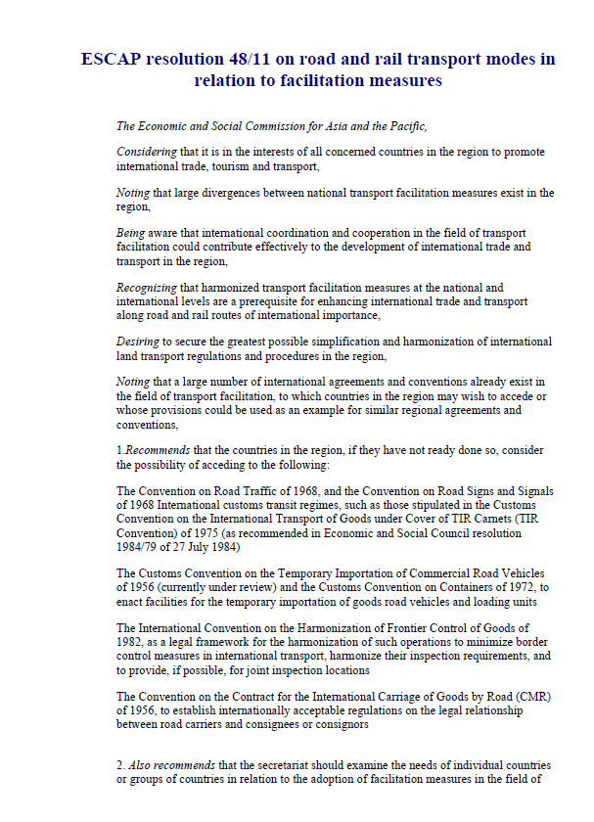
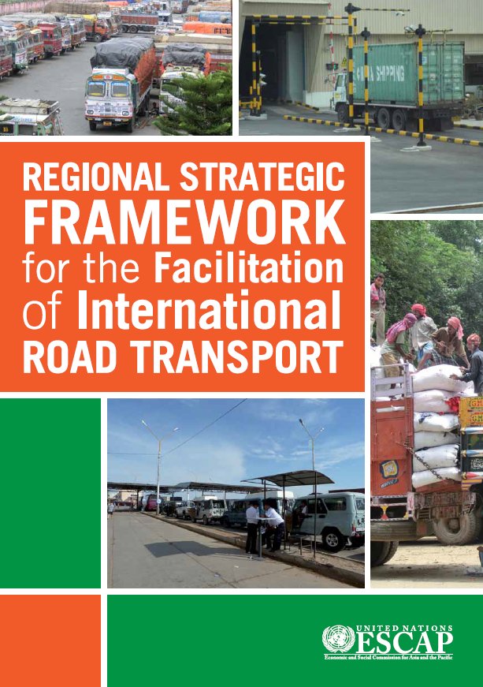
UNESCAP Resolution 48/11 and UNESCAP strategic framework calls on Governments to implement TIR
Adopted on 23 April 1992
Established on 14 June 2013

Slide 18
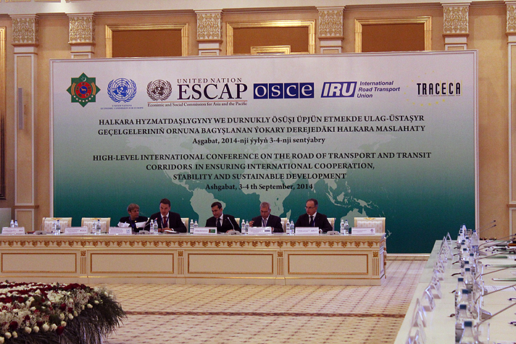
International High Level Conference encourages all UNESCAP countries to implement TIR

Slide 19
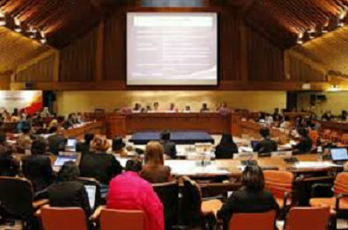
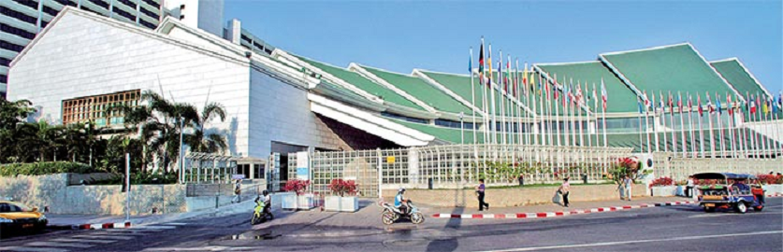

Let’s join forces as …

Slide 20
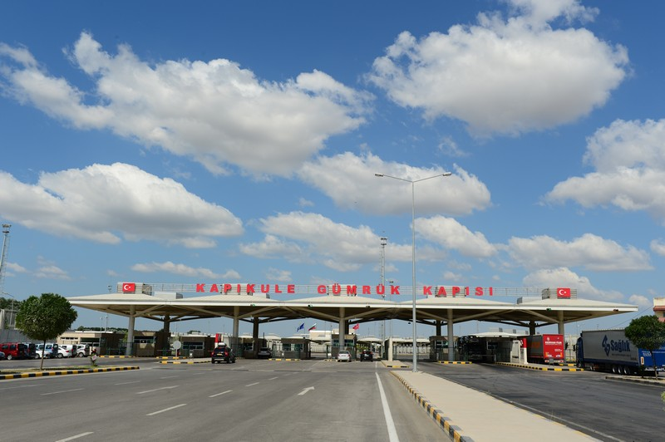
We want to see this...

Slide 21
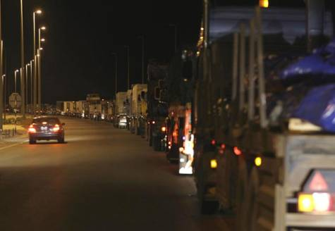
…instead of this

Slide 22
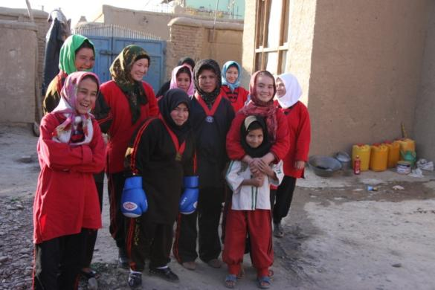
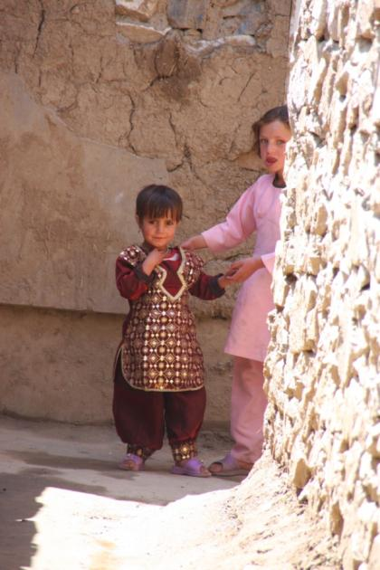
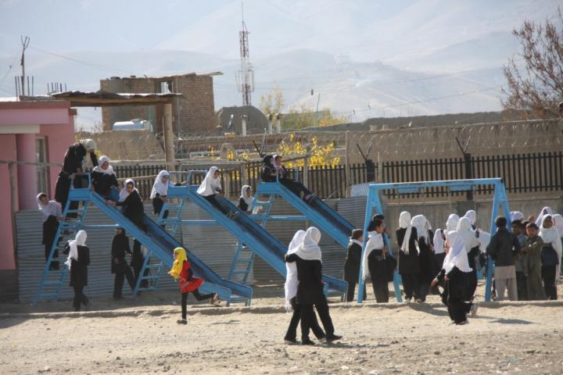
To bring them hope!

