Slide 1

OSCE Economic and Environmental Committee Meeting on Transport
Vienna, 18 September 2013
Road transport:
Making land-locked
countries land-linked!
Umberto de Pretto
IRU Secretary General

Slide 2
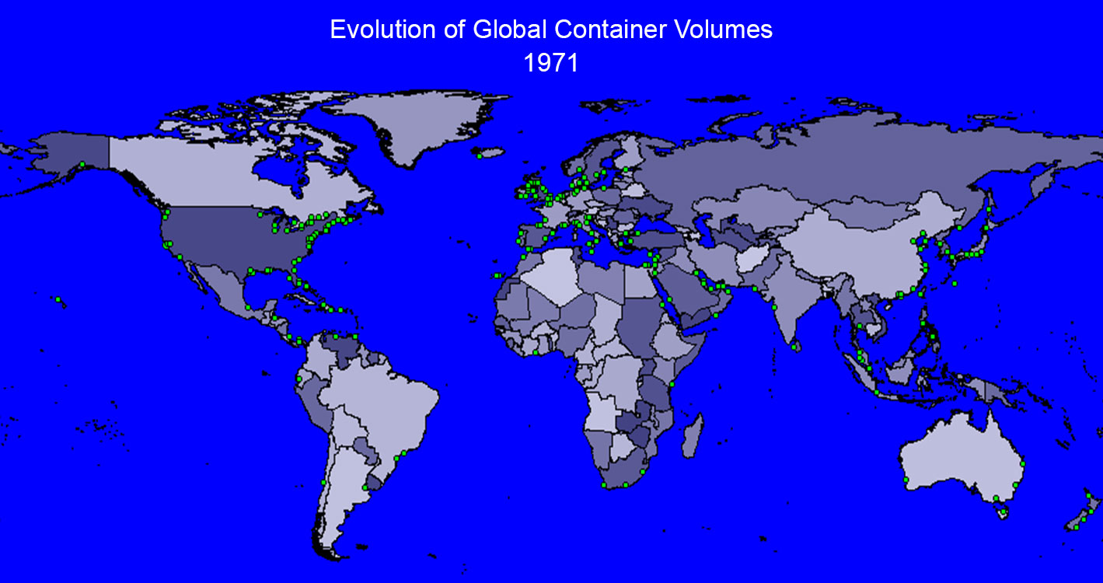

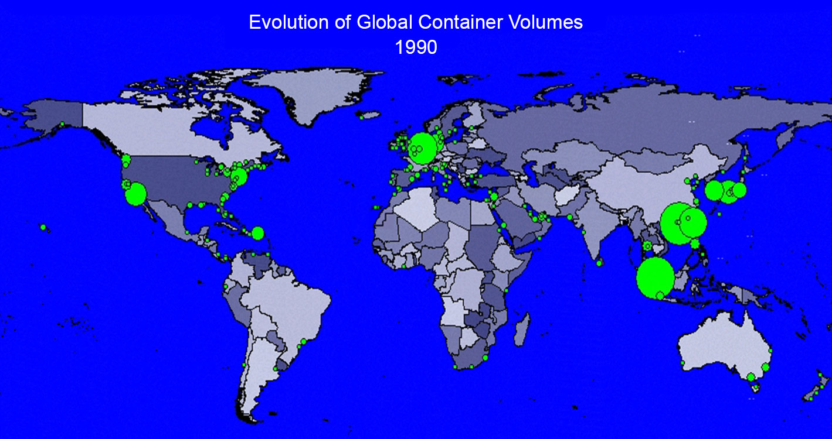
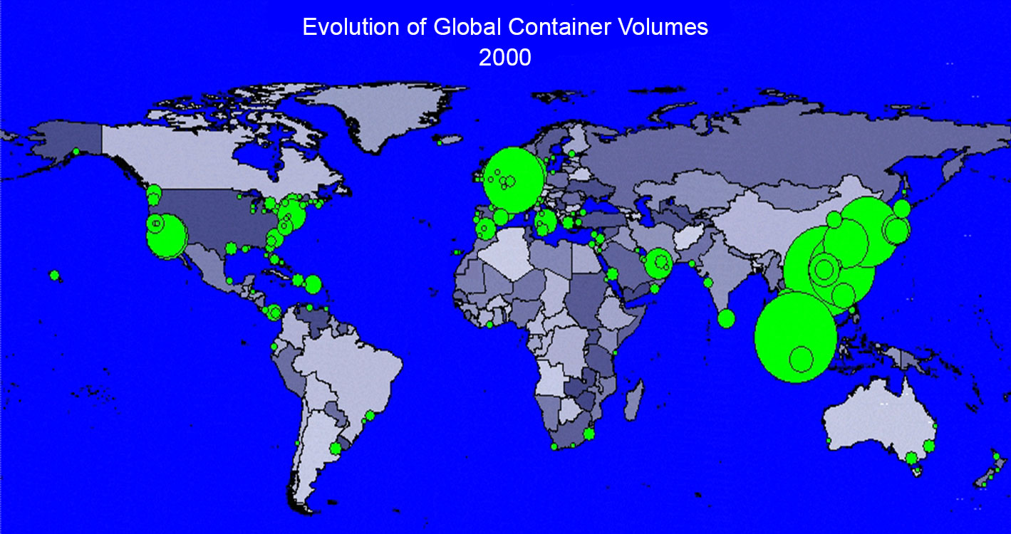
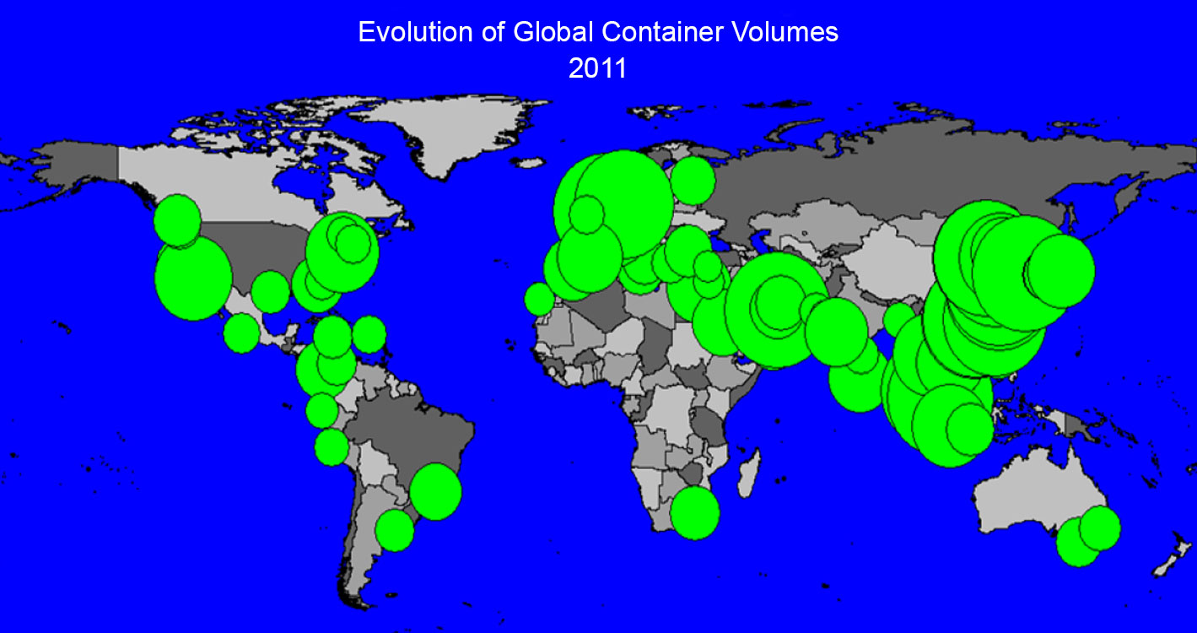
Evolution of sea containers
in ports

Slide 3
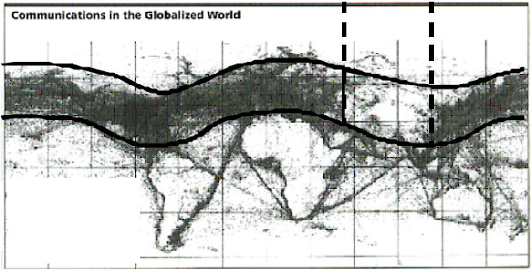
Daily telecommunications activities
Telecommunications gap corresponds to the regions that have not been interconnected to global trade
Source: Centre for Strategic International Studies (CSIS), Washington, DC

Slide 4
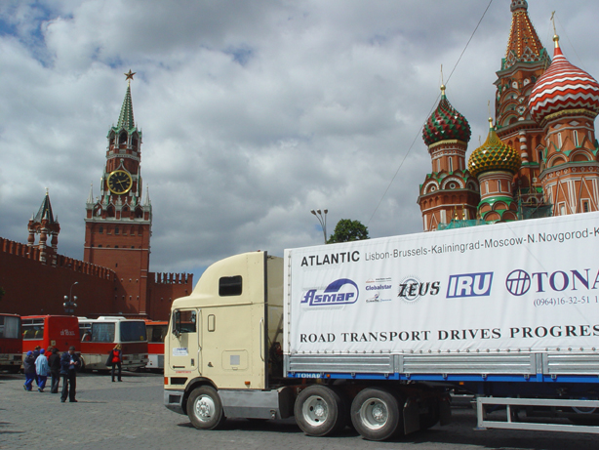
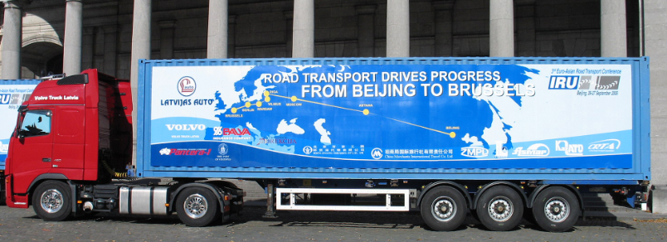
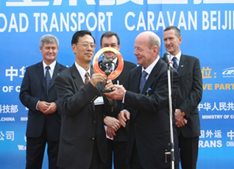
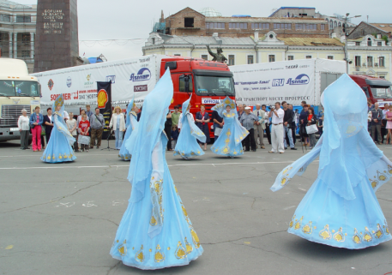
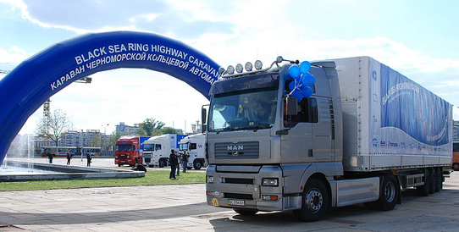
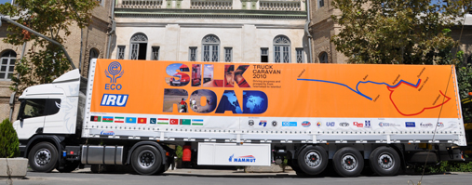
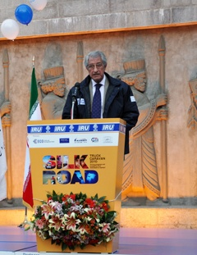
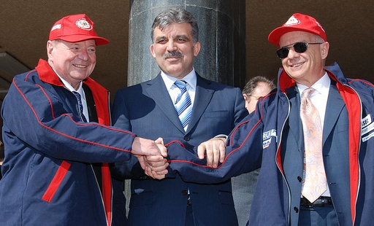
IRU Caravans: No country is landlocked to road transport!
2004: The Lisbon-Vladivostok Caravan
2005: The Beijing-Berlin-Brussels Caravan
2007: Black Sea Highway Caravan
2010: IRU-ECO Silk Road Truck Caravan

Slide 5
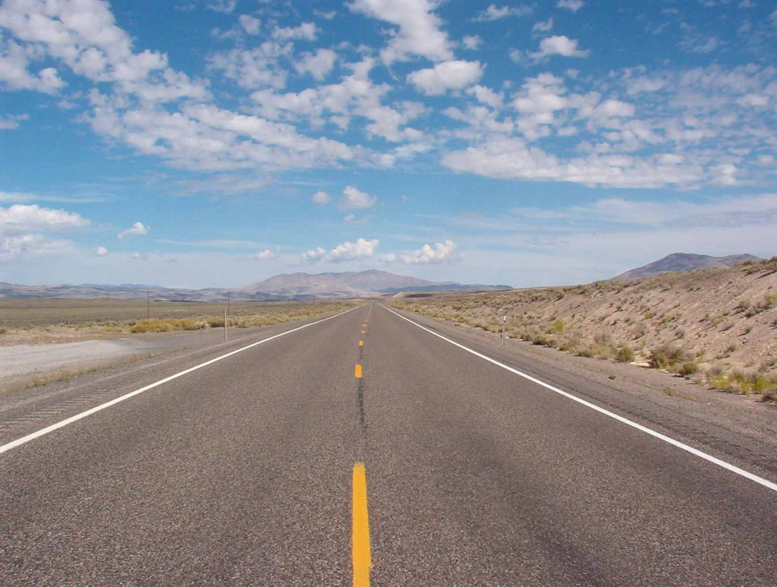
IRU Caravans demonstrated that adequate roads exist, but that there is little traffic!!

Slide 6
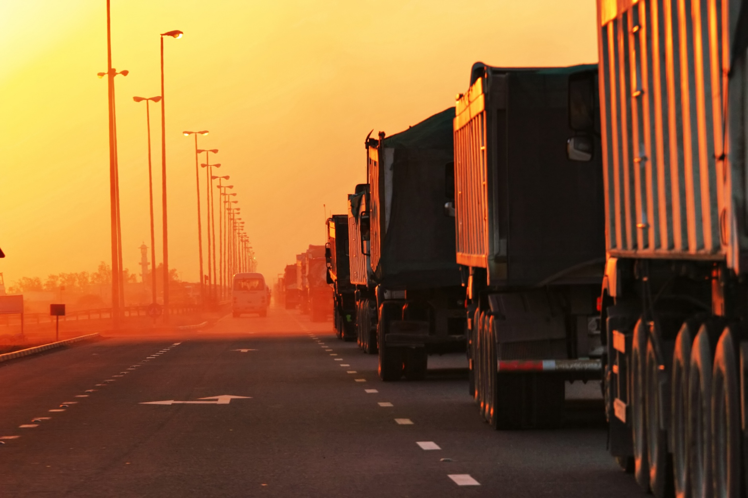
…until the trucks reached border crossings!!

Slide 7




IRU New Eurasian Land Transport Initiative (NELTI)
From September 2008 to date
Monitoring of over 200,000 border crossings
57% of transport time lost at border crossings!
38% of transport costs due to unofficial levies

Slide 8
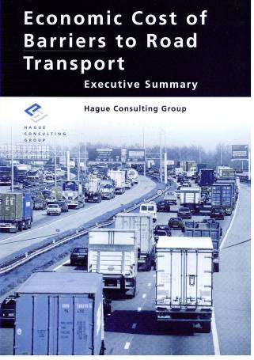
Any penalty on road transport is an even greater penalty on the economy as a whole!
Source: Hague Consulting Group
* Includes lost opportunities

Slide 9
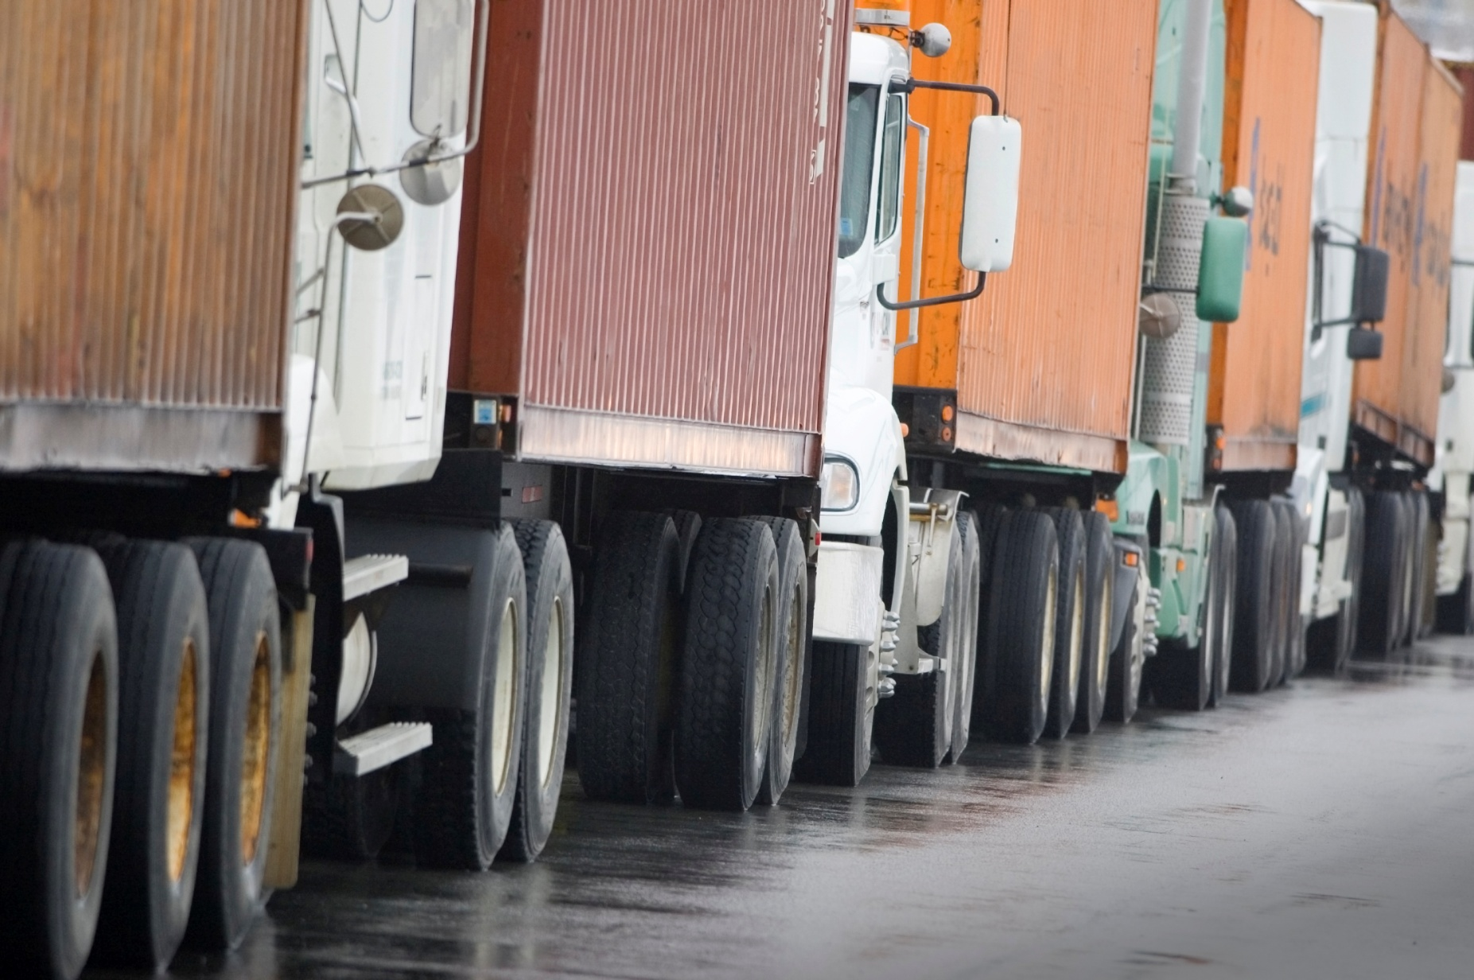
How can we change this view and let road transport drive trade, progress and prosperity?

Slide 10
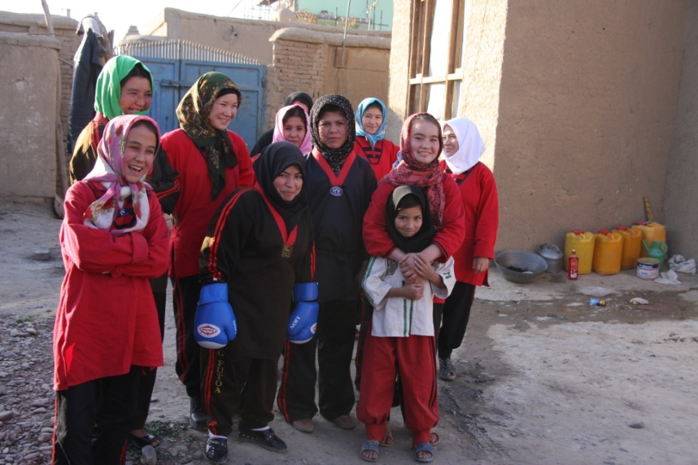
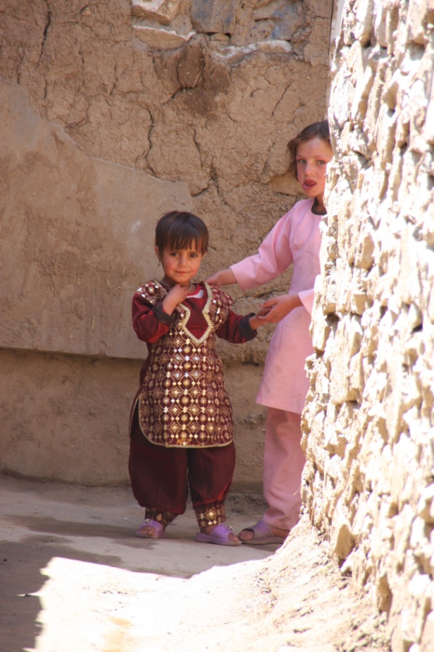
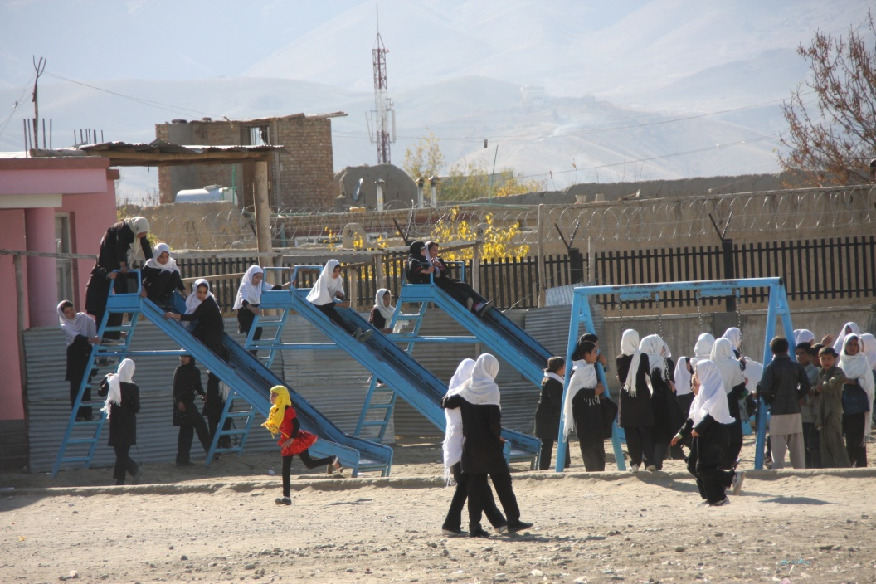
To bring them hope!

Slide 11
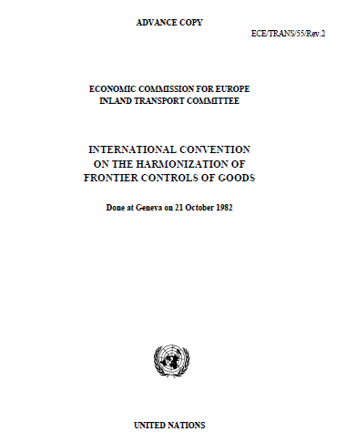
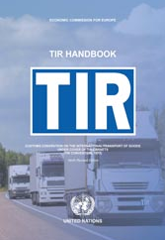
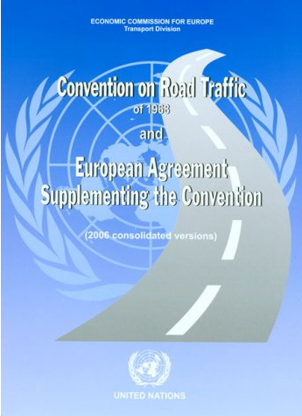
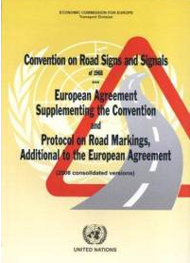
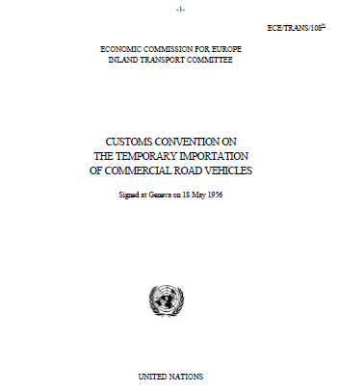
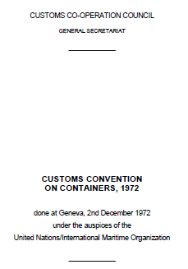
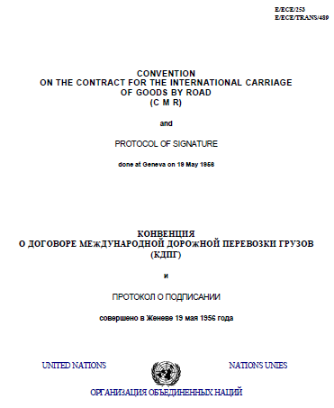
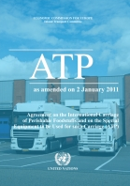
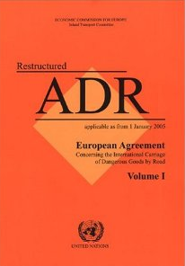
Implement key UN trade facilitation and security instruments to allow countries to be land linked!

Slide 12

www.iru.org

