Slide 1
Financing road infrastructure
European Parliament, Brussels, 4 November 2014
Marc Billiet, Head EU Goods Transport

Slide 2
This is the IRU

Slide 3
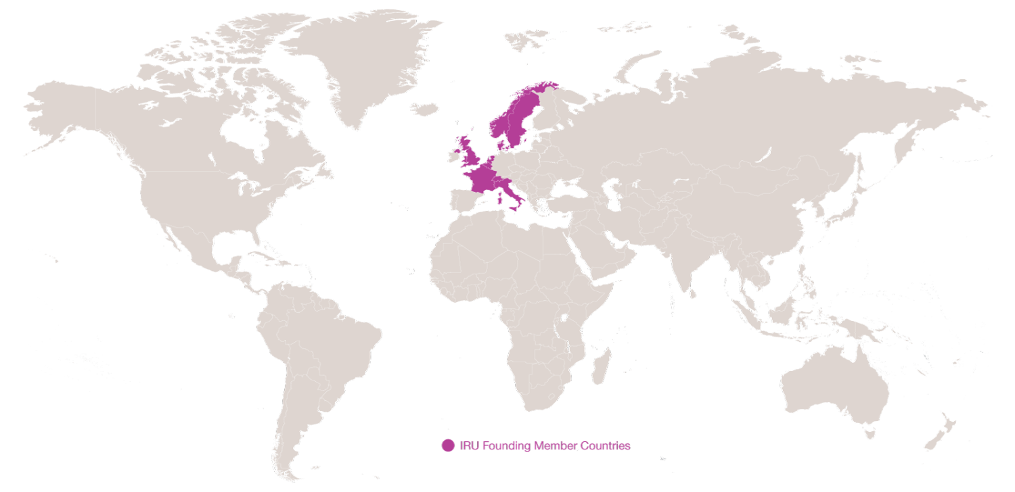
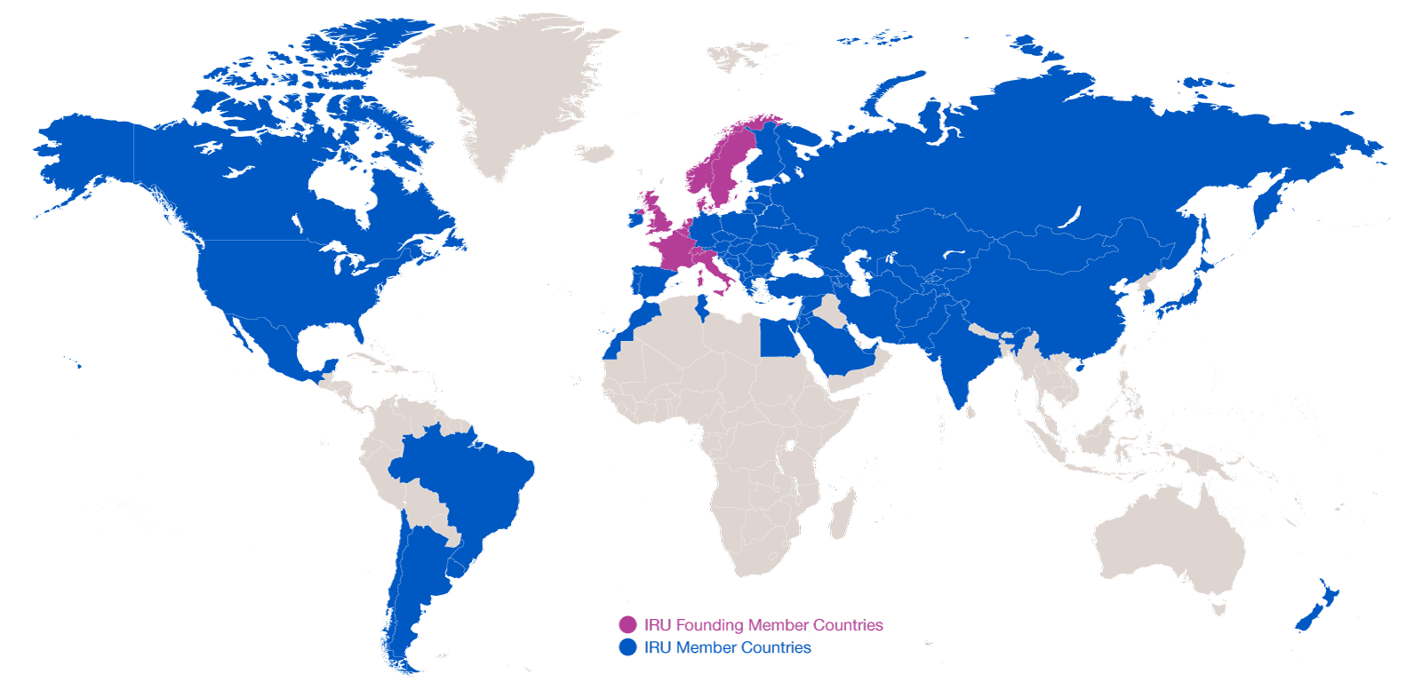
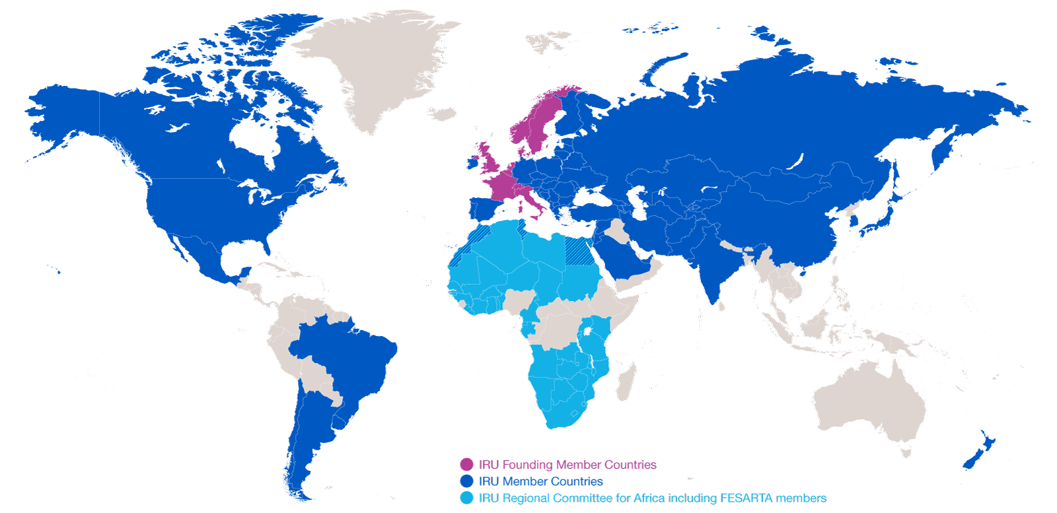
Evolution of IRU Membership
2014: 170 Members in 75 countries
2014: 170 Members in 75 countries
1948: eight founder countries
…and CRIPA: 27 Members + FESARTA in 38 countries

Slide 4
Who finances road infrastructure?
The EU Member States – fuel duties, infrastructure charging, vehicle taxation
Infrastructure providers (public – private concession holders)
The road infrastructure user – taxes, duties, charges
The European Union – Cohesion & Structural funds, TEN-T
Member States have different means at their disposal to finance infrastructure and to make the “user” pay.

Slide 5
Do we need to pay more?
Today, who pays what, how much, where, when and how?
In Germany: cost coverage of 264% (all roads, all users) in 2007. (DIW, 2009)
In the Netherlands: cost coverage of 167% (all roads, all users in 2009. (TLN, 2014)
In France: cost coverage of 240% (all roads, all users) in 2011. (Prud’homme, 2013)
Evidence of insufficient payment before deciding on who should pay more, how much, where and how!
Is infrastructure charging the right choice?

Slide 6
Pillars for road infrastructure charging
Simple, fair, transparent and non-discriminatory.
No double payment, no increase in the overall fiscal burden for road users.
Earmarking of the revenues to road transport projects, including infrastructure, road safety, etc….
Cost-effective.
Interoperability of electronic systems.
Every transport mode should cover its infrastructure costs.

Slide 7
CONCLUSIONS:
Good road infrastructure in the EU is essential.
Adequate funding is required.
Road users tend to pay too much.
Earmarking of the revenues.
Additional payments only if proven that users do not pay enough.
Fair, transparent, non-discriminatory, cost-effective solutions.
No increase of the fiscal burden for road users.

