Slide 1

AFRICAN REGIONAL REVIEW MEETING ON THE IMPLEMENTATION OF THE ALMATY PROGRAMME OF ACTION
Addis Ababa (Ethiopia), 15-18 July 2013

Slide 2
International support measures to LLDCS
Contribution by IRU
Addis Ababa (Ethiopia), 17 July 2013
Jean Acri
Head – IRU Regional Committee
for Africa Secretariat

Slide 3
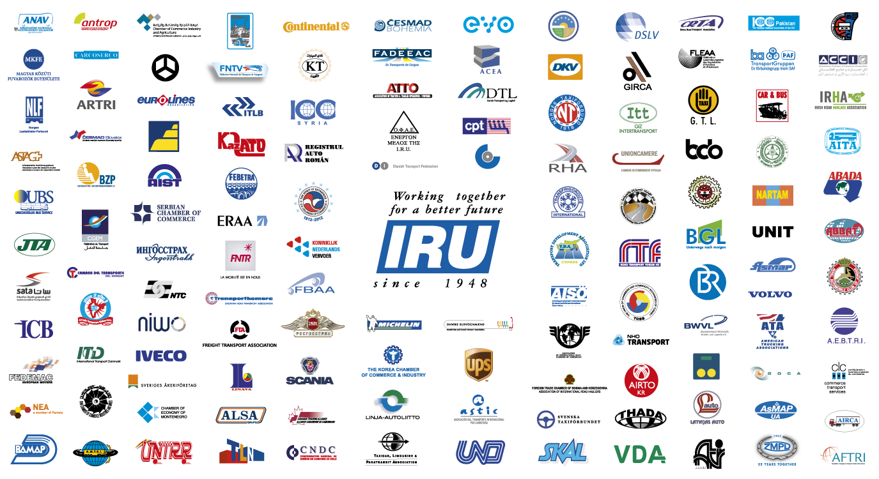
This is the IRU

Slide 4
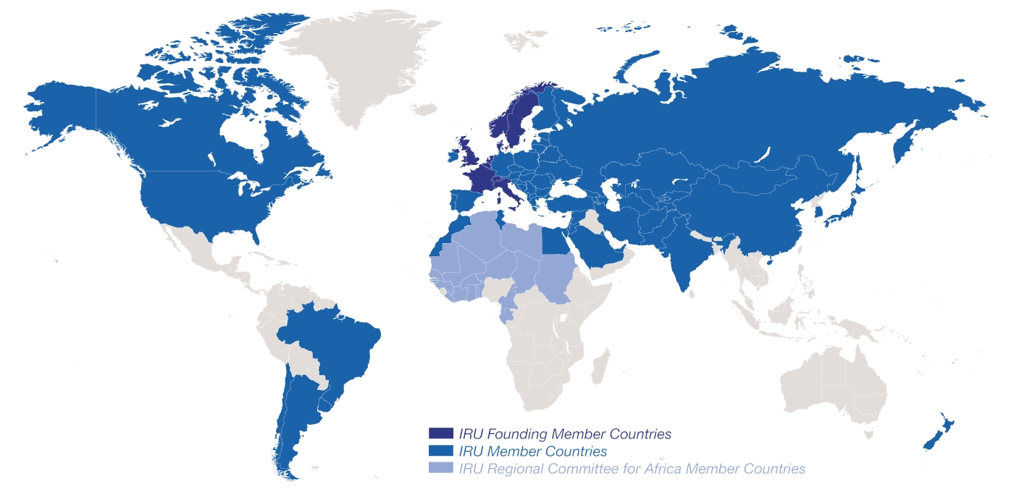
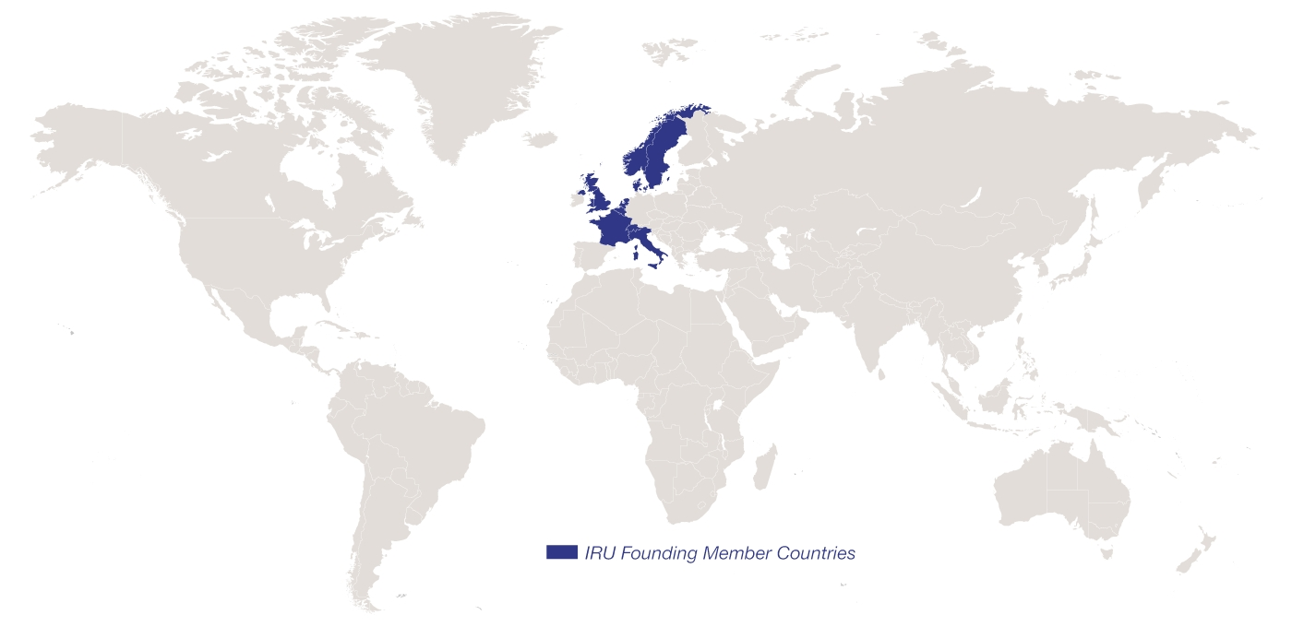
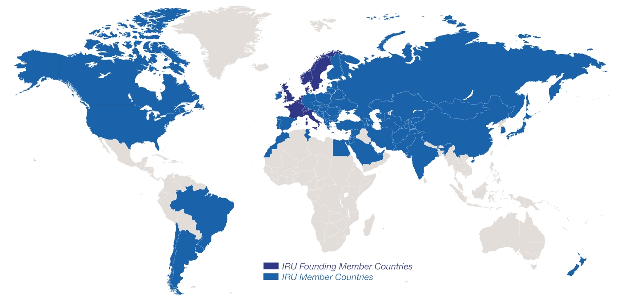
Evolution of IRU Membership
2013: 170 Members in 74 countries
2013: 170 Members in 74 countries
1948: eight founder countries
…and 26 CRIPA Members in 22 countries

Slide 5

IRU Priority Issues
Sustainable Développements
  Innovation
  Incentives
  Infrastructure
Facilitation
  Trade
  Tourism
  Road Transport
These are also the priorities of the IRU Academy

Slide 6
Securing and facilitating trade and international road transport
Transports
Internationaux Routiers
Managed by the IRU since 1949
Notes:
6

Slide 7
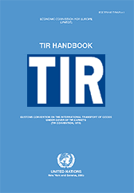


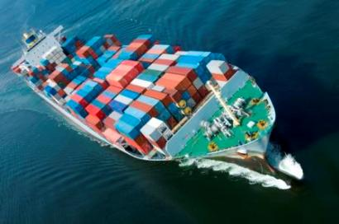
What is the TIR System?
A tried and tested, affordable facilitation instrument for international transport and trade
  Multilateral
  Multimodal (road-rail, road-maritime, road-air)
  Global
Based on TIR Convention of 1975, signed by 68 contracting parties
Notes:
7

Slide 8
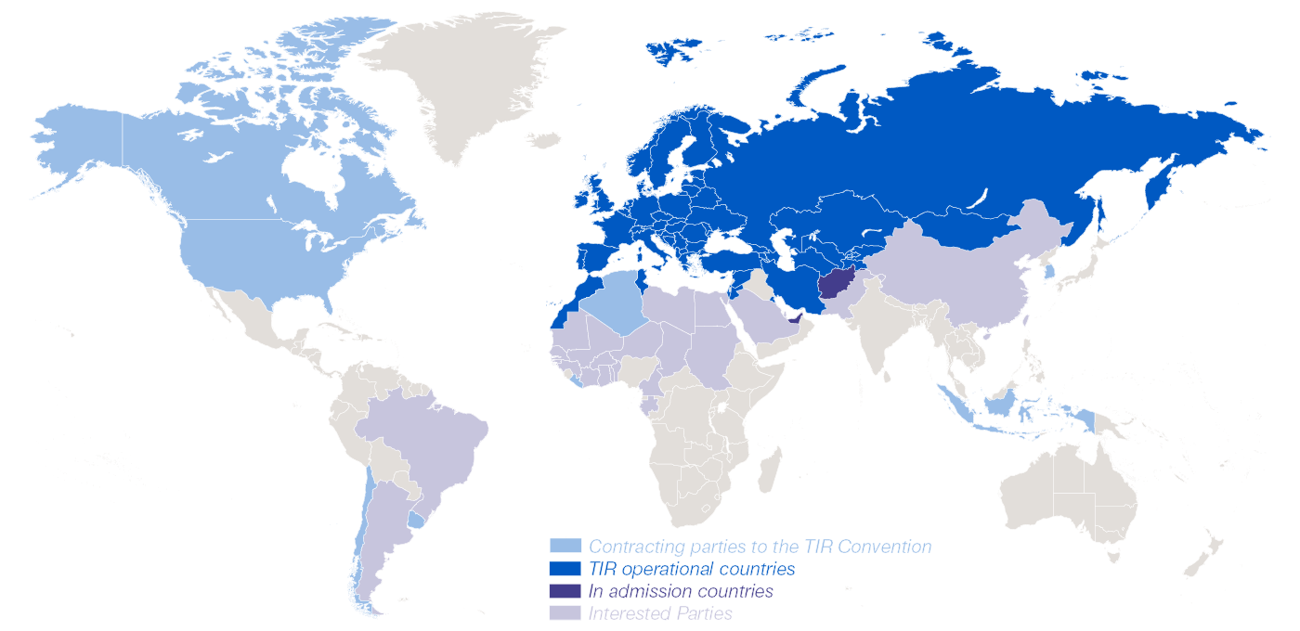
Geographical scope of the TIR Convention
IRU 2012: 3’158’300 TIR Carnets issued

Slide 9
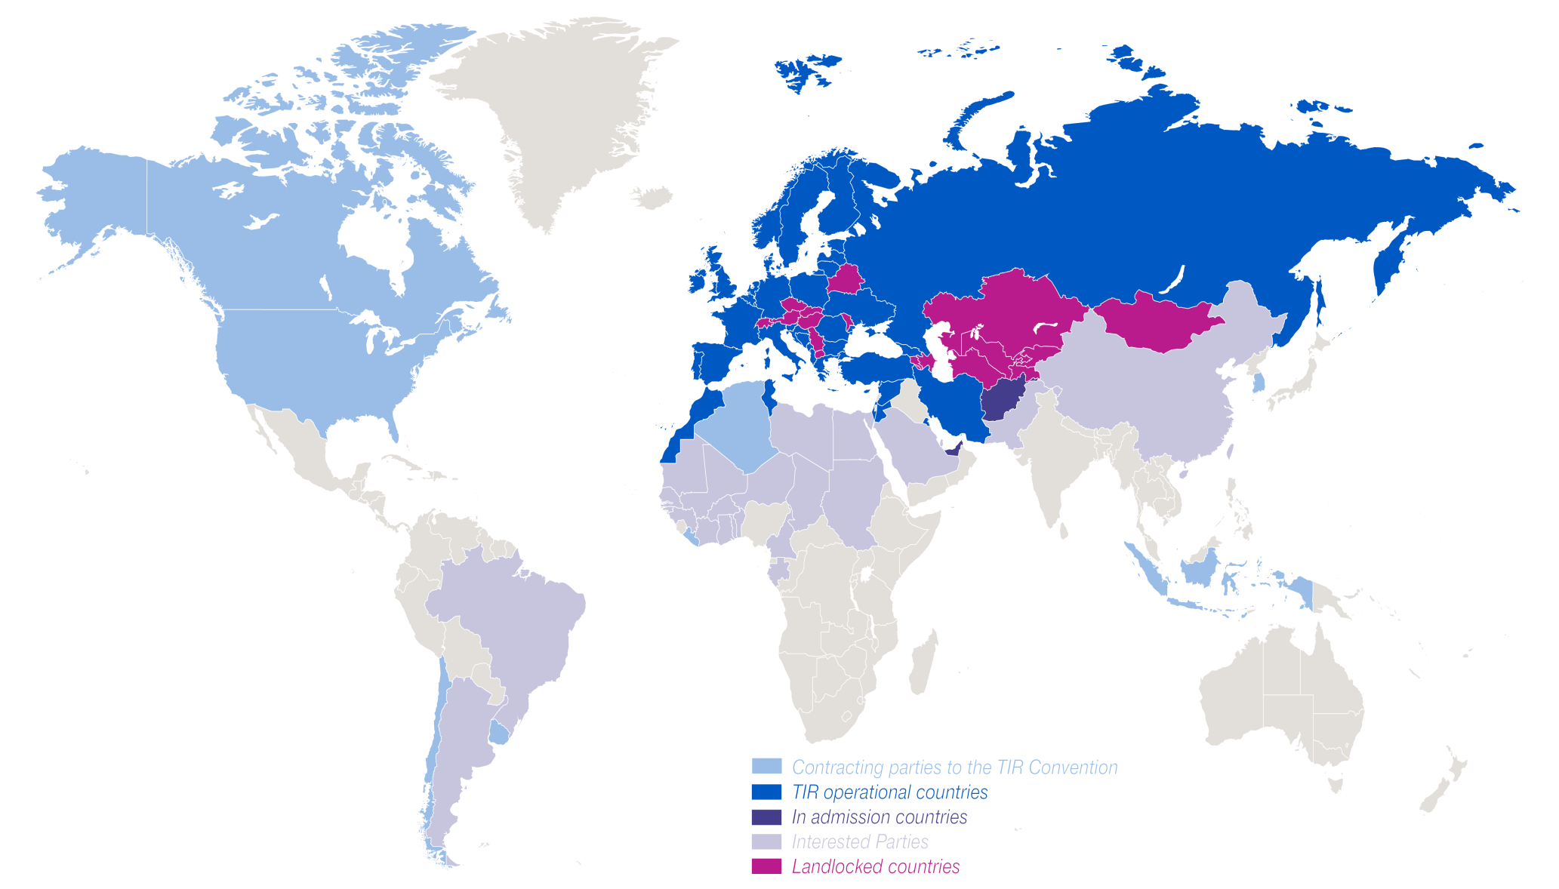
TIR Carnets issued in LLCs
LLC 2012: 507’200 TIR Carnets issued

Slide 10
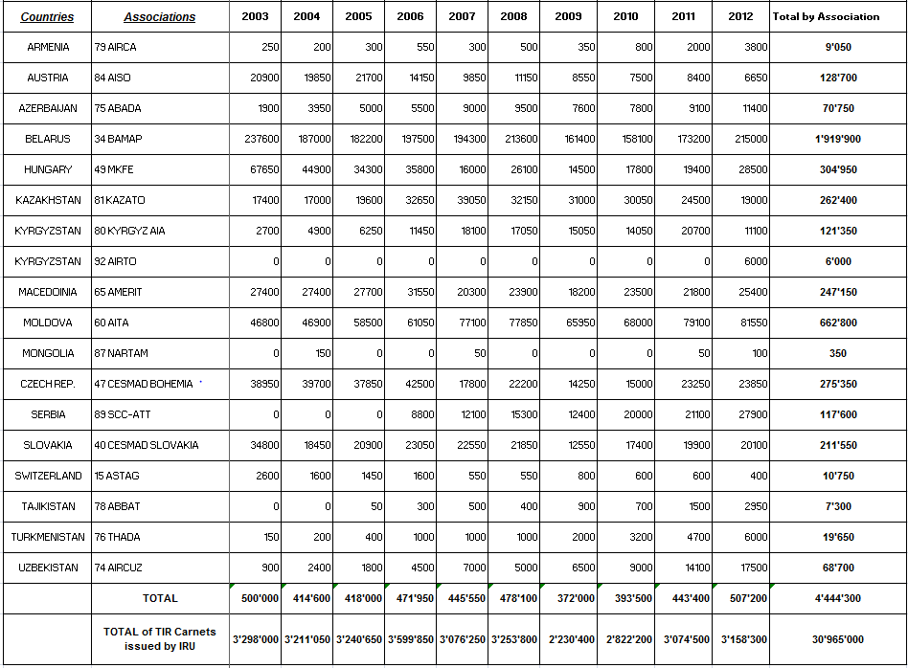
TIR Carnets issued in LLCs
LLC 2003 – 2012 = 14.35% of TIR Carnets issued

Slide 11
TIR Carnets terminated in LLCs
466’585 TIR Carnets terminated in LLC

Slide 12
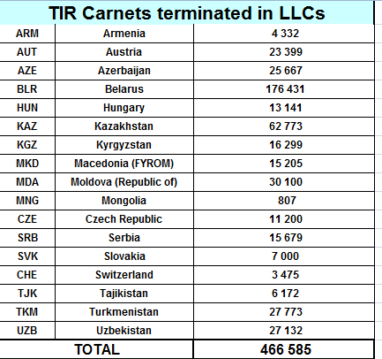
TIR transports ending in LLCs

Slide 13
Next steps
Afghanistan soon TIR operational
TIR and UN trade and road transport facilitation Conventions are an opportunity for African island developping States:
  To facilitate their access to African continental partner countries
  To benefit from harmonised procedures to ensure territorial continuity with African continent

Slide 14
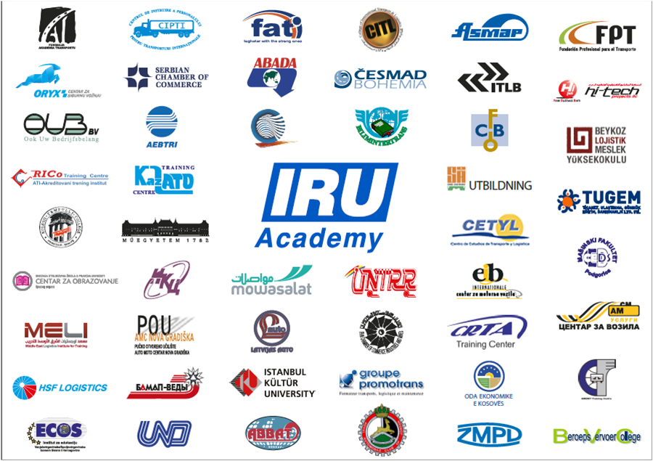




IRU Academy: Worldwide Excellence in Road Transport Training
International Network of IRU Academy Accredited Training Institutes (ATIs)
IRU Academy Advisory Committee
World Bank
United Nations Economic Commission for Europe

Slide 15
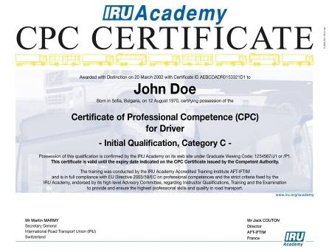
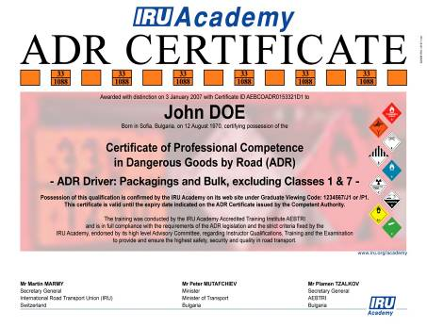
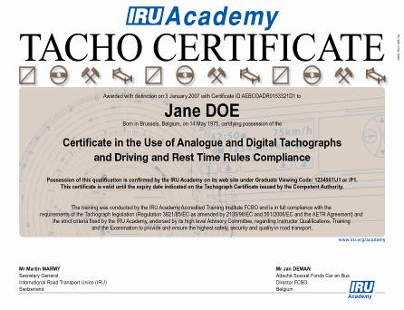
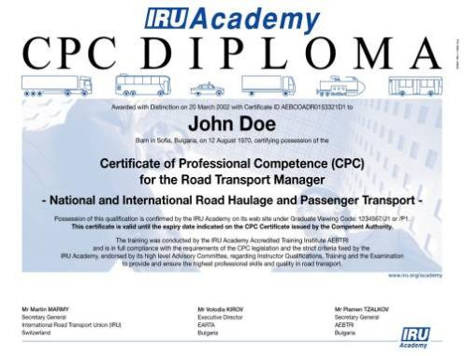
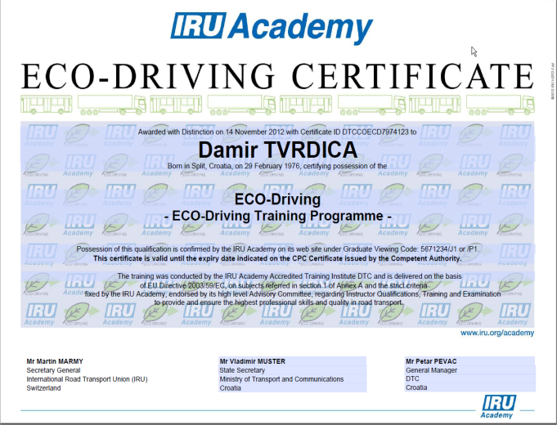
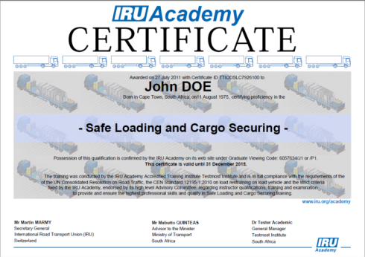
IRU Academy Programmes
Competence
Compliance
Safety
Recognition
Awareness
Notes:
15

Slide 16
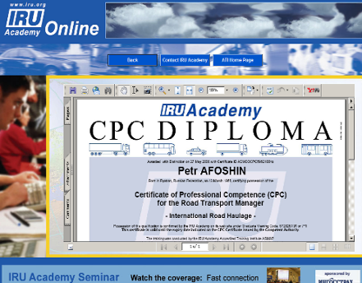
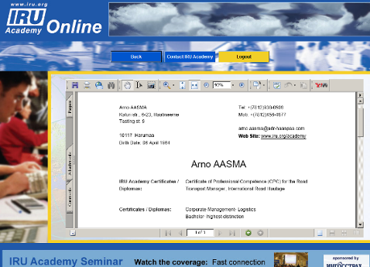
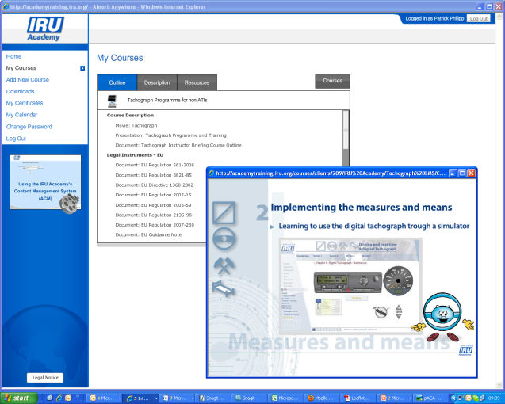
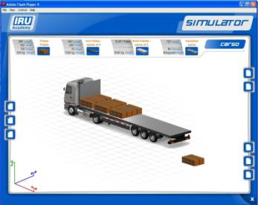
IRU Academy Online (AOL)
Promotion
ATIs to access up-to-date learning material, reference information and multimedia resources through a single web access
Knowledge
Private and secure web sites for
IRU Academy ATI promotion
IRU Academy graduate promotion
Real-time credential verification

Slide 17
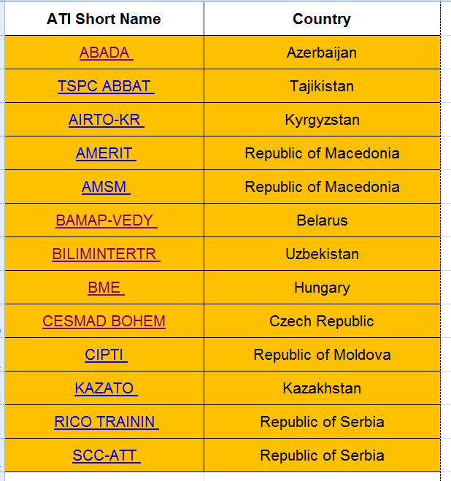
IRU Academy accredited training institutes in landlocked countries

Slide 18
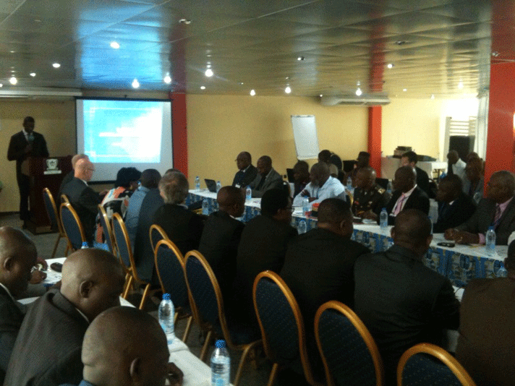
IRU briefs transport leaders of CEMAC Countries on road transport facilitation, safety and capacity building
The IRU briefed some 50 high level experts from the public and private road transport sector at seminar organised by the World Bank and the Economic and Monetary Commission for Central African countries (CEMAC - Cameroun, Chad, the Central African Republic, Congo-Brazzaville, Equatorial Guinea and Gabon), focusing on the need to further facilitate road transport, organise the profession, and develop professional training at internationally recognised standards, as provided by the IRU Academy, to ensure economic growth and enhance road safety.
Seminar participants concluded that CEMAC Member States should in priority adhere to and implement key UN multilateral trade and road transport facilitation instruments, such as the Harmonization and TIR Conventions to achieve regional and pan-African economic integration.
Douala, 15 June 2013

Slide 19

www.iru.org

