Slide 1
Prospects and challenges in view of the connectivity of Transportation Infrastructure
Chongqing, China, 27 May 2015
Dmitriy Cheltsov
General Delegate, Head of IRU Permanent Delegation to Eurasia

Slide 2
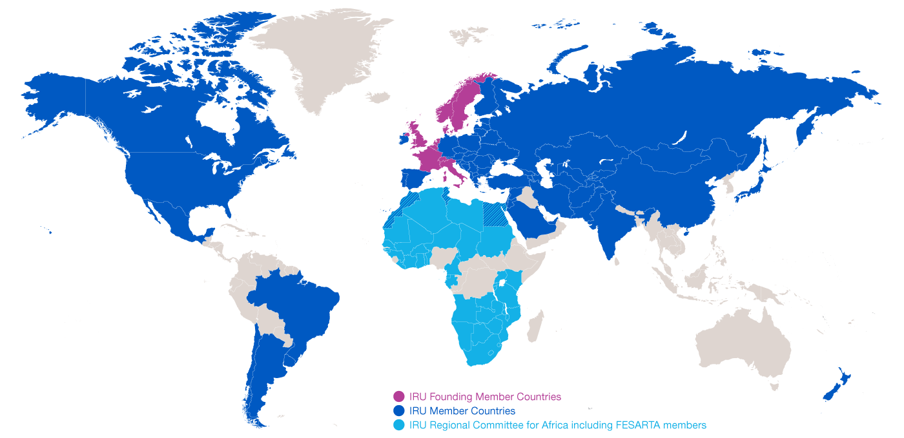
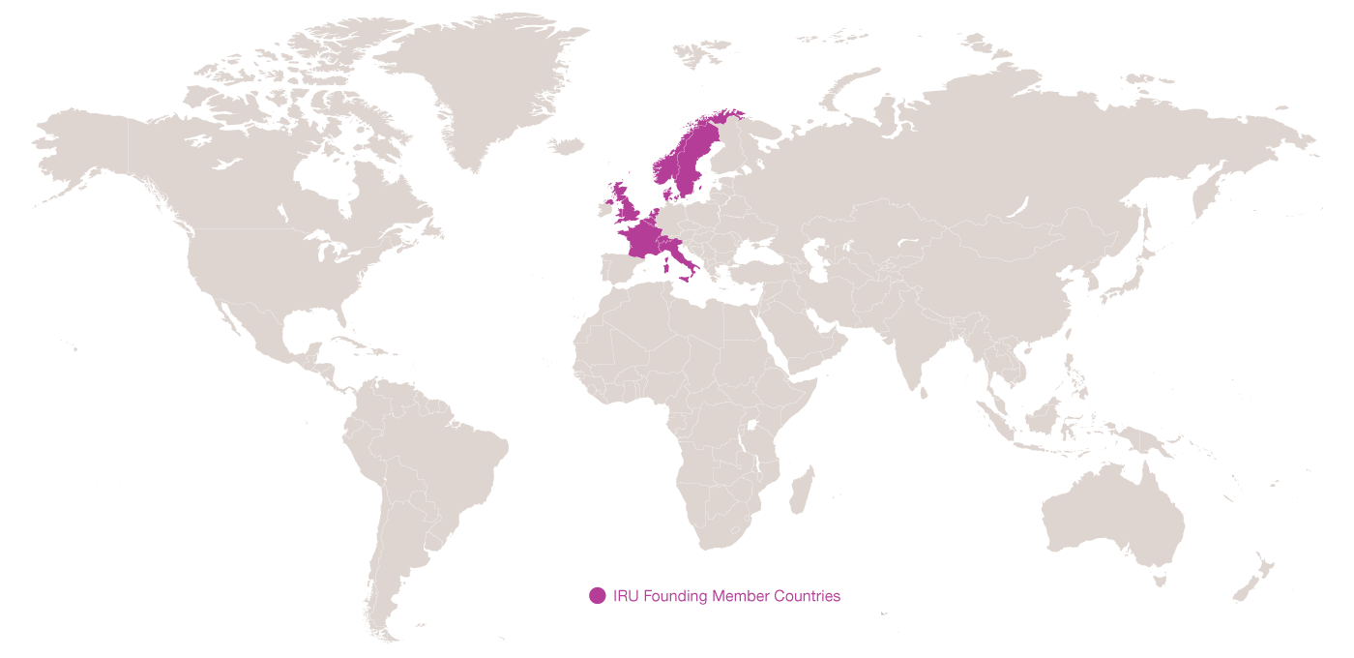
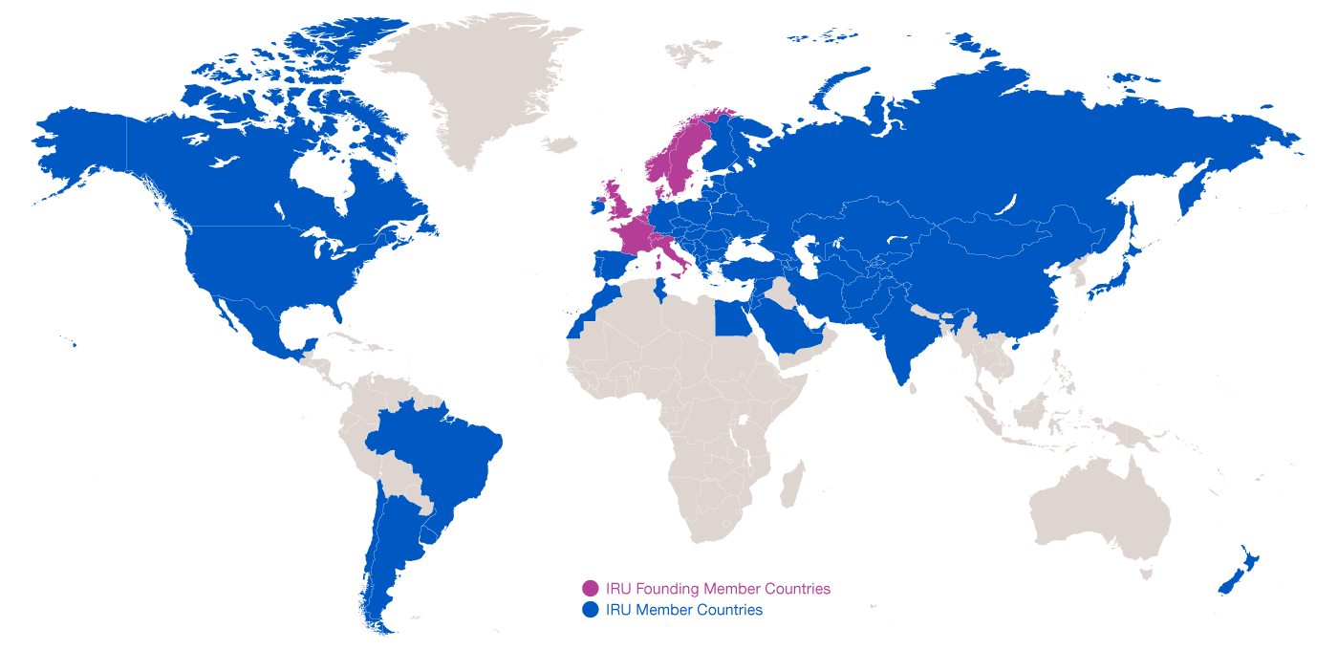
IRU Membership
1948: 8 Founding Member Countries
2015: present in over 100 countries

Slide 3
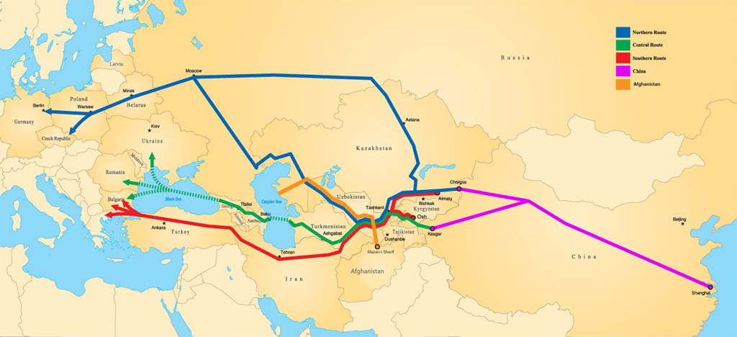

One Belt – IRU NELTI activities to support development of trade between Europe and Asia
Northern Route: 10–16 days (between 6,000 – 7,700 km)
Central Route: 13–18 days (between 5,300 – 6,000 km)
Southern Route: 8–17 days (between 4,500 km – 6,200 km)

Slide 4

IRU Caravan and NELTI drivers saw this… adequate roads but little traffic!!

Slide 5

…until they reached border crossings!!

Slide 6

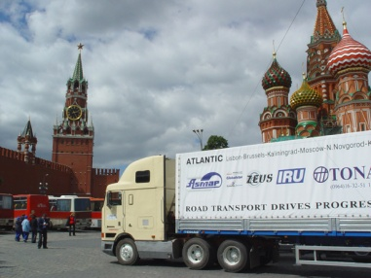
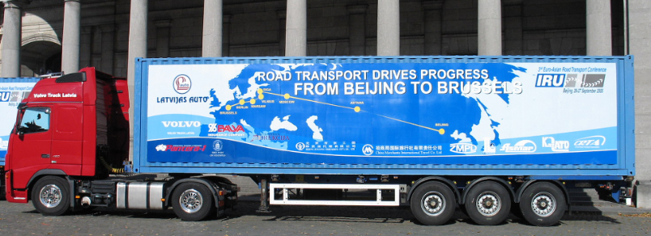
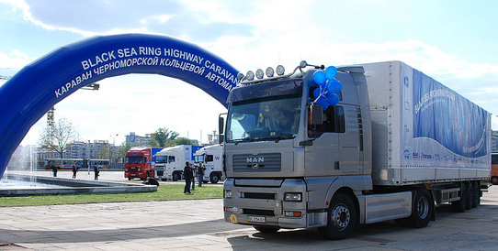





Pilot Caravans and NELTI results
Lisbon-Vladivostok
Beijing-Berlin-Brussels
Black Sea Highway
IRU-ECO Silk Road
Up to 40% of transport time = border crossings
30% of transport costs = unofficial levies
Notes:
IRU has done several caravans in the past x years specifically focused on the Silk Road that show that in Central Asia …

Slide 7
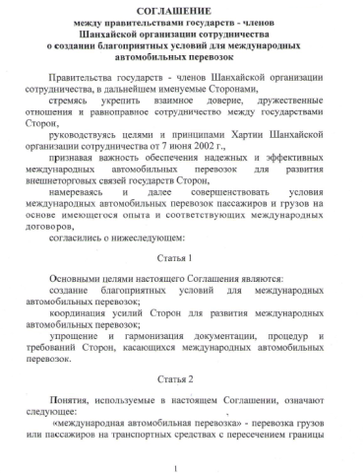
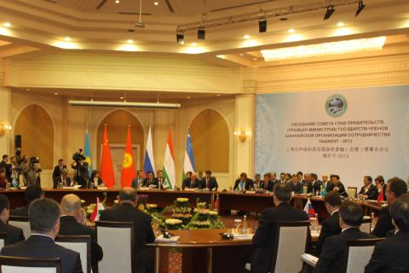
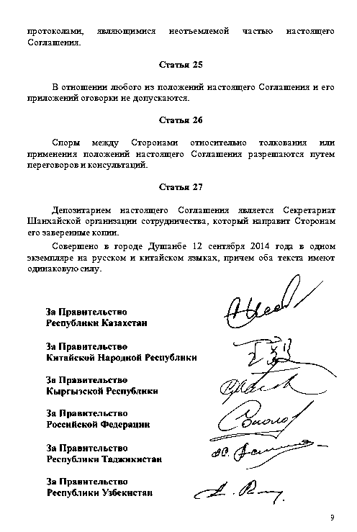
Multilateral SCO Agreement
12 September 2014, Dushanbe,
Republic of Tajikistan
SCO Member States Agreement on Facilitation of International Road Transport is expected to significantly enhance regional connectivity and integration, to promote international trade facilitation and economic growth in China, Russian Federation and the Central Asian countries.
Notes:
Main components of SCO Agreement
Creation of SCO road routes opened for transit and cross border commercial operations;
Creation of multilateral permits system with more free transit and bilateral traffic rights for road transport operators.

Slide 8
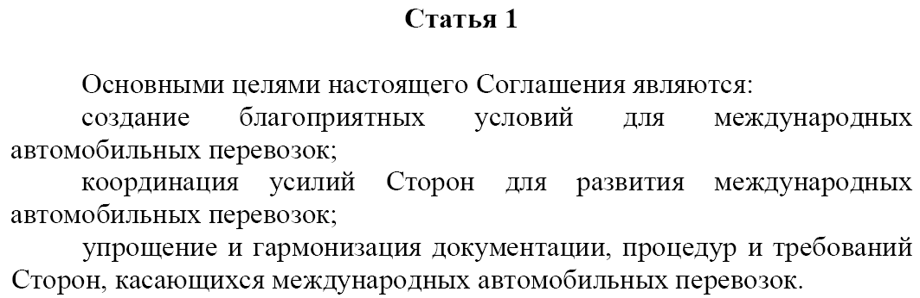
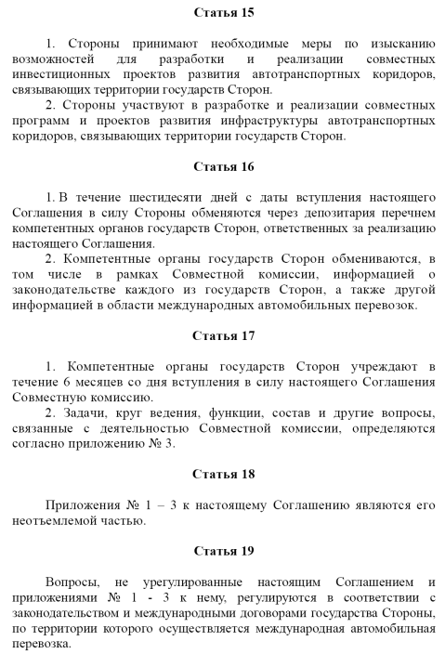
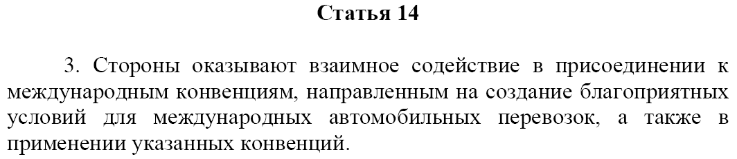
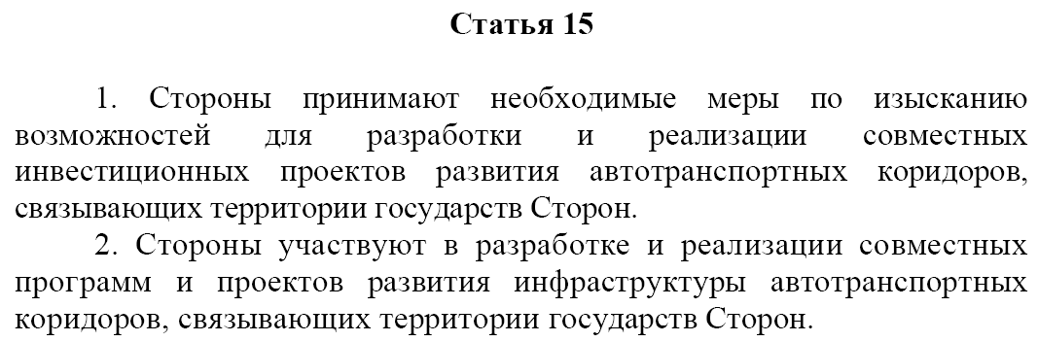
Commitments under the SCO Agreement
The Parties have agreed:
Article 1
« … to facilitate and harmonise documentation, procedures and requirements on the territory of member states related to the international road transport …»
Article 14
“ … to promote the acsession to international conventions aimed at creating favorable conditions for international road transport, as well as the implementation of these Conventions …”
Article 15
“ … to participate in the implementation of joint projects and programs on the development of road corridors connecting the territories of Member States …”

Slide 9

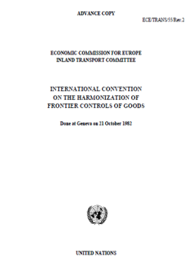
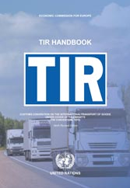
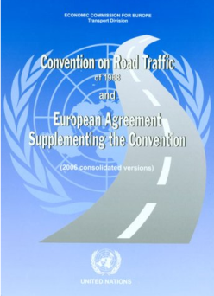
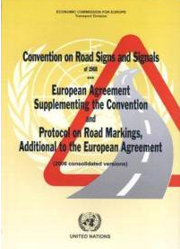
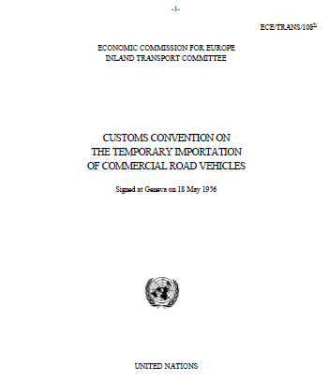
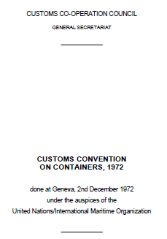
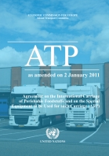
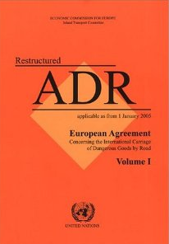
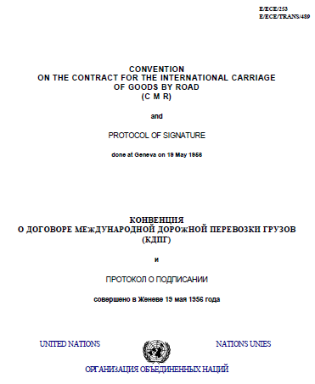
Implement key UN facilitation instruments to allow transport to drive trade!

Slide 10

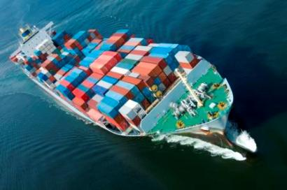

Facilitating transit and border crossing procedures
A global United Nations Customs transit and guarantee system that uses one simple, secure, mutually recognised procedure for door-to-door transport by road, sea and rail.

Slide 11

TIR Intermodality

Slide 12
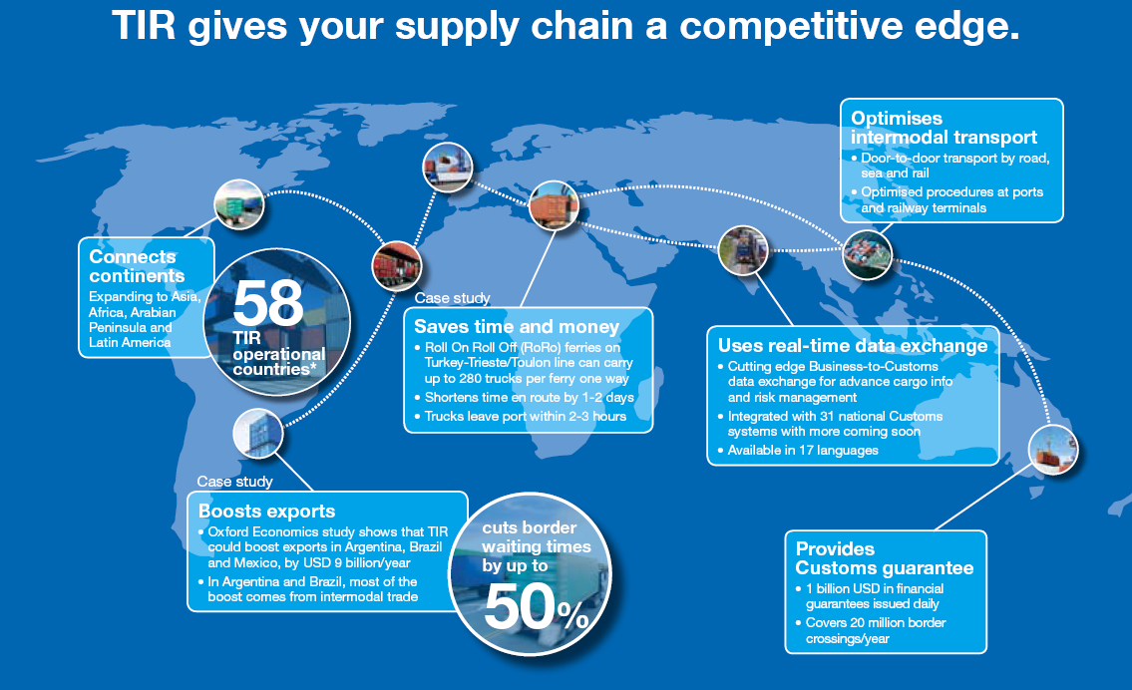

Slide 13


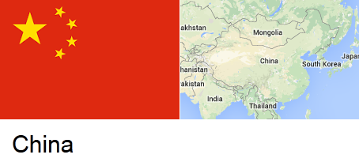


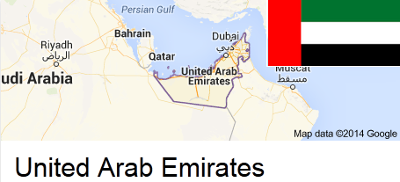

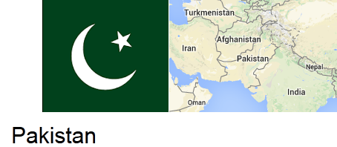

TIR in 2015: more competitive, attractive and global
Notes:
Countries actively discussing joining TIR:
LATAM: Argentina, Brazil, Mexico
Middle-east: Irak, Oman, Saudi Arabia, Egypt, Qatar
Africa: Kenya (most recently) and other
CRIPA members

Slide 14
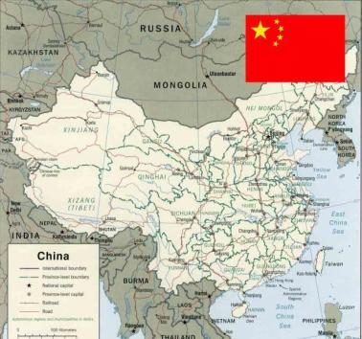
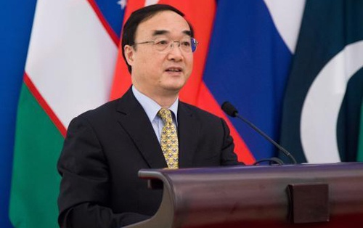
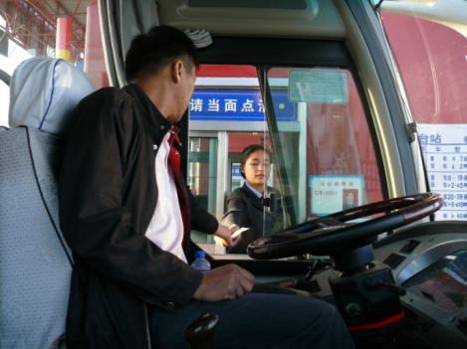
China speeds up TIR accession process
13 February 2015
China Customs officially approved TIR accession file:
APPROVED
27 February 2015
Chinese Ministry of Transport: APPROVED
03 March 2015
Administration of Quality Inspection & Quarantine:
APPROVED
06 March 2015
Ministry of Public Security: APPROVED
16 April 2015
Ministry of Foreign Affairs: APPROVED

Slide 15
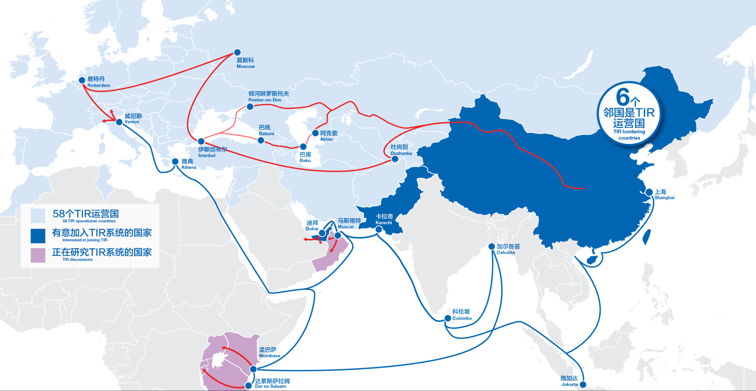
One Belt, One Road – TIR is the solution!
Notes:
What changes the dimension of TIR is the accession of China !
Calls for intermodality

Slide 16
China’s accession to TIR will further increase trade between Asia and Europe
All EU Member States use TIR
TIR – is only-one transit system in Central Asia
Central Asian region shows the biggest growth in TIR usage worldwide in recent years (approx. 400 000 TIR Carnets issued by national associations in 2014)
Other South-Asian countries are showing interest in TIR
TIR is an efficient, transparent and reliable customs transit system that brings uniformity and enhanced connectivity in a global context

