Slide 1
Eliminating Paper Walls Across the Modern Silk Road
1st IRF Europe & Central Asia Regional Congress
Istanbul, 16 September 2015
Jens Hügel, Head – Sustainable Development

Slide 2
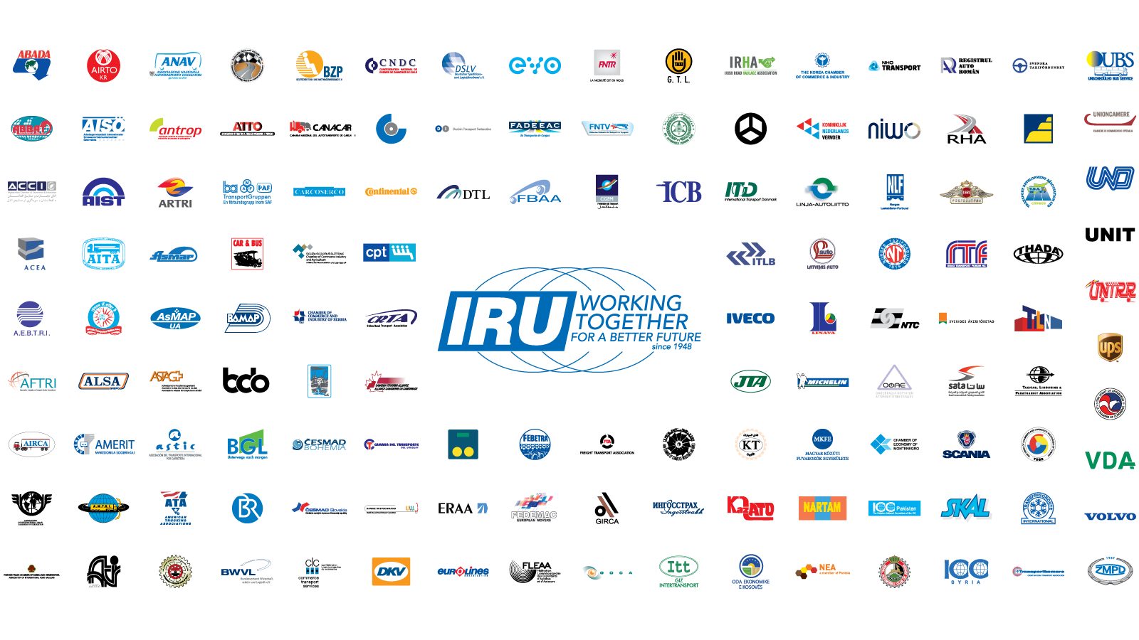
This is the IRU

Slide 3
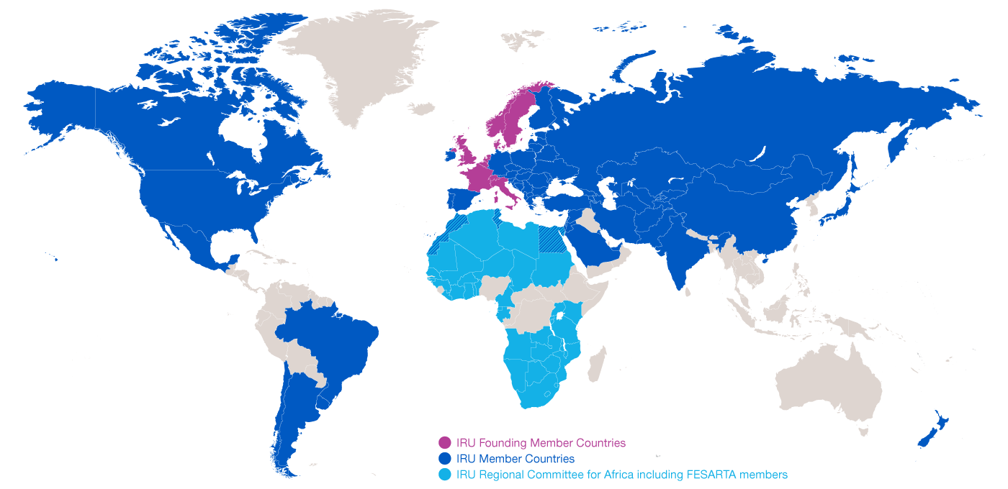
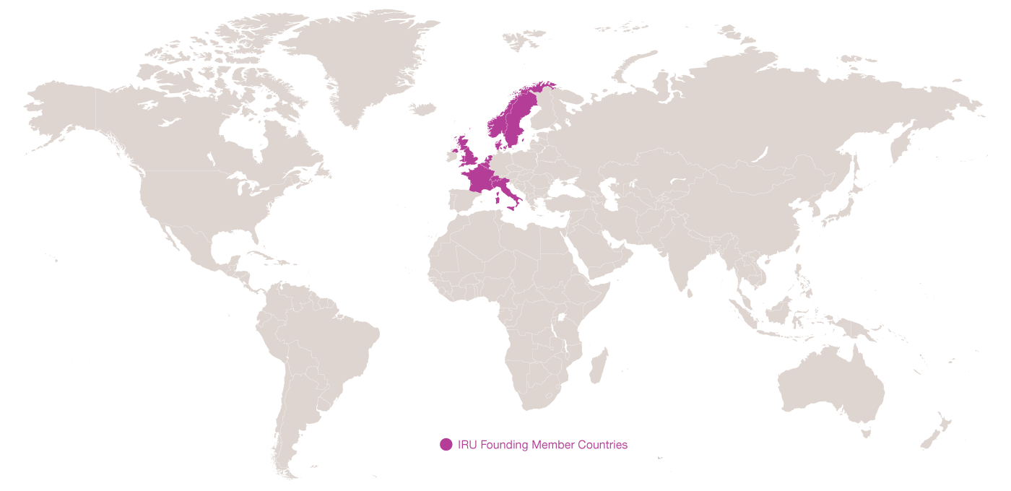
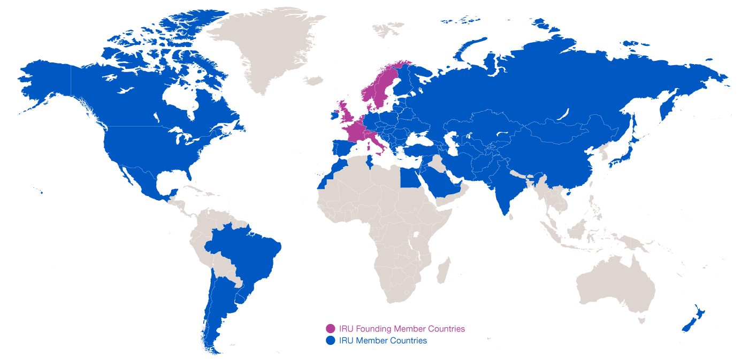
Evolution of IRU Membership
1948: 8 Founding Member Countries
2015: present in over 100 countries

Slide 4
What is Globalisation?
What does it take to have a cup of coffee in a café?
The combined efforts of 29 companies in
18 countries
Road Transport has become a vital production tool!
Source: IRU
Notes:
Needs to be less "road transport" and more about how today's complex production processes need efficient intermodal transport and harmonised/standardised rules and regulations to allow secure, predictable and efficient trade operations hence TIR and Harmonization Convention

Slide 5
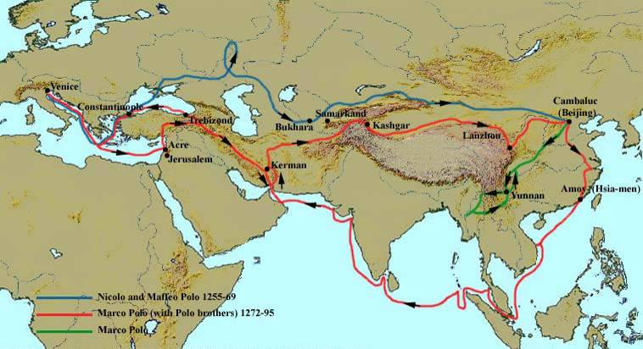
Revitalising the Silk Road
If the Silk Road worked for Marco Polo then, why shouldn’t it work for trade and transport today?

Slide 6
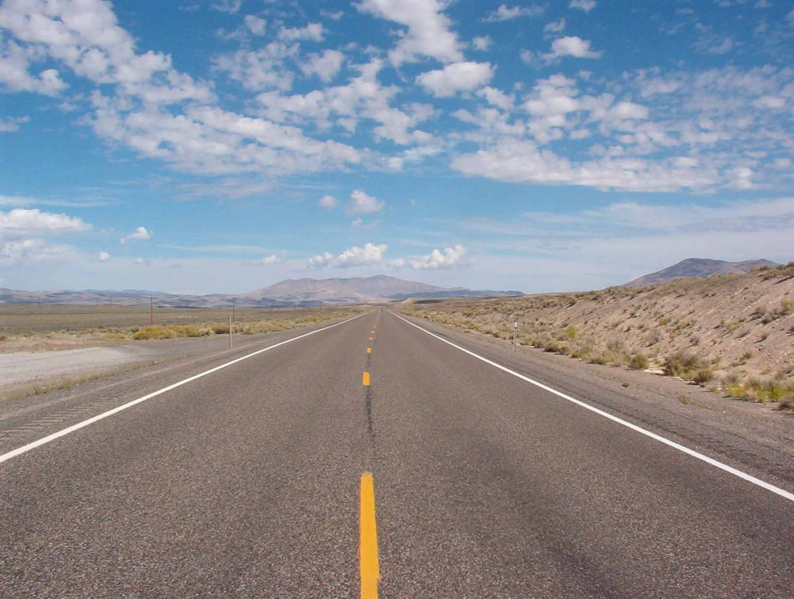
IRU Caravan drivers saw this… adequate roads but little traffic!!

Slide 7
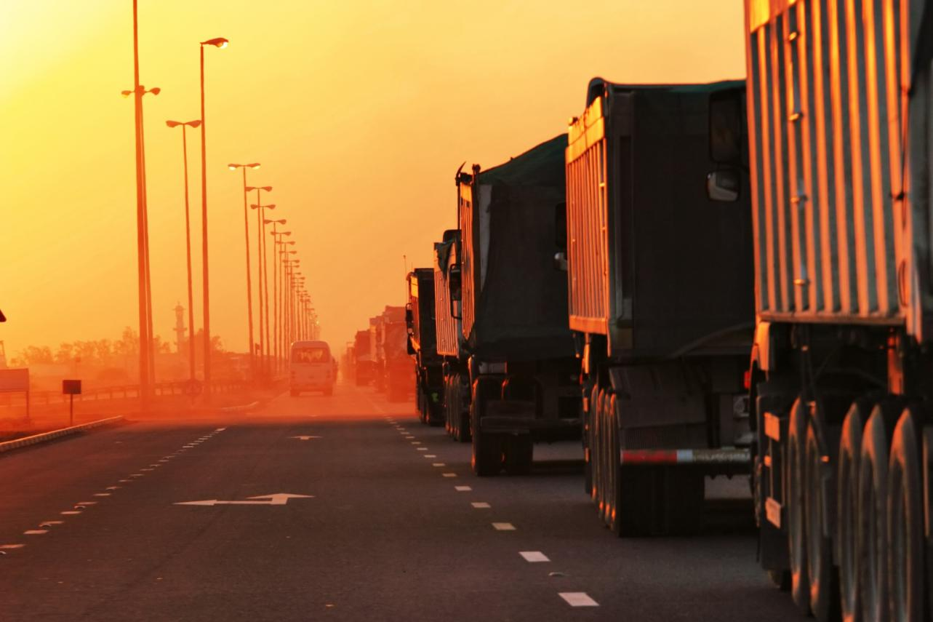
…until they reached border crossings!!

Slide 8
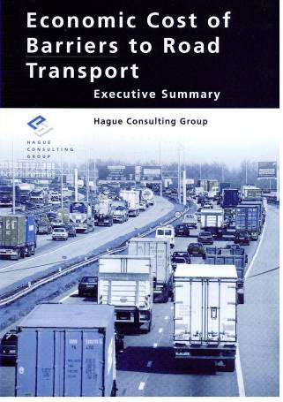
Any penalty on road transport is an even greater penalty on the economy as a whole!
* Includes lost opportunities
Source: Hague Consulting Group

Slide 9

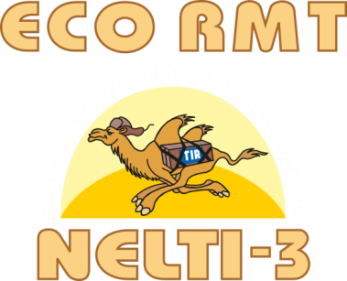


IRU New Eurasian Land Transport Initiative (NELTI)
From September 2008
Monitoring over 200,000 border crossings
57% of transport time lost at border crossings
38% of transport costs due to unofficial levies

Slide 10

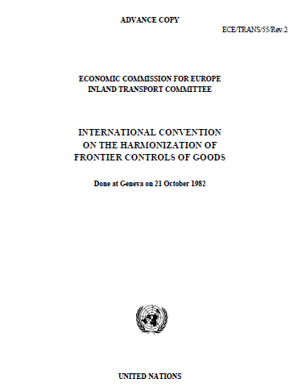
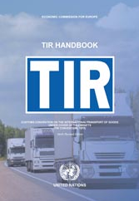
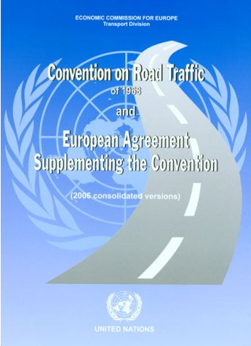
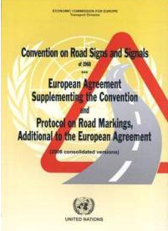
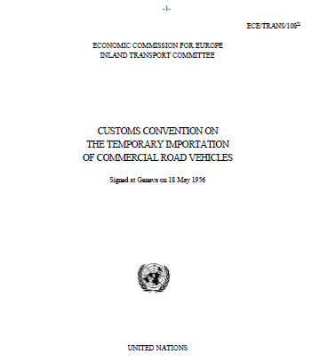
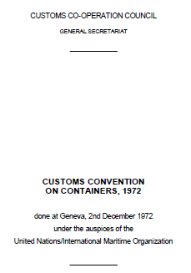
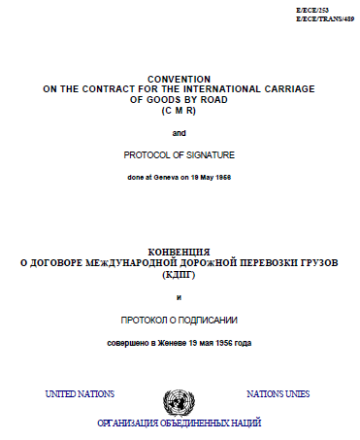
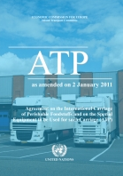
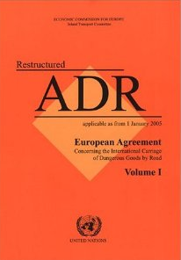
Implementation of key UN facilitation instruments
Allow the goods to cross the borders!

Slide 11
Securing and facilitating trade and international road transport
Transports
Internationaux Routiers
Managed by the IRU since 1949

Slide 12
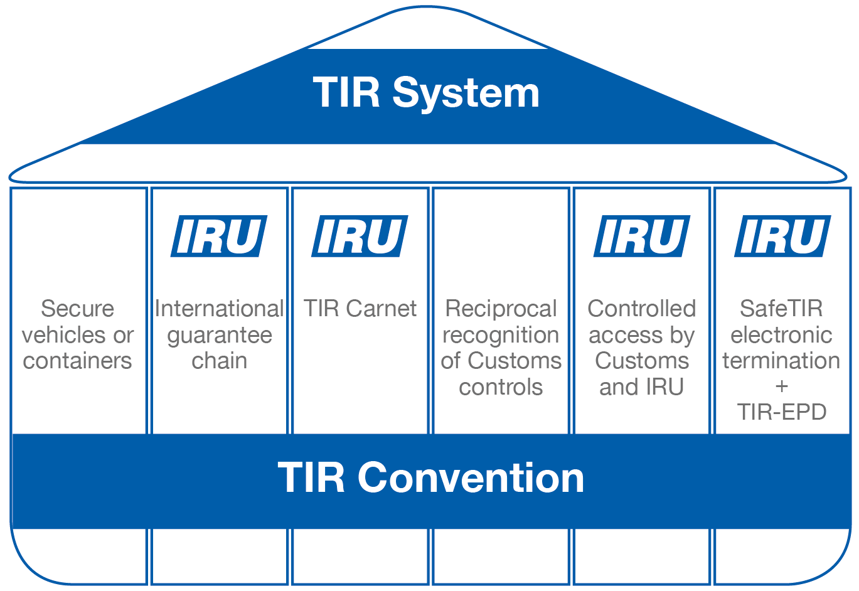
The six pillars of the TIR System

Slide 13
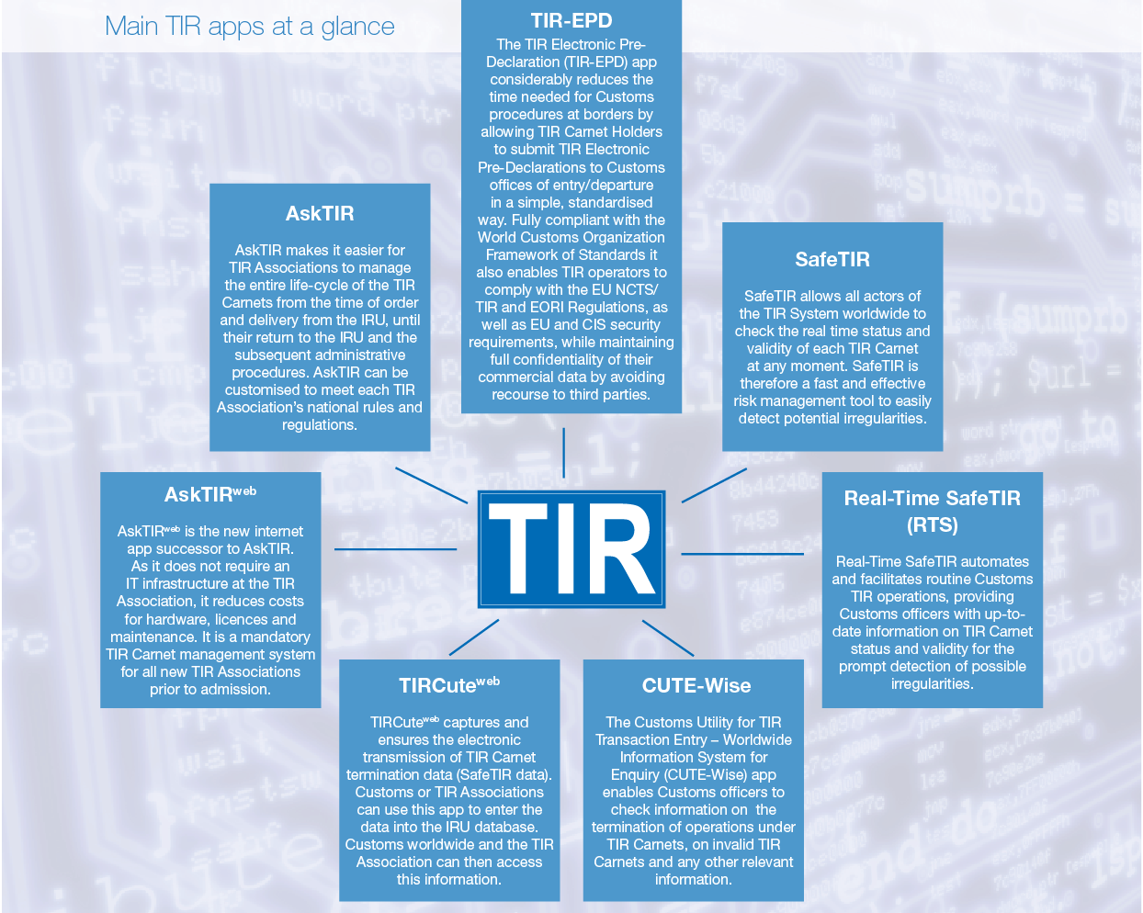
Computerised TIR procedures

Slide 14
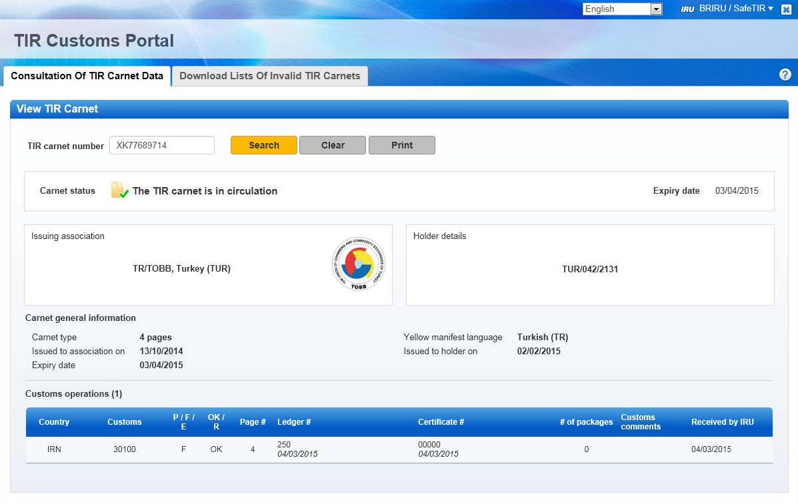

These Electronic C2C and B2C data exchanges...

Slide 15
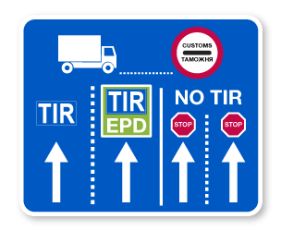
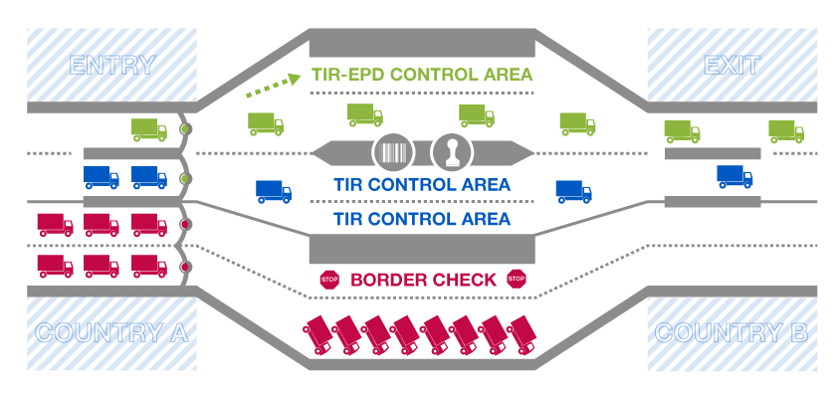
…allow TIR EPD Green Lanes at
Border Crossing Points
Notes:
Reduce border waiting times, facilitate trade, increase risk management efficiency, improve customs controls, secure trade and transport!

Slide 16
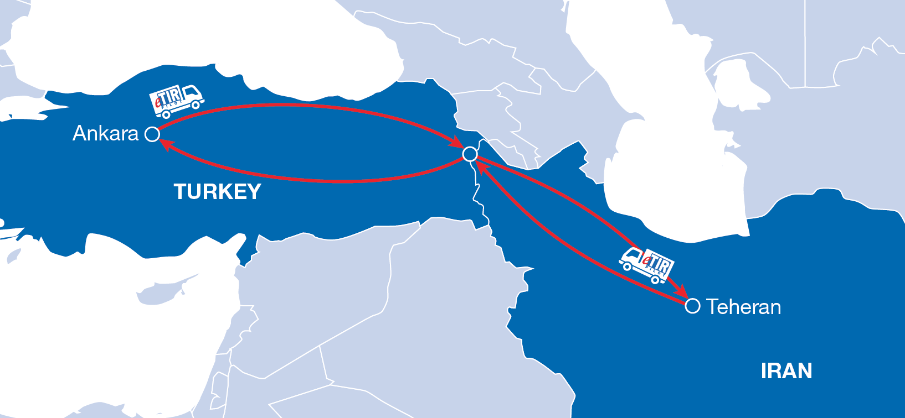
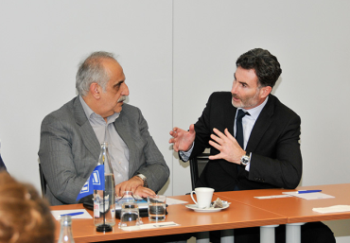
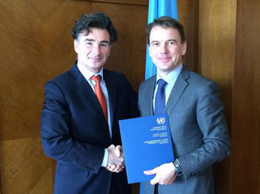
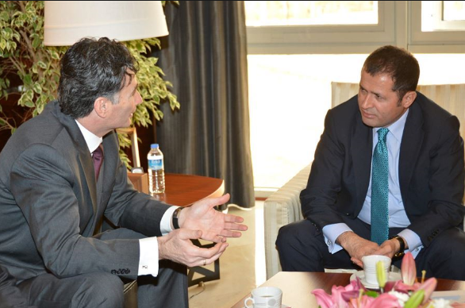
eTIR pilot project
Notes:
IRU and UNECE finally agreed at high level and technical level to work together to achieve a concrete pilot project
eTIR Pilot project:
Will be a simplified version of the existing eTIR Reference Model
It will be based on the infrastructure developed by Customs and IRU
Leverage elements already computerized
Rapidly launch (and at minimal cost) a paper-less TIR procedure between two pilot countries
Constitute a first step towards the implementation of the full-fledged eTIR system (as per the objectives described in the eTIR Reference Model).

Slide 17
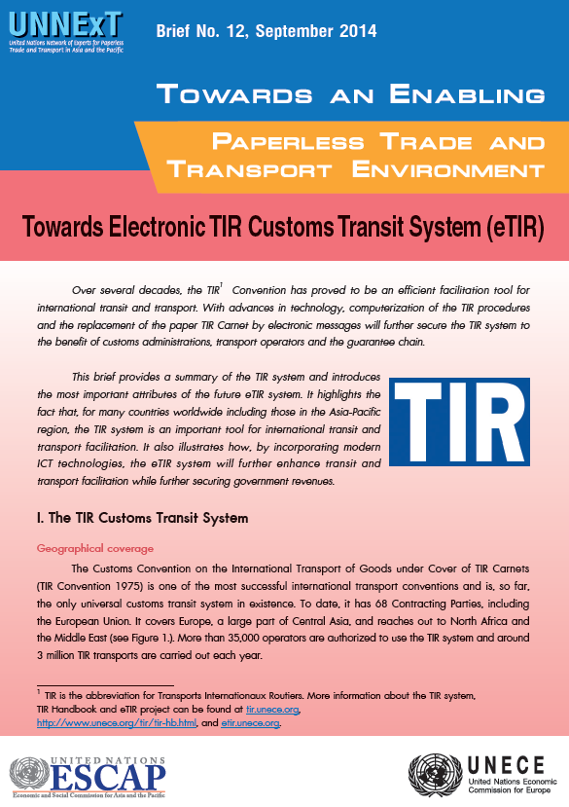
UNECE and UNESCAP join forces to promote e-TIR
Notes:
IRU and UNECE finally agreed at high level and technical level to work together to achieve a concrete pilot project
eTIR Pilot project:
Will be a simplified version of the existing eTIR Reference Model
It will be based on the infrastructure developed by Customs and IRU
Leverage elements already computerized
Rapidly launch (and at minimal cost) a paper-less TIR procedure between two pilot countries
Constitute a first step towards the implementation of the full-fledged eTIR system (as per the objectives described in the eTIR Reference Model).

Slide 18
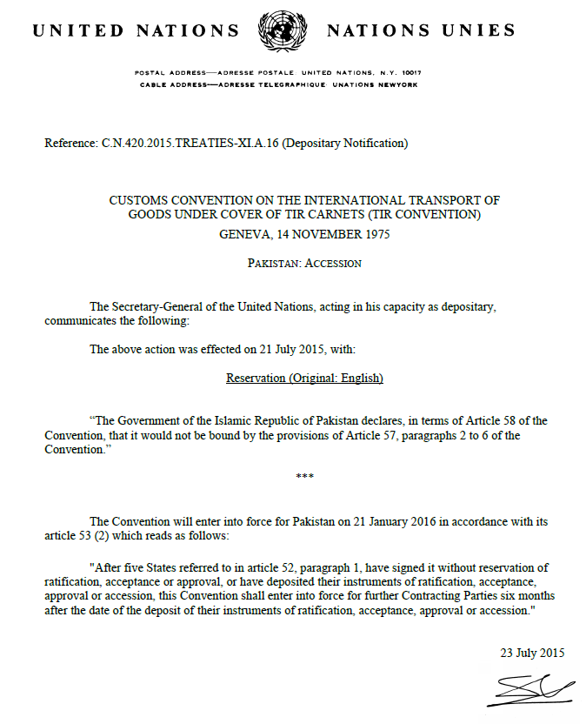

Countries see the Benefits!
Pakistan just acceeded to TIR Convention and...

Slide 19
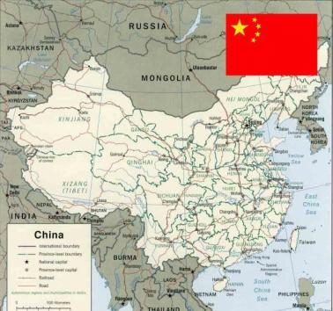
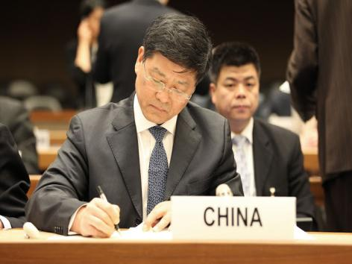
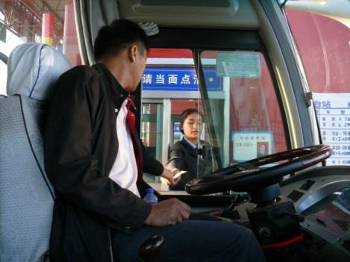
...China on the brink of joining the TIR Convention
13 February 2015
China Customs officially approved TIR accession file, which was sent for final review to 4 ministries
27 February 2015
Chinese Ministry of Transport: APPROVED
03 March 2015
Administration of Quality Inspection & Quarantine: APPROVED
06 March 2015
Ministry of Public Security: APPROVED
16 April 2015
Final Decision of Foreign Affairs: APPROVED
... 2015
For State Council
of China approval

Slide 20
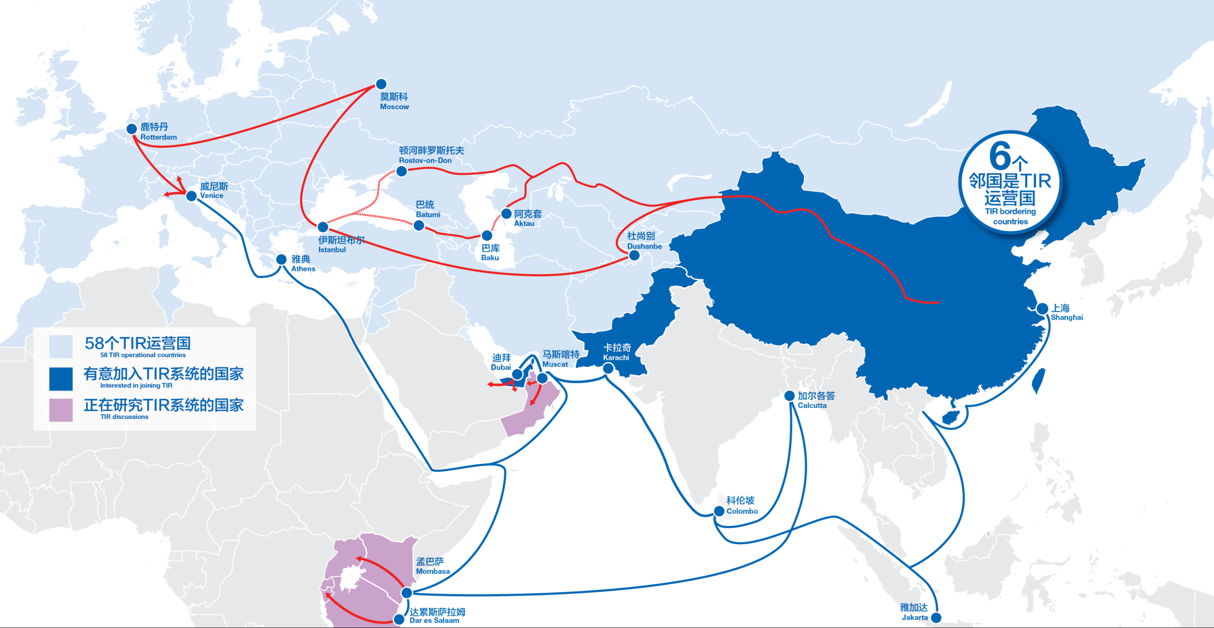
Remember Marco Polo....
One Belt, One Road – with TIR!
Notes:
What changes the dimension of TIR is the accession of China !
Calls for intermodality

